Slide 1
CBCT (seated computOrizeD tomography images) allow for a 360 viewing of the cervical spine.
See if you can find the listings on the following 10 images, after the example.
LIFE WEST WEEKEND 2, HOUR 7

Slide 2
When viewing cbct, assume your right is patient’s right based upon direction they are facing.

Slide 3
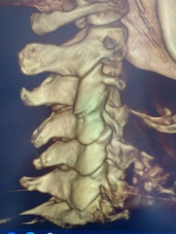
When viewing cbct, assume your right is patient’s right based upon direction they are facing. Thus, viewing c-4, how would you list this misalignment?
L
R

Slide 4
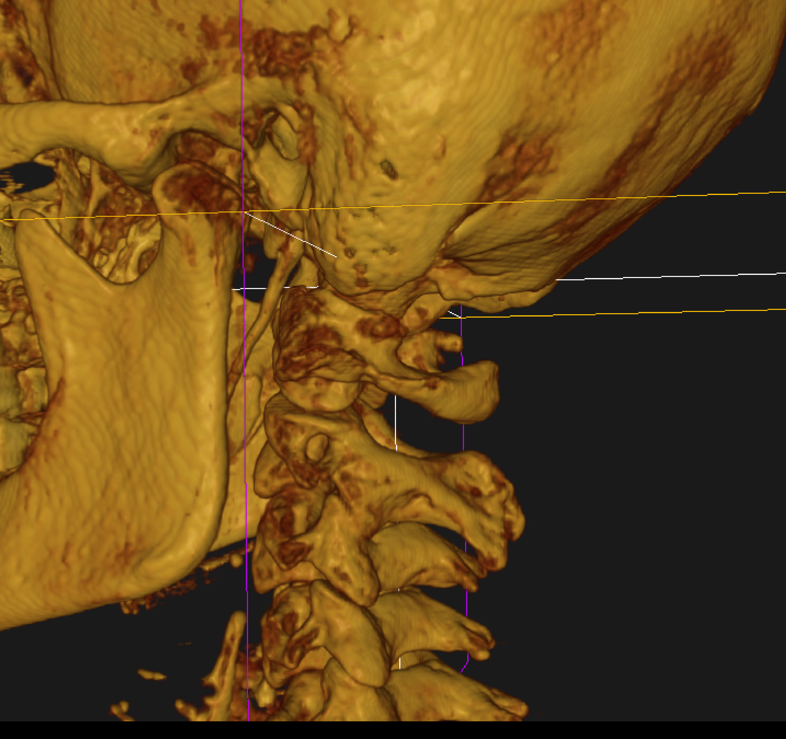
Focus on the anterior aspect of the left C-2,3 articulation.
Listing?
1

Slide 5
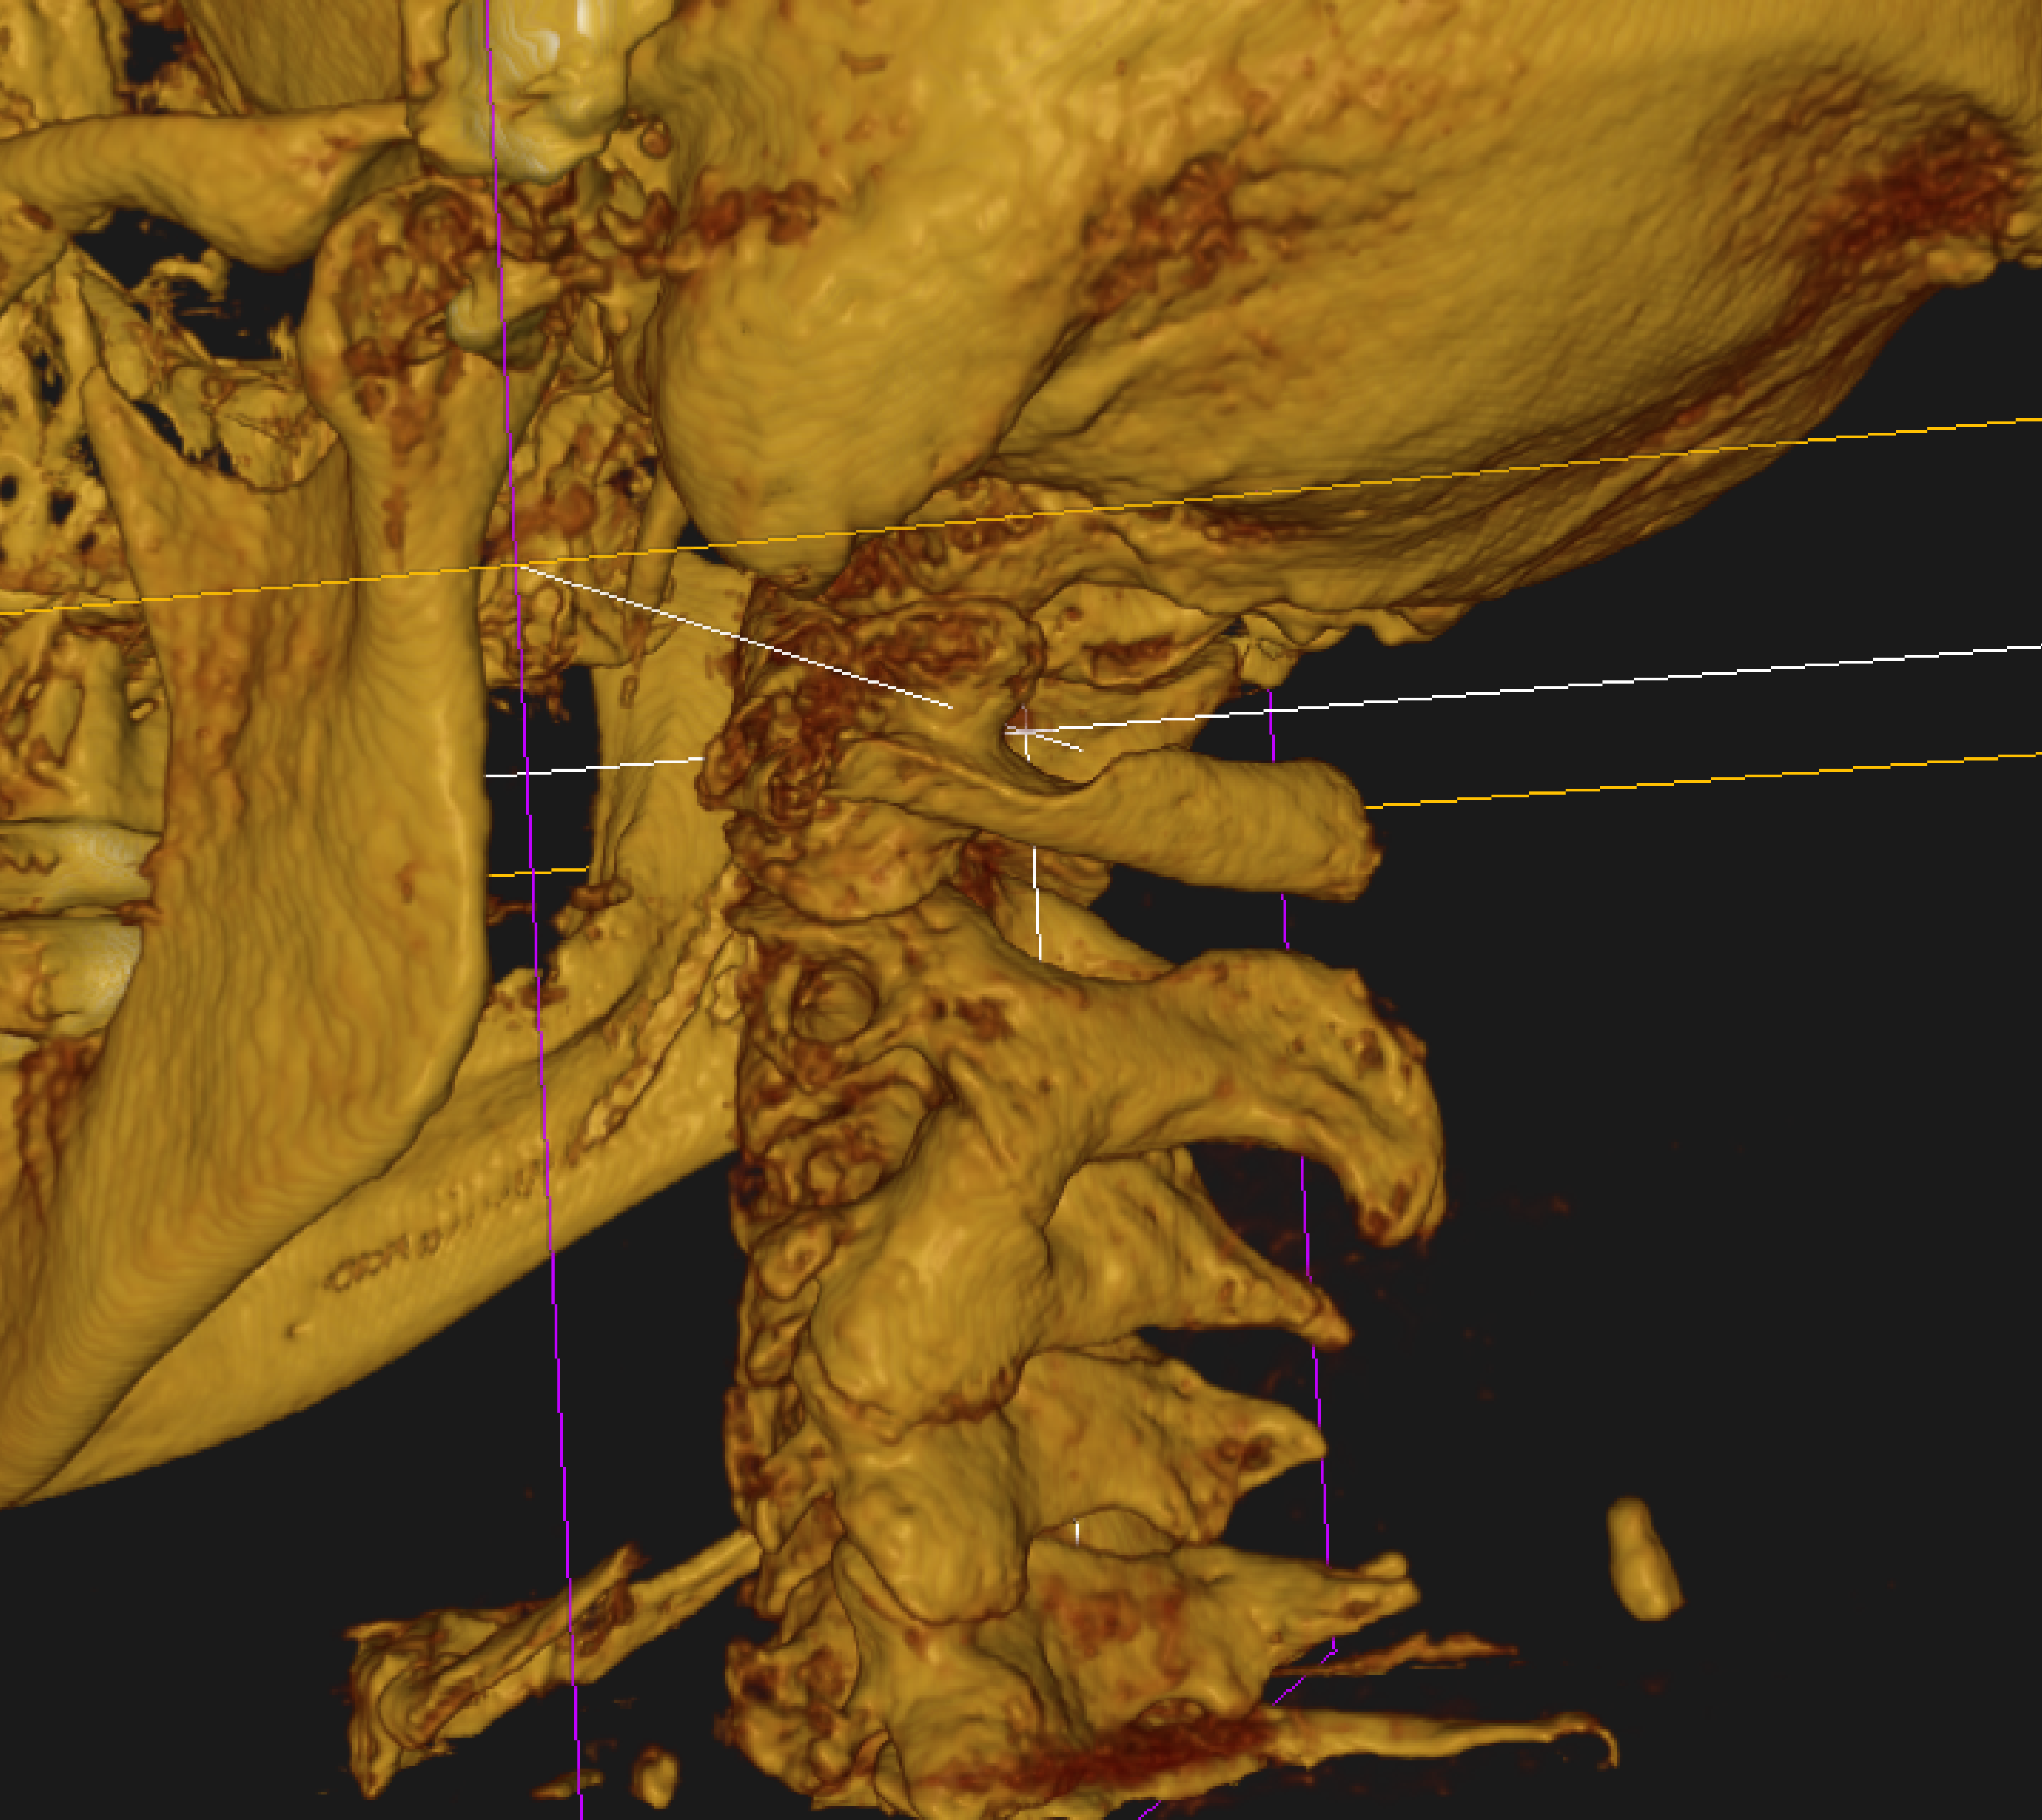
Focus on anterior aspect of left
C-2,3 articulation.
2

Slide 6
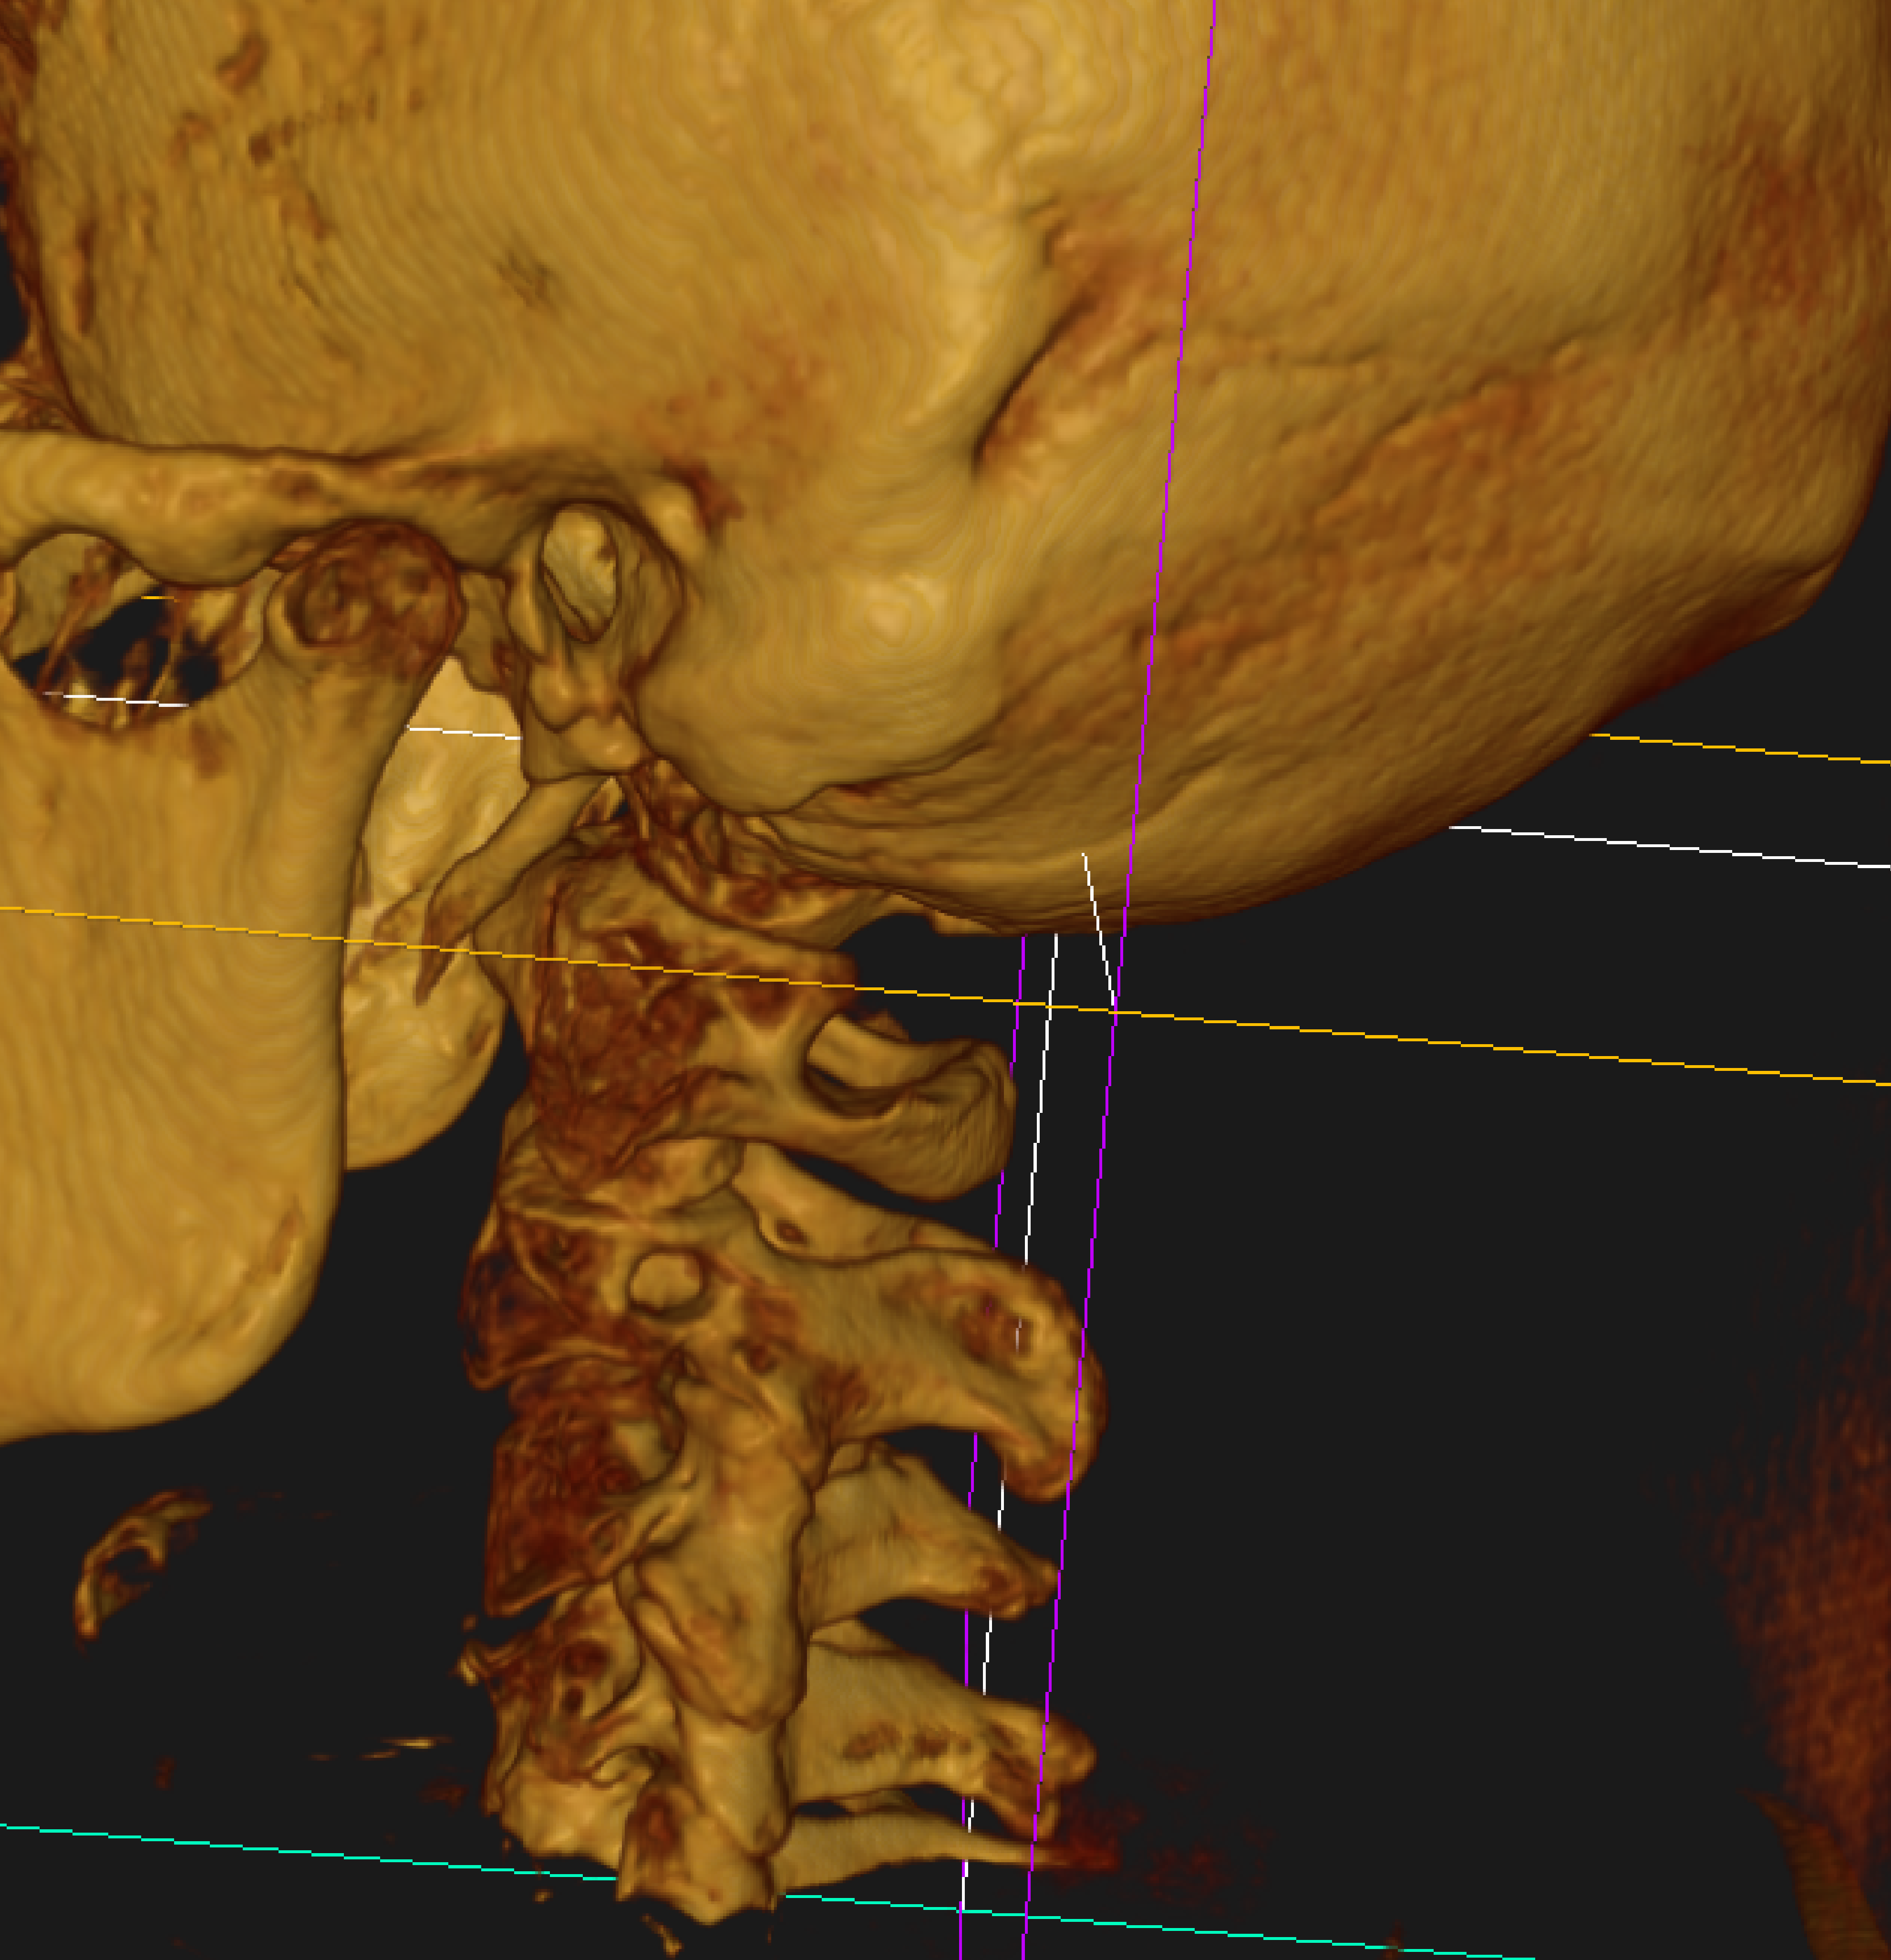
Look at anterior aspect of left
C-2,3 and
C-3,4.
Listings?
3

Slide 7
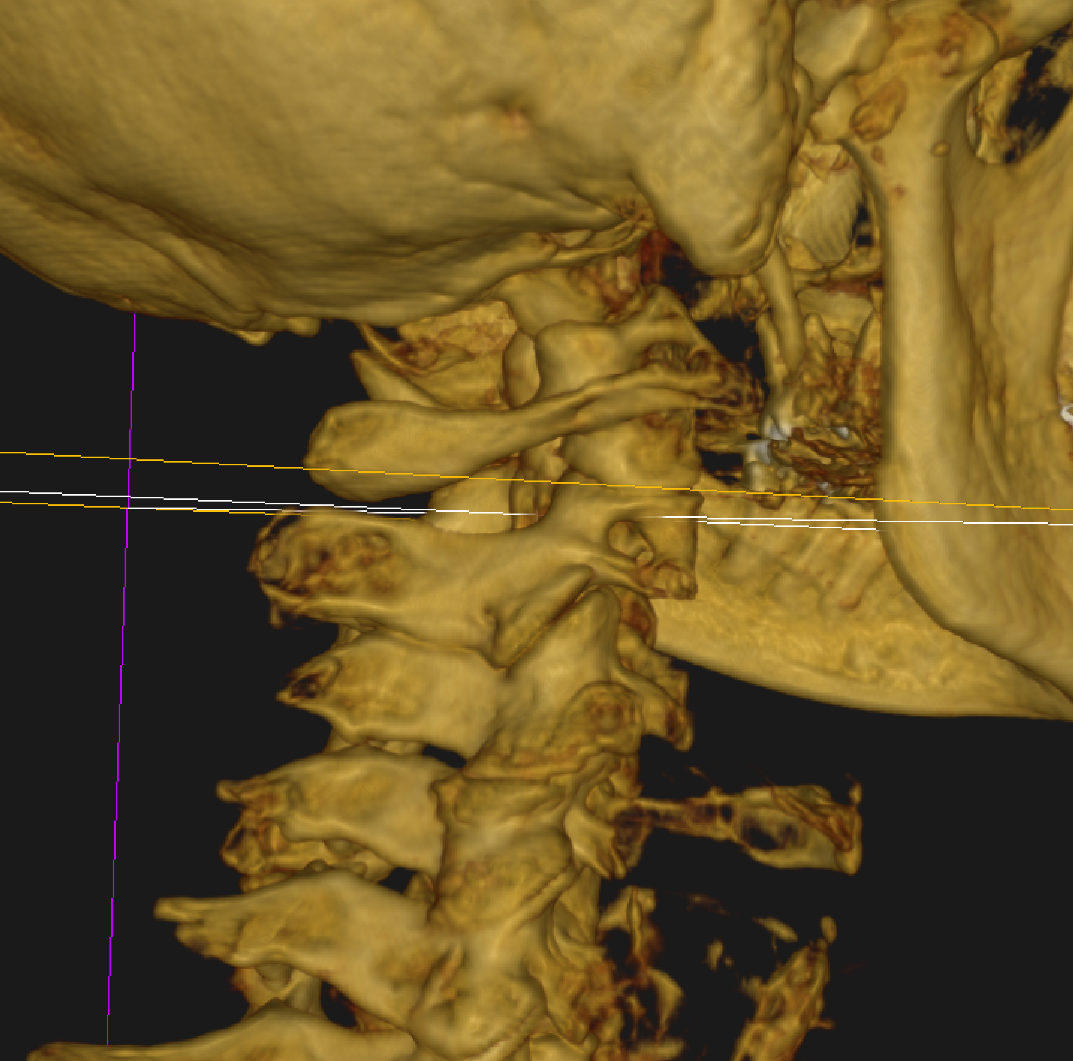
Focus on anterior aspect of right C-3,4.
Listing?
4

Slide 8
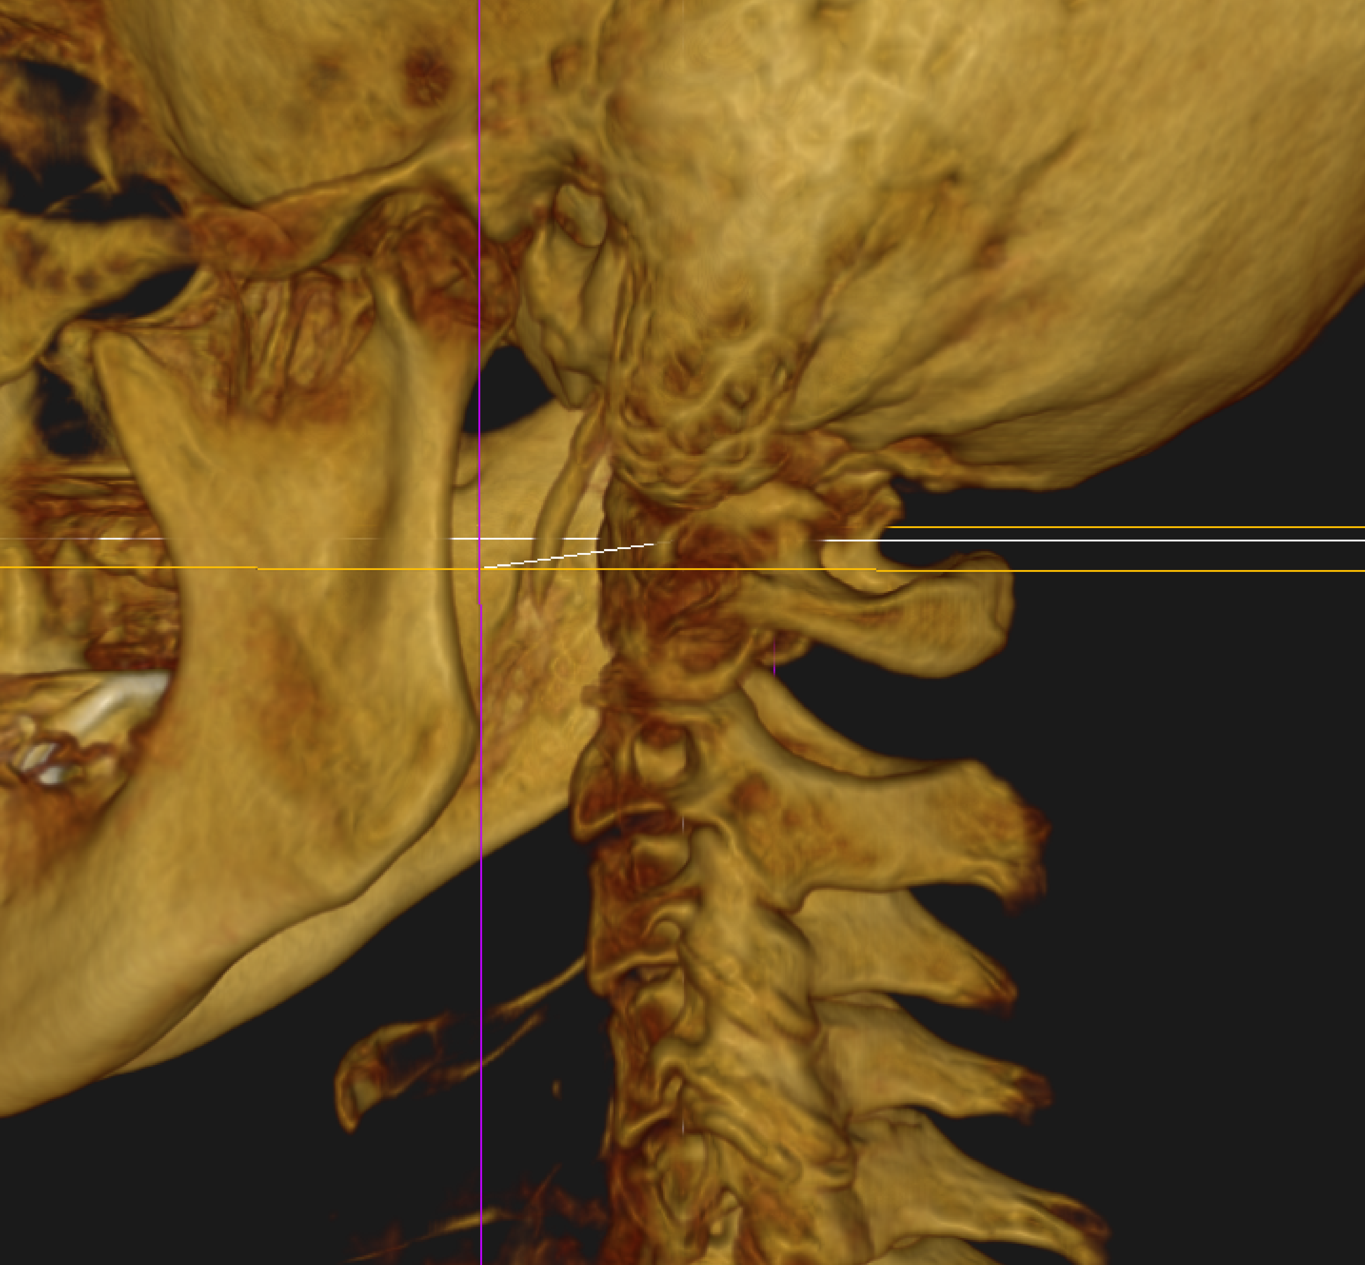
Focus on the anterior aspect of left C-2,3 articulation. Listing?
5

Slide 9
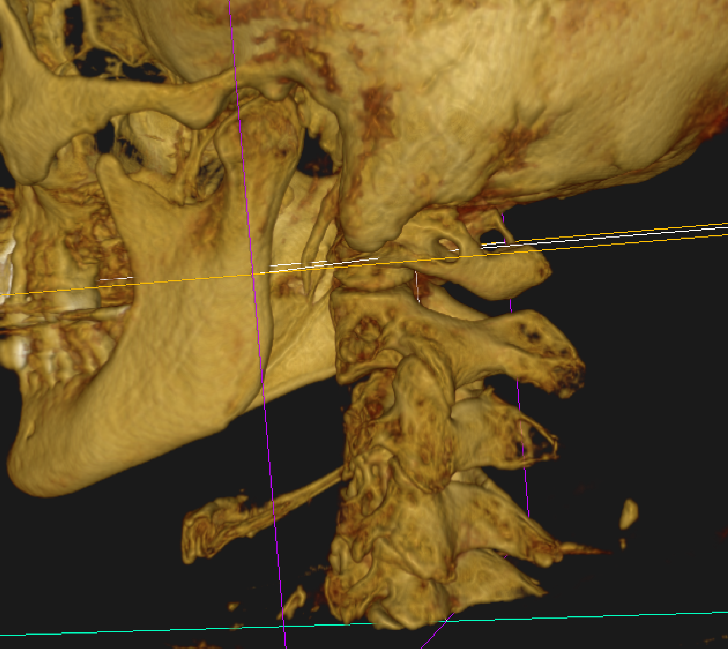
Focus on the left C-4,5 articulation and try to determine a listing.
6

Slide 10
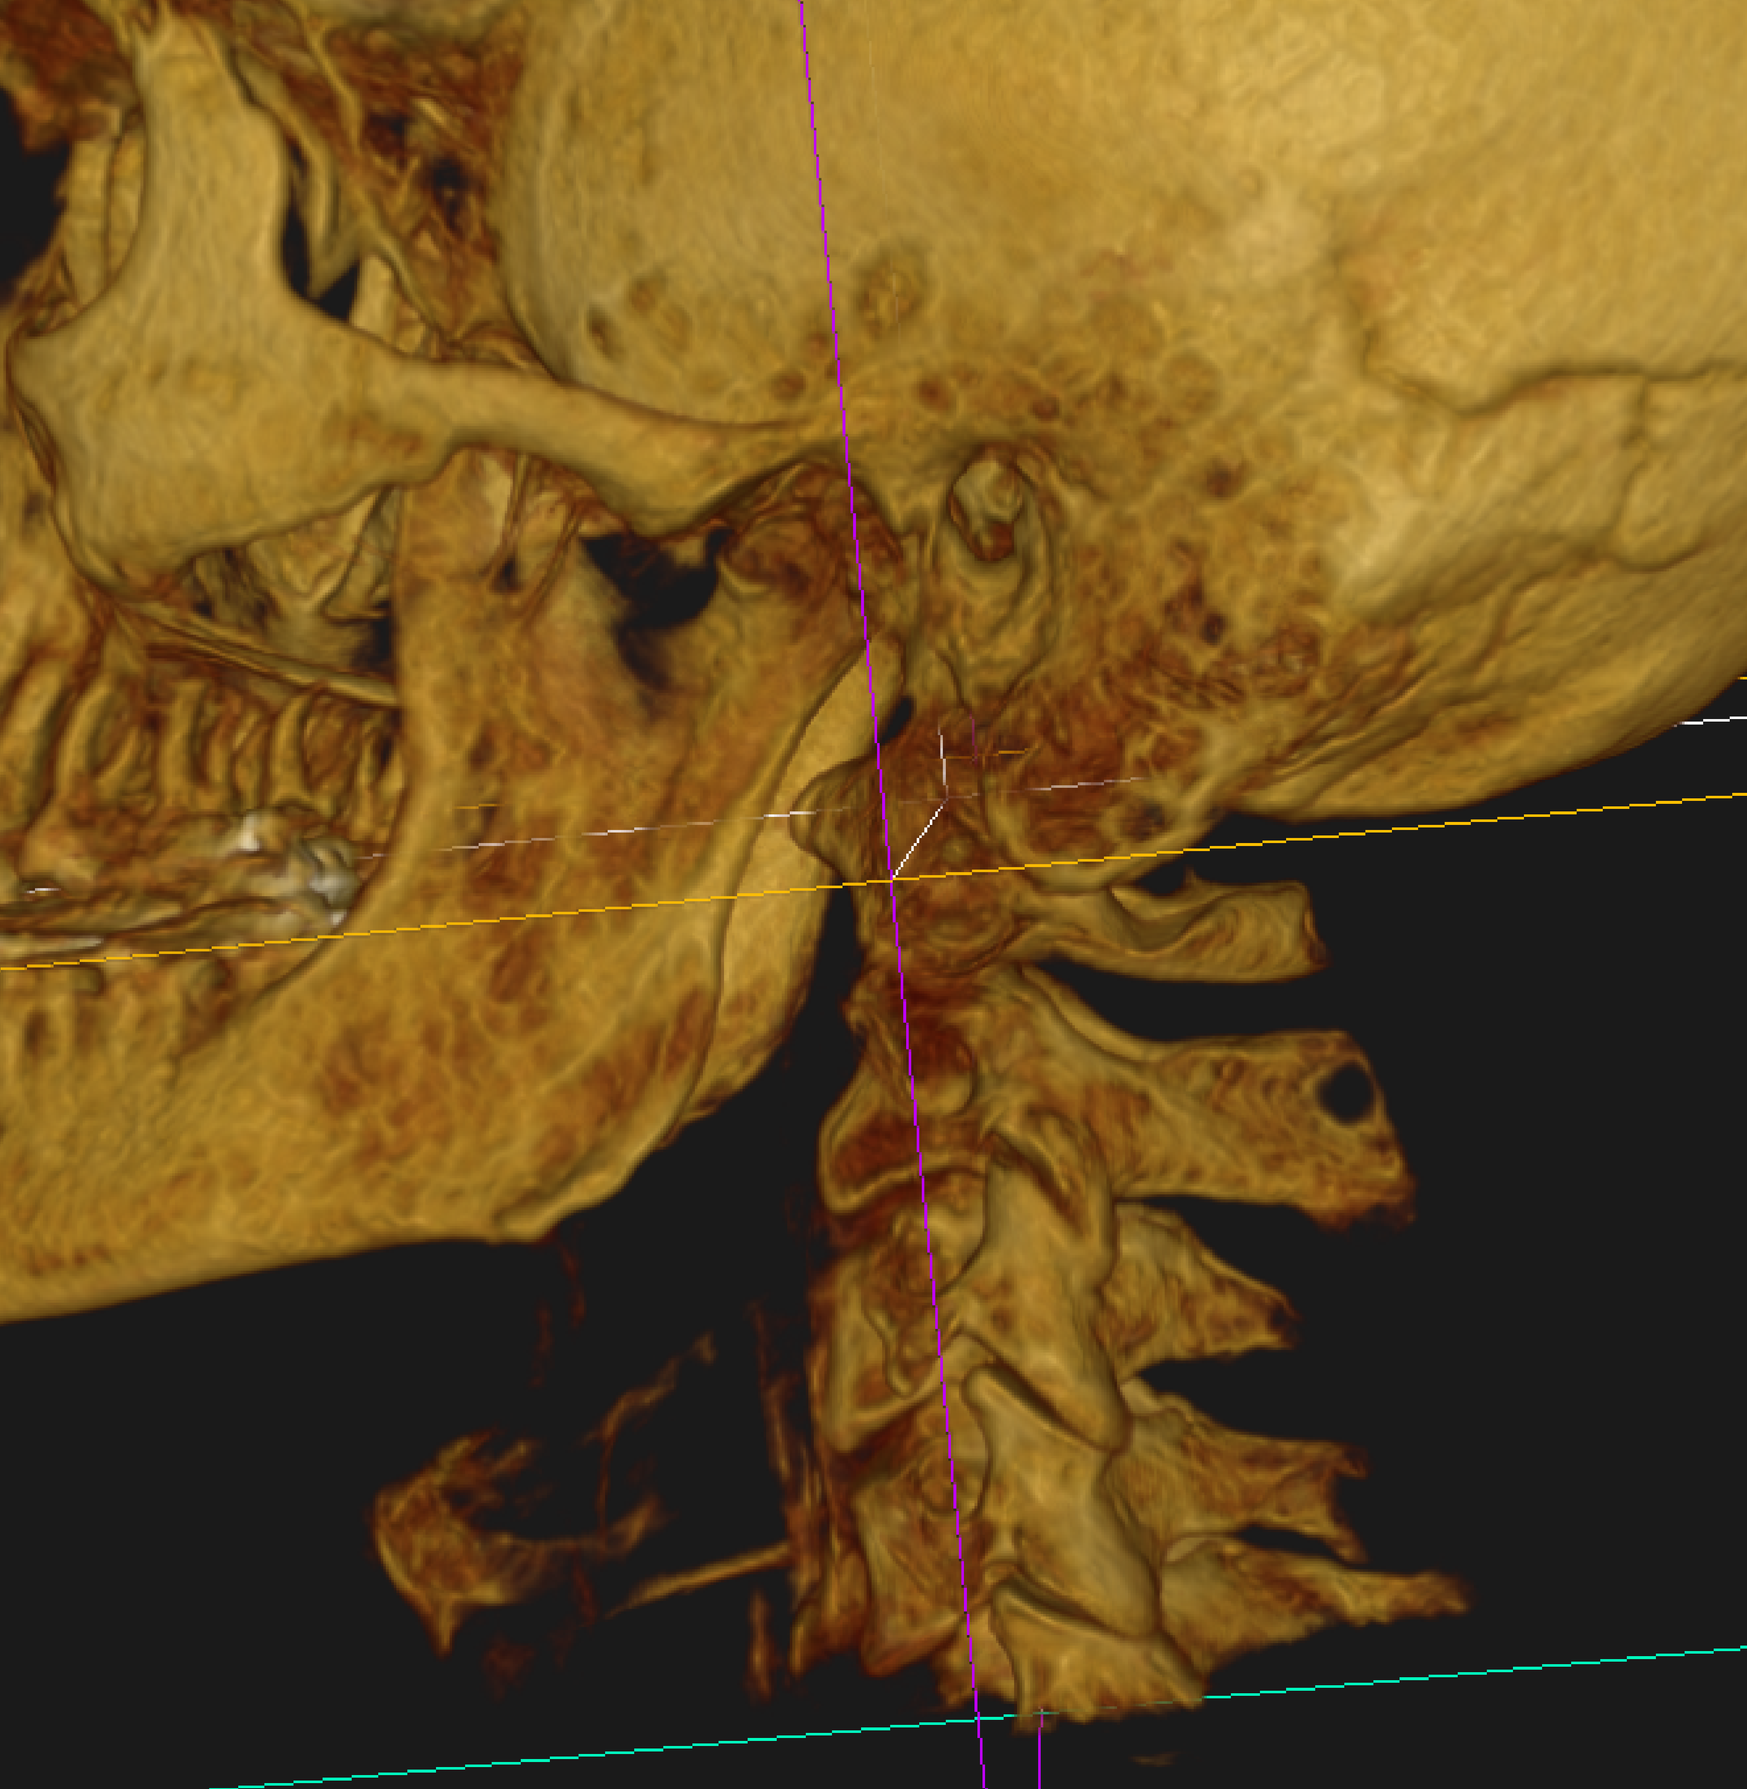
Look at anterior aspect of C-4,5.
Listing?
7

Slide 11
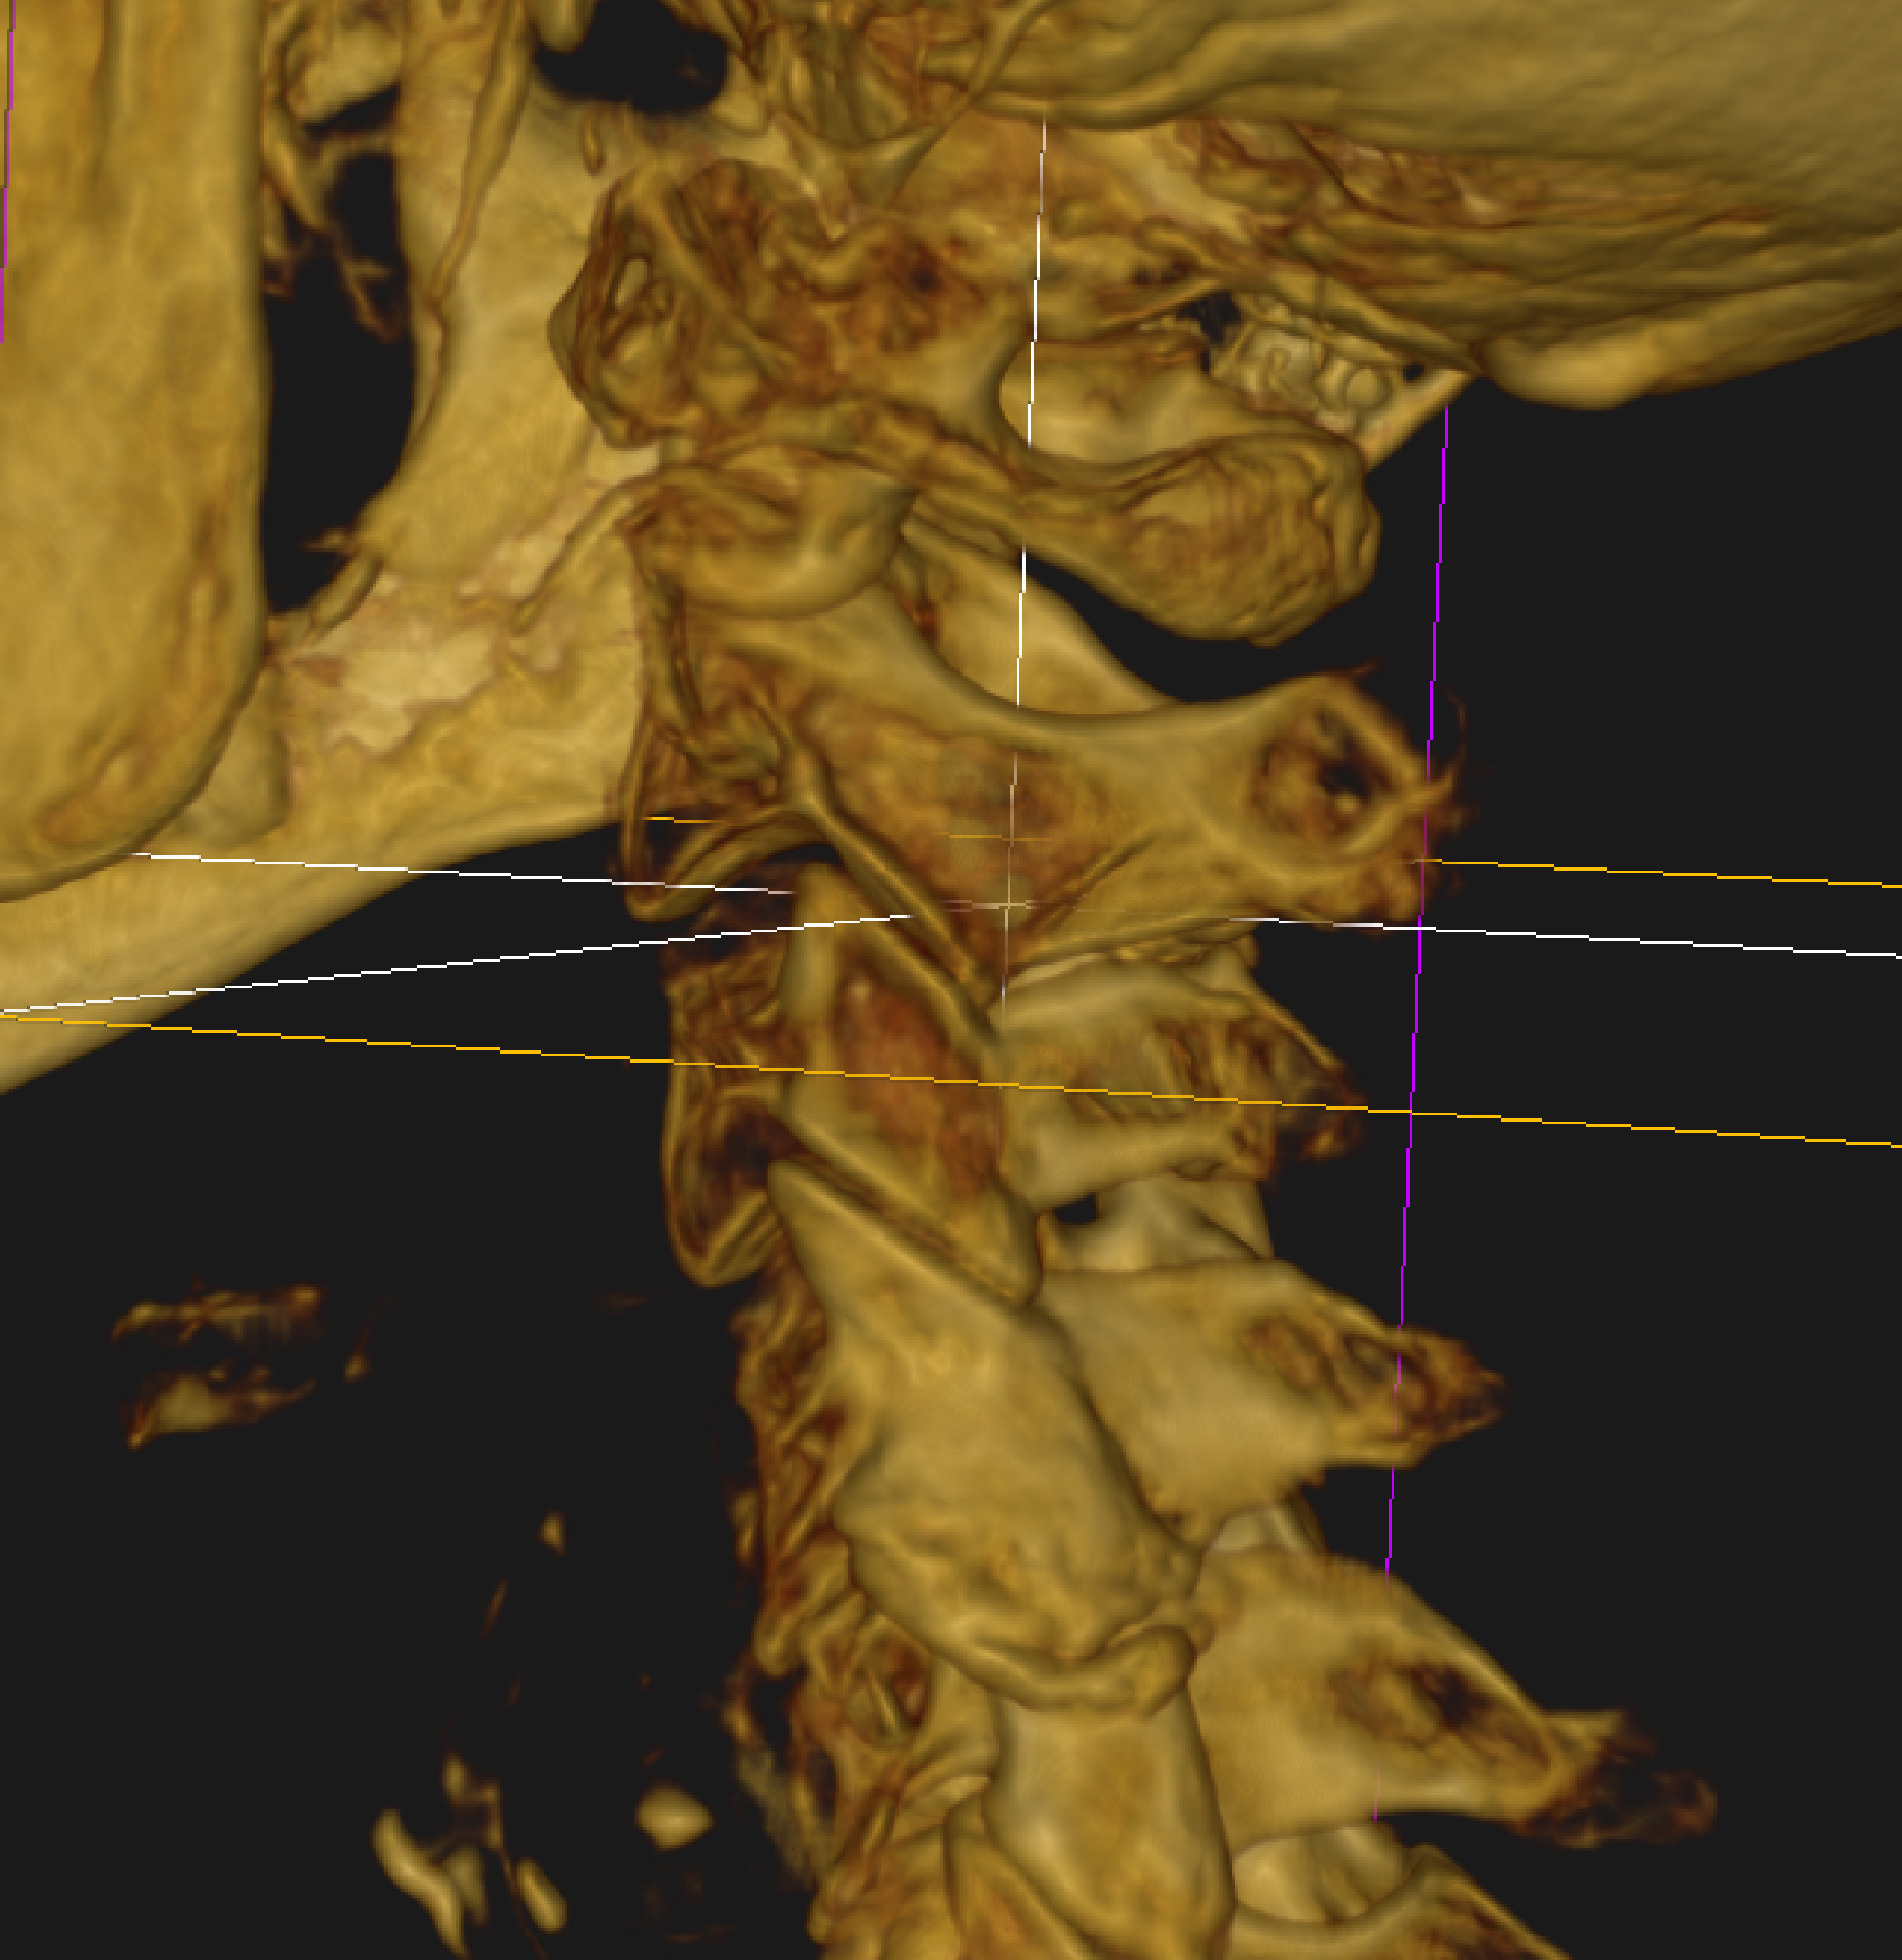
View anterior aspect of left C-2,3 articulation.
Listing?
8

Slide 12
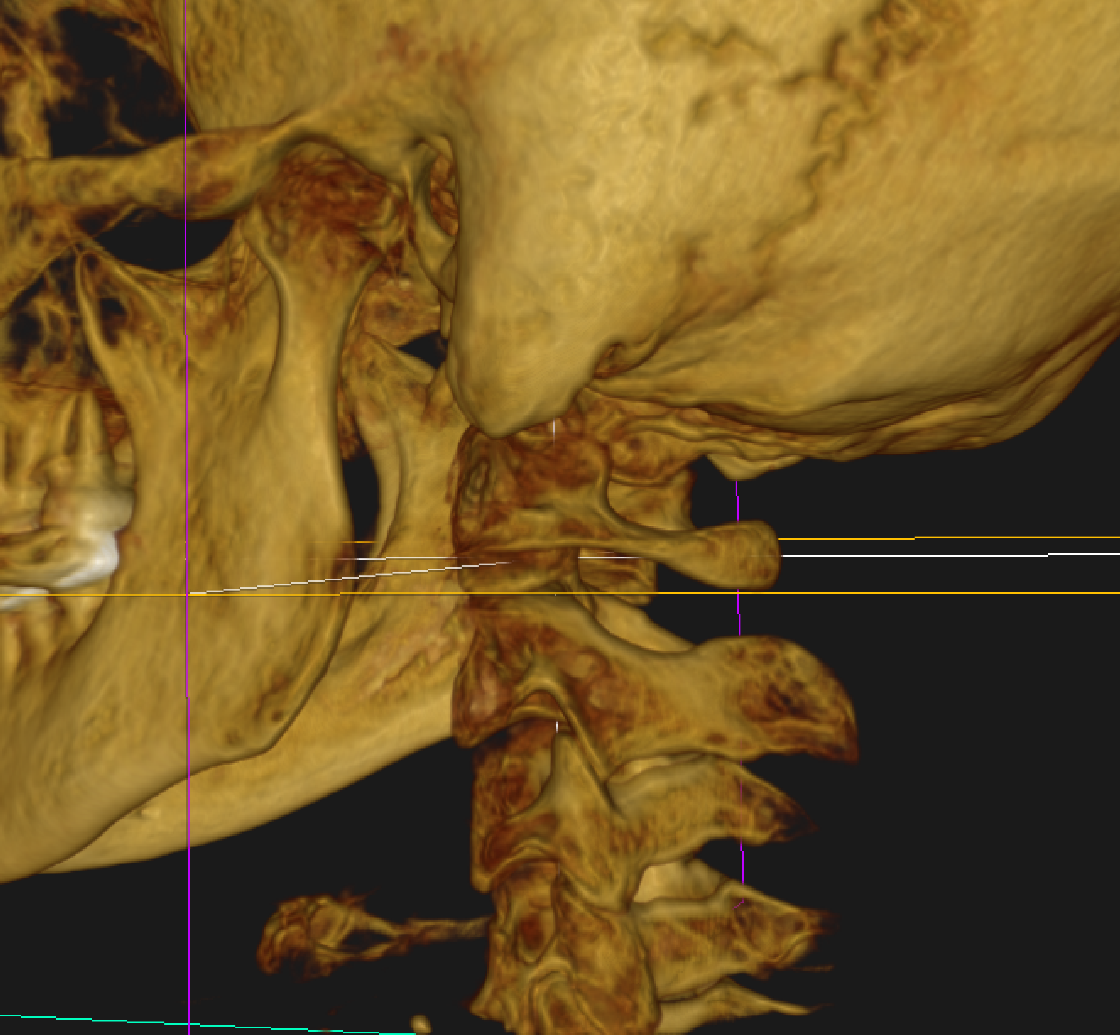
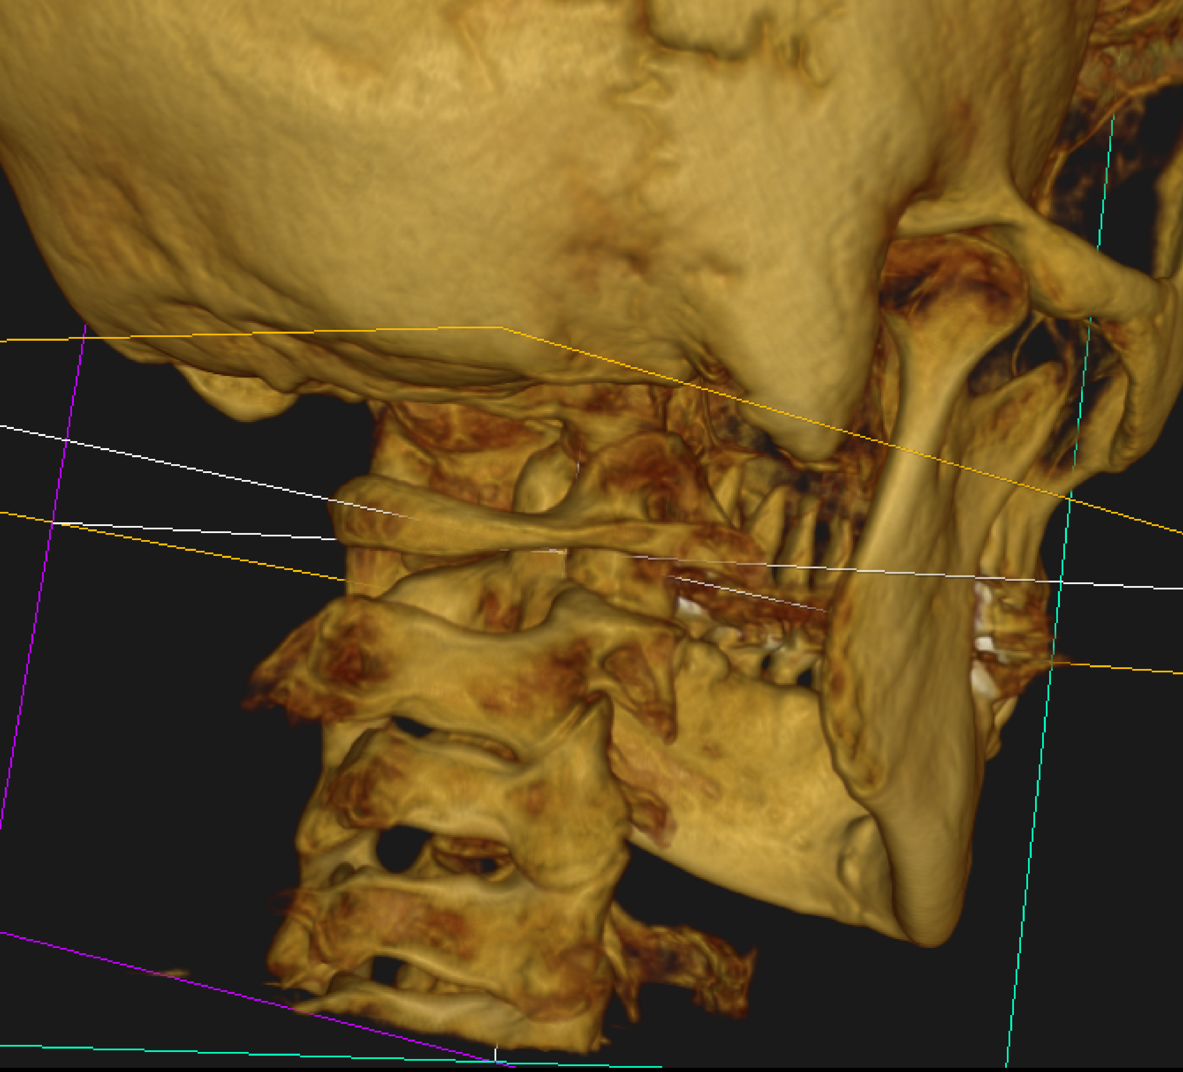
Patient with coronal left C-2,3 joint but semi-sagital right, called a turned articulation.
Right C-2 listing?
Left C-2 listing?
9

Slide 13
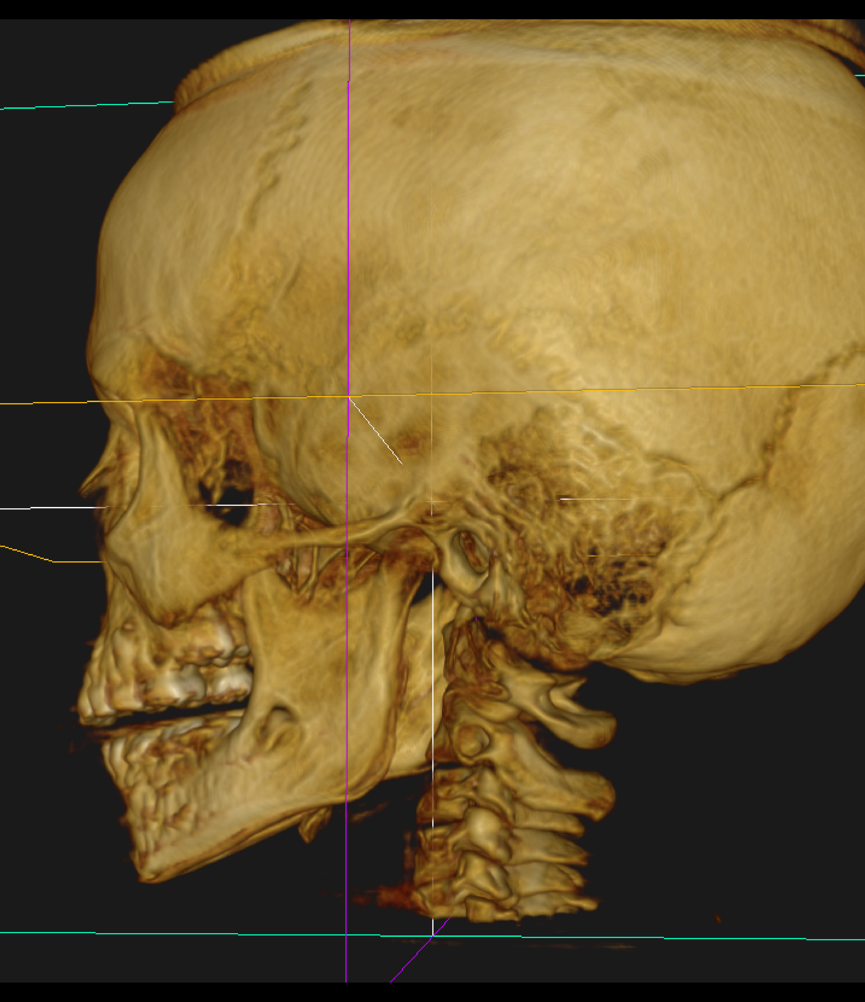
CBCT on 5 year old child who was having out of control emotional problems. Check the left C-2,3 articulation and see if you get a listing that may be the source if his problems.
10

Slide 14
ANSWERS OF CBCT LISTINGS BELOW C-1

Slide 15
Focus on the anterior aspect of the left C-2,3 articulation.
Listing?
1
ALS C-2

Slide 16
Focus on the anterior aspect of the left C-2,3 articulation.
Listing?
1
ALS C-2

Slide 17
Focus on anterior aspect of left
C-2,3 articulation.
ALS C-2
2

Slide 18
Focus on anterior aspect of left
C-2,3 articulation.
ALS C-2
2

Slide 19
Look at anterior aspect of left
C-2,3 and
C-3,4.
Listings?
PRI C-2/
ALS C-3
3

Slide 20
Look at anterior aspect of left
C-2,3 and
C-3,4.
Listings?
PRI C-2/
ALS C-3
3

Slide 21
Look at anterior aspect of left
C-2,3 and
C-3,4.
Listings?
PRI C-2/
ALS C-3
3

Slide 22
Focus on anterior aspect of right C-3,4.
Listing?
ARS C-3
4

Slide 23
Focus on anterior aspect of right C-3,4.
Listing?
ARS C-3
4

Slide 24
Focus on the anterior aspect of left C-2,3 articulation. Listing?
PRI C-2
5

Slide 25
Focus on the anterior aspect of left C-2,3 articulation. Listing?
PRI C-2
5

Slide 26
Focus on the left C-4,5 articulation and try to determine a listing.
PRI C-4
6

Slide 27
Focus on the left C-4,5 articulation and try to determine a listing.
PRI C-4
6

Slide 28
Look at anterior aspect of C-4,5.
Listing?
PRI C-4
7

Slide 29
Look at anterior aspect of C-4,5.
Listing?
PRI C-4
7

Slide 30
View anterior aspect of left C-2,3 articulation.
Listing?
ALS C-2
8

Slide 31
View anterior aspect of left C-2,3 articulation.
Listing?
ALS C-2
8

Slide 32
Patient with coronal left C-2,3 joint but semi-sagital right, called a turned articulation.
Right C-2 listing?
ALS C-2
PLI C-2
Left C-2 listing?
9

Slide 33
Patient with coronal left C-2,3 joint but semi-sagital right, called a turned articulation.
Right C-2 listing?
ALS C-2
PLI C-2
Left C-2 listing?
9

Slide 34
CBCT on 5 year old child who was having out of control emotional problems. Check the left C-2,3 articulation and see if you get a listing that may be the source if his problems.
10
PRI C-2

Slide 35
CBCT on 5 year old child who was having out of control emotional problems. Check the left C-2,3 articulation and see if you get a listing that may be the source if his problems.
10
PRI C-2

