Slide 1
Some images seen on CBCT
Life West weekend 2, hour 6

Slide 2
16 y/o rear ended three years ago

Slide 3
CBCT of left C-0-1 articulation

Slide 4
CBCT of right C-0-1 articulation

Slide 5
CBCT showing fibrosis of left C-2,3 joint as a result of three concussions

Slide 6
Same patient will normal right C-2,3 joint, displaced anterior, superior.

Slide 7
Left posterior arch viewed from the left.

Slide 8
Same patient viewed from the right

Slide 9
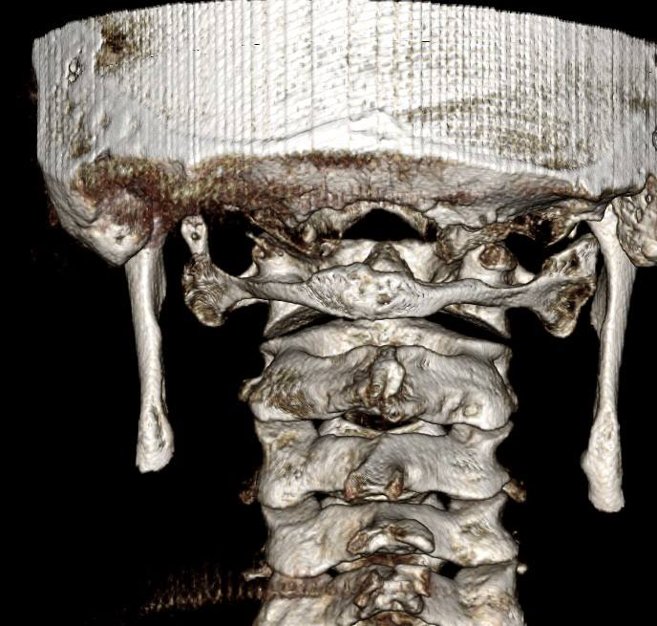
Note pseudo-artculations bilaterally

Slide 10
3-D printed image off a CBCT scan

