Slide 1
Review of marking base posterior & protractoview Blair x-rays
Life West
Weekend 2, hour 3.5
Drs. Campbell & Forest

Slide 2
MARKING
THE
BASE POSTERIOR

Slide 3
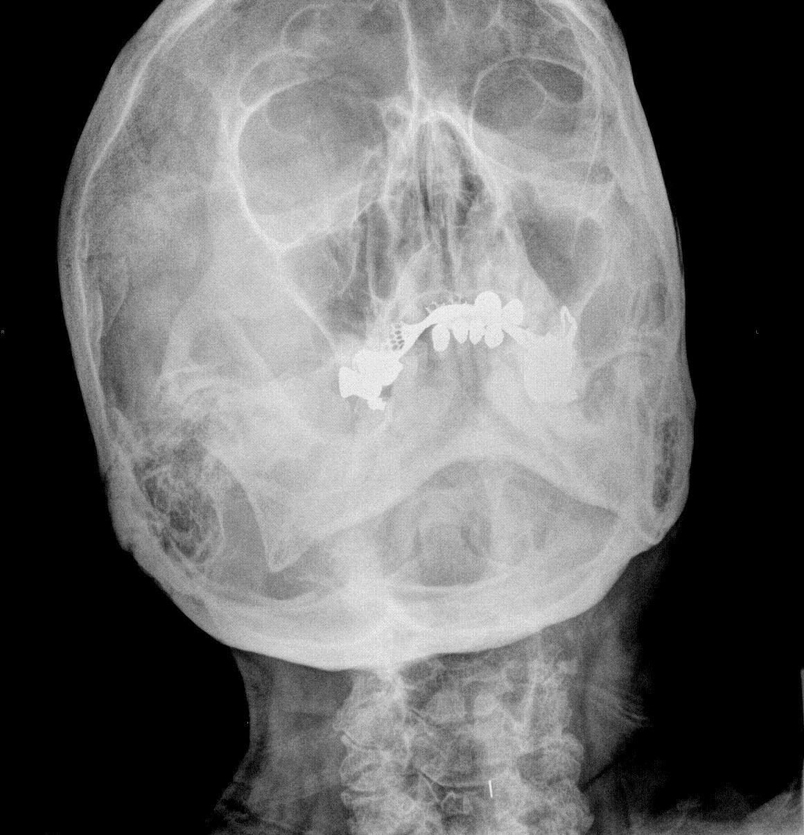
SQUASHED HEAD

Slide 4
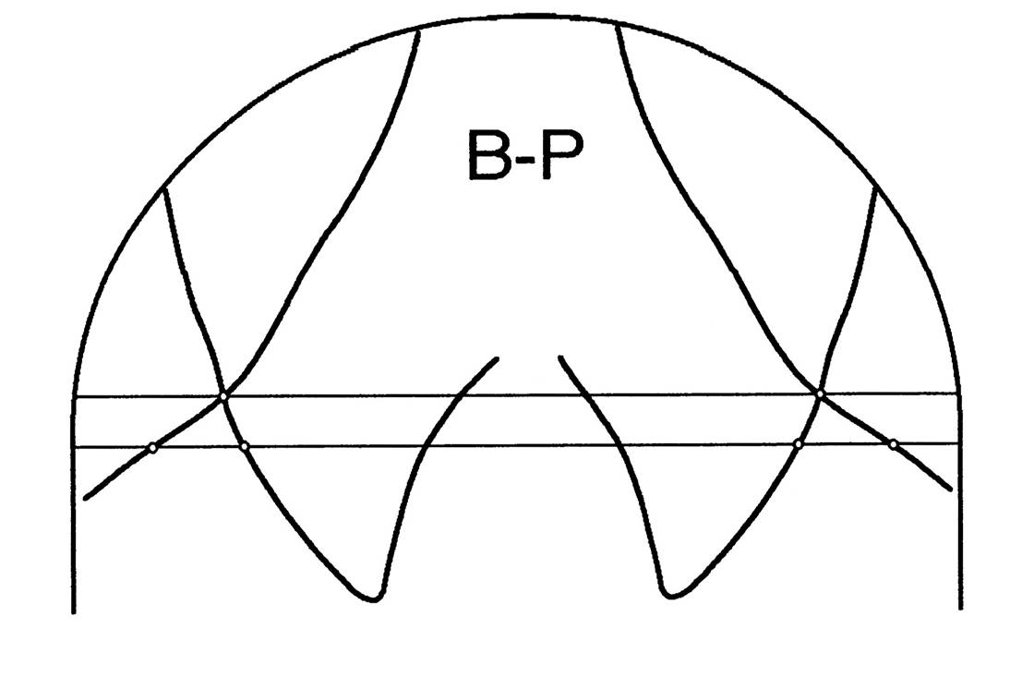
Check head
Tilt - - if more
Than 1/4” or 6.5 mm
Retake

Slide 5
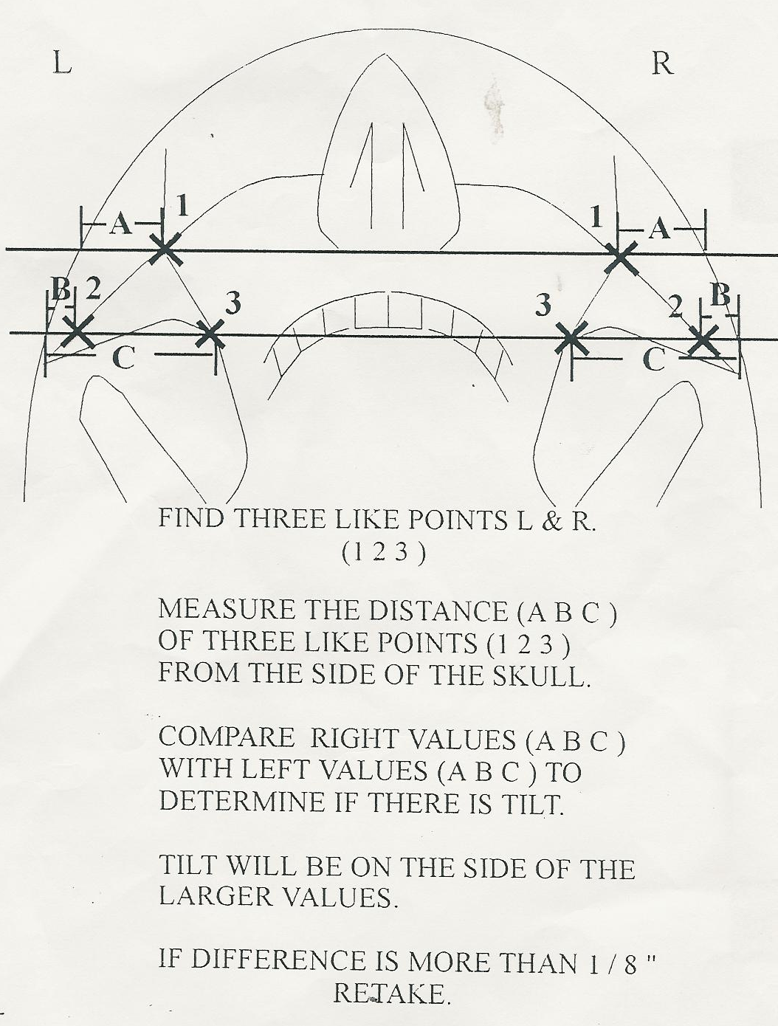
Checking the BP for head tilt

Slide 6
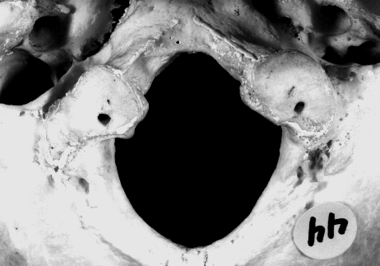

Slide 7
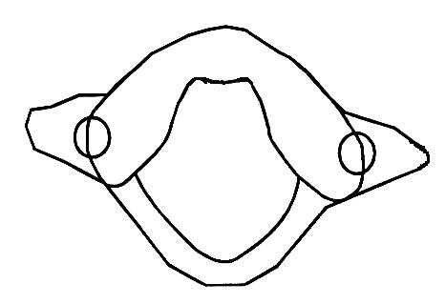

Slide 8
Anterior arch & medial border of lateral mass

Slide 10
Foramen magnum & posterior border of lateral mass

Slide 11
Ant. Pt. 1
Post. Pt. 1

Slide 14
Trace distal margin of lateral margin

Slide 18
Perpendicular from line to distal margin of lateral mass

Slide 20
ANTERIOR POINT 2

Slide 21
ANTERIOR POINT 2
POSTERIOR POINT 2

Slide 22
Perpendicular from line to distal margin of lateral mass

Slide 24
Bisect points

Slide 29
Longitudinal axis of the condyles

Slide 32
Ear Plug Line

Slide 33
EAR PLUG LINE

Slide 34
Ear Plug Line

Slide 35
Ear Plug Line

Slide 36
EAR PLUG LINE

Slide 37
Ear Plug Line
33
35

Slide 38
EAR PLUG LINE
35
33

Slide 39
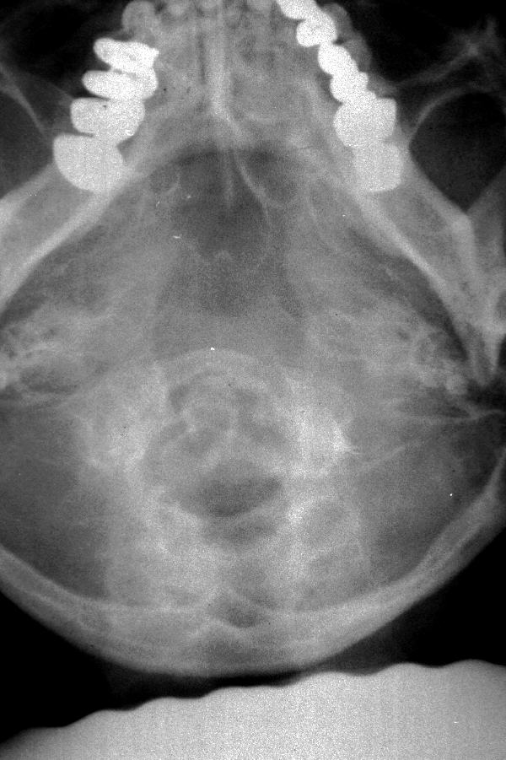

Slide 40
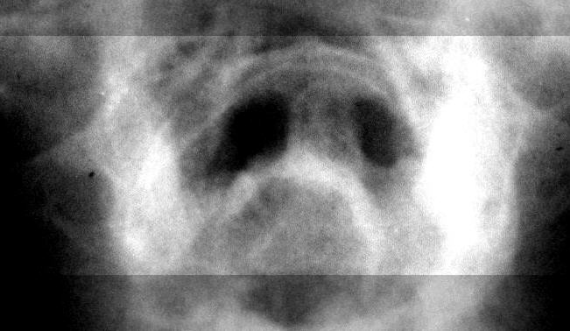

Slide 47
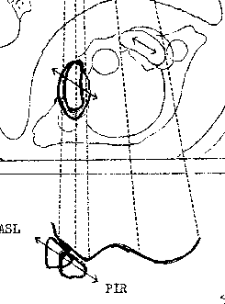
Left Protractive View
Blair

Slide 48
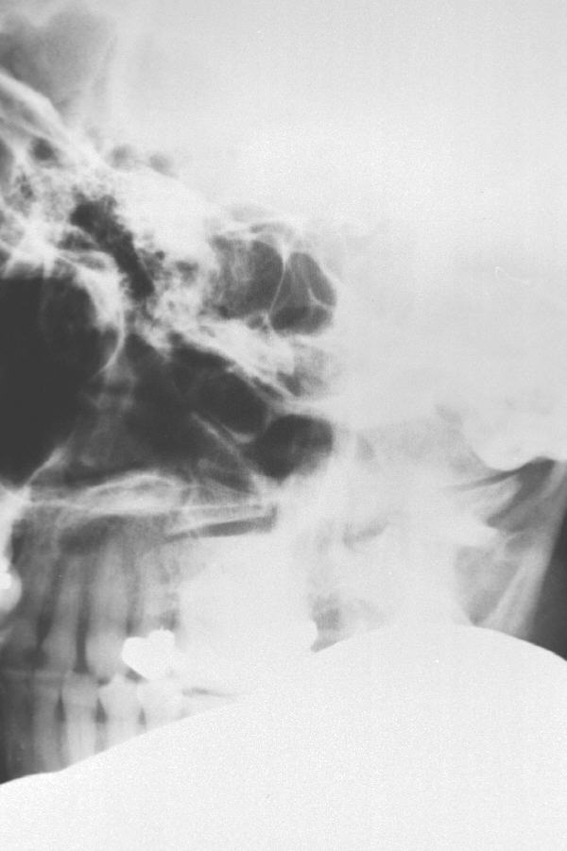
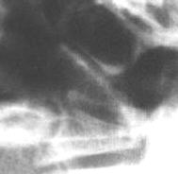

Slide 49
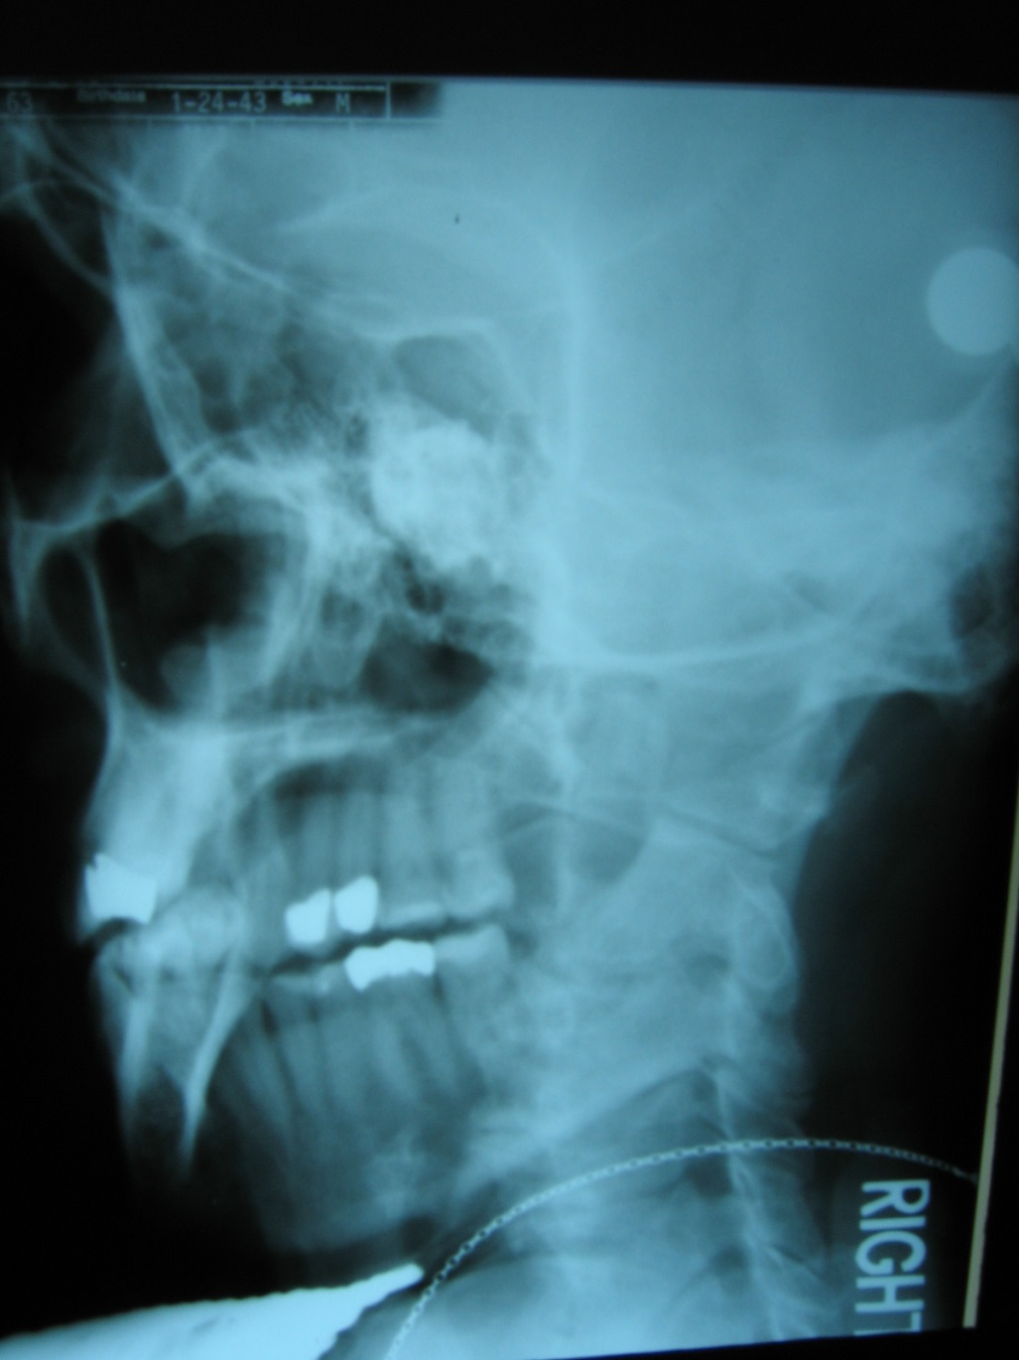

Left Blair Protractoview

Slide 50
Left Blair Protractoview

Slide 51
PIR

Slide 52
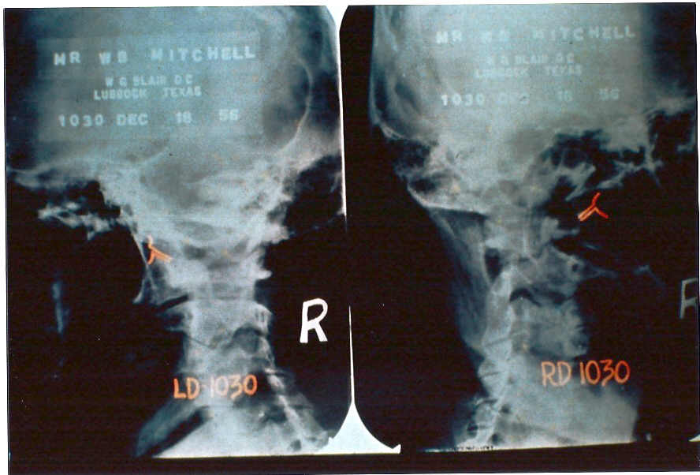

Slide 53
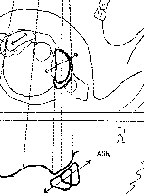
Right Protractive View
Blair

Slide 54
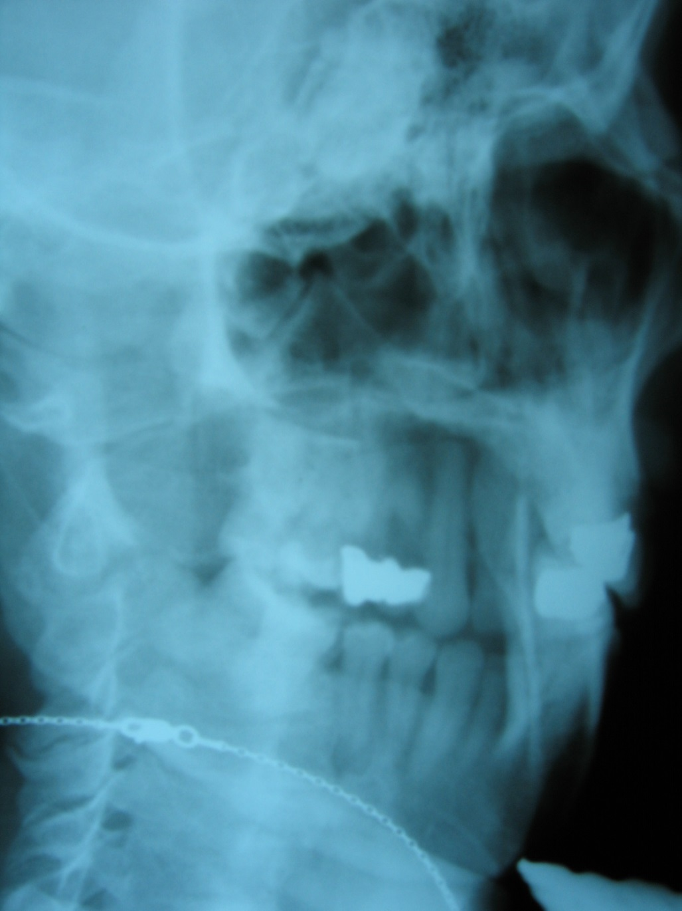

Right Blair Protractoview

Slide 55
Right Blair Protractoview

Slide 56
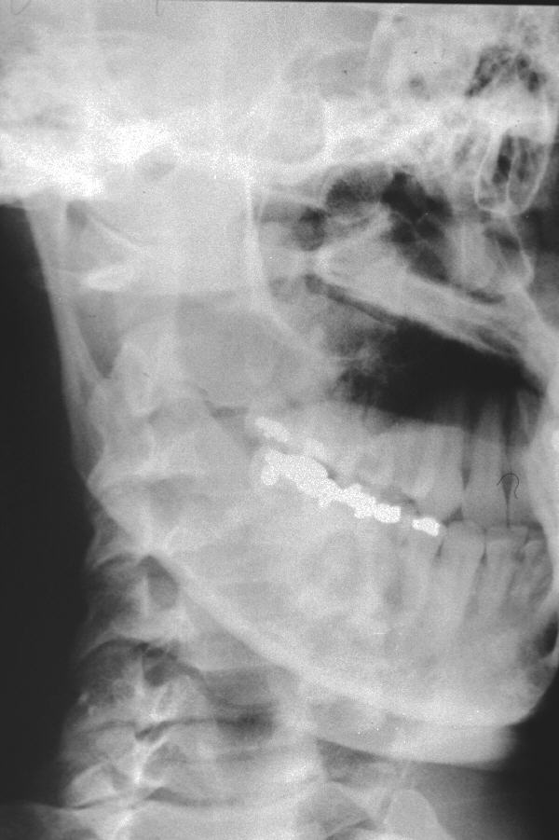
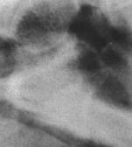

Slide 57
ASR

Slide 58
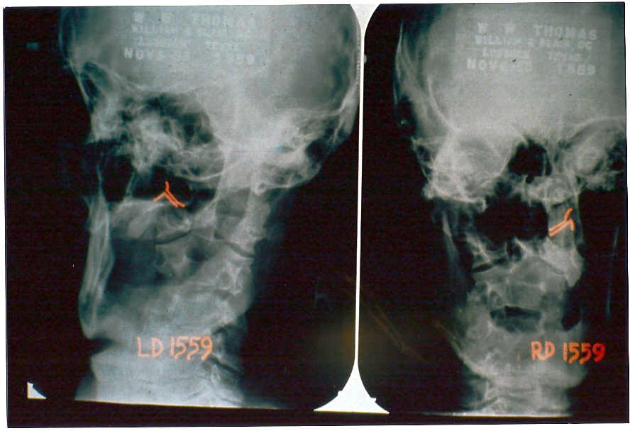

Slide 59
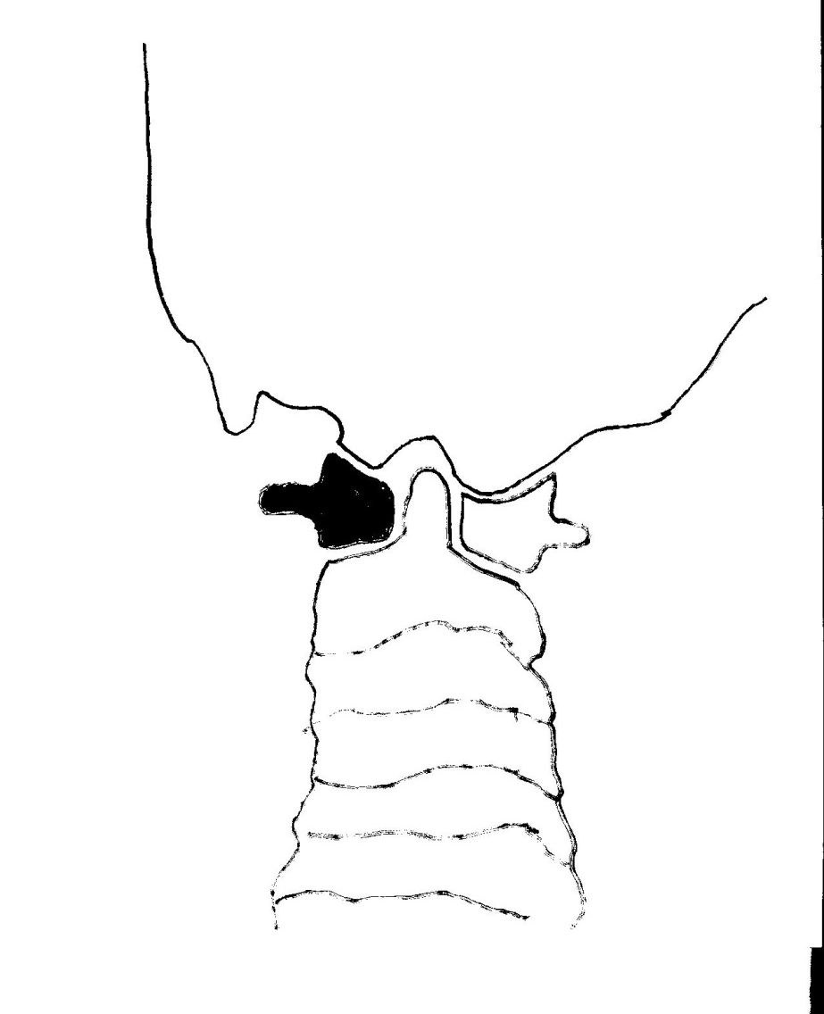
Marking LEFT SLOPE and RIGHT CONVEXITY on the LEFT PROTRACTOVIEW (LPV)

Slide 60
Marking LEFT SLOPE and RIGHT CONVEXITY on the LEFT PROTRACTOVIEW (LPV)

Slide 61
Marking LEFT SLOPE and RIGHT CONVEXITY on the LEFT PROTRACTOVIEW (LPV)

Slide 62
Marking LEFT SLOPE and RIGHT CONVEXITY on the LEFT PROTRACTOVIEW (LPV)

Slide 63
Marking LEFT SLOPE and RIGHT CONVEXITY on the LEFT PROTRACTOVIEW (LPV)

Slide 64
Marking LEFT SLOPE and RIGHT CONVEXITY on the LEFT PROTRACTOVIEW (LPV)

Slide 65

Marking LEFT SLOPE and RIGHT CONVEXITY on the LEFT PROTRACTOVIEW
32
28

Slide 66
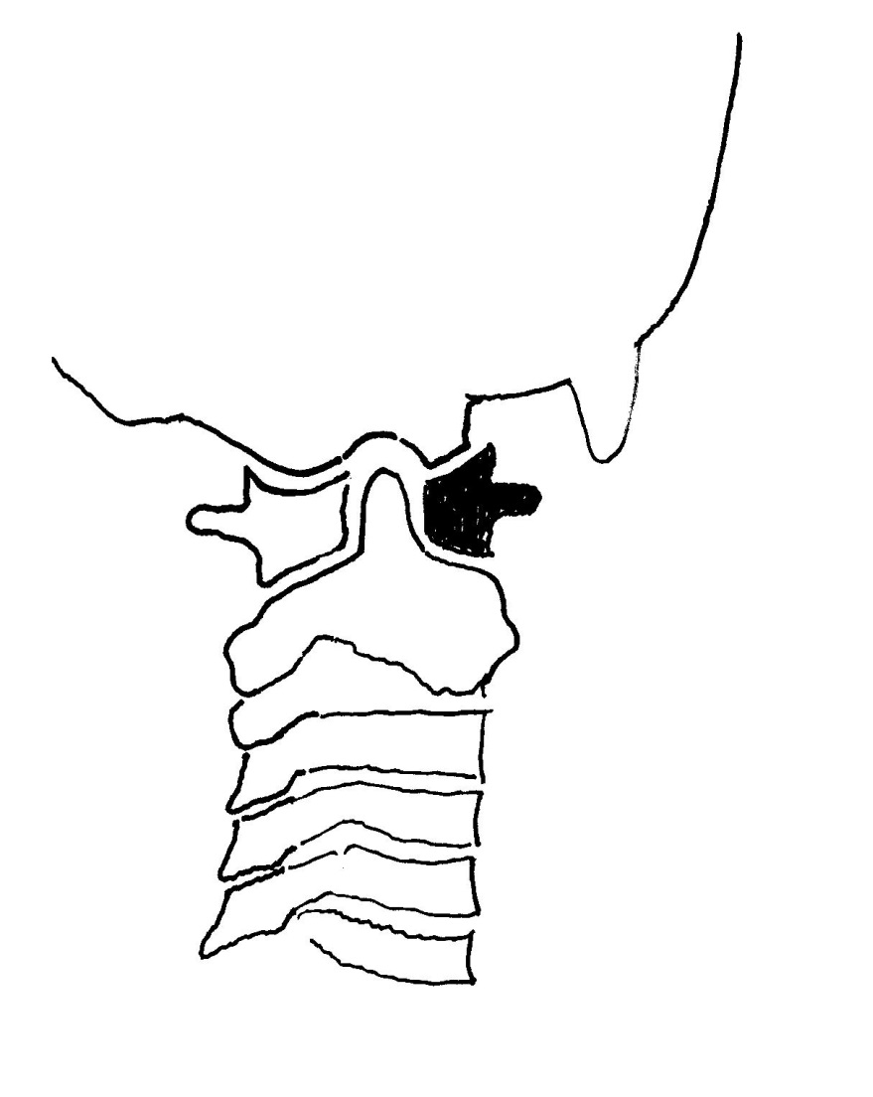
Marking LEFT CONVEXITY and RIGHT SLOPE on the RIGHT PROTRACTOVIEW
34
41

Slide 67
LEVERAGE FACTOR
Once you have determined your atlas misalignment, decide which condyle is the TRACK condyle. Then proceed to determine the “leverage factor” to determine the best approach towards unlocking and repositioning the displaced atlas.

Slide 68
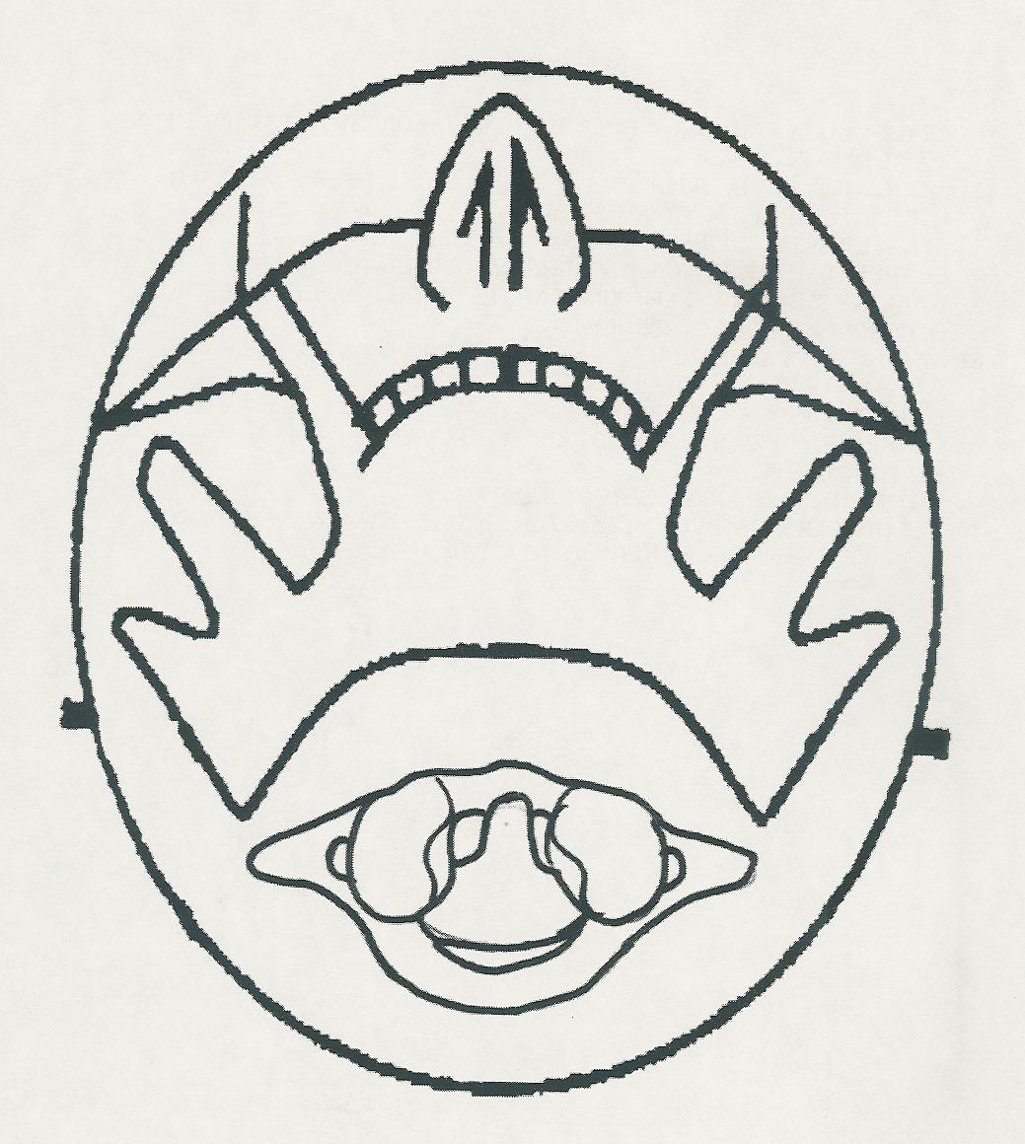
On the side of track condyle, draw a short line perpendicular to the convergence line at both the anterior & posterior aspect of the condyle
ANT=1
POST=2
LEVERAGE FACTOR
1
2

Slide 69
Half the distance between lines one and two and place a dot at the midpoint. Then draw a perpendicular line off this dot from the convergence line past the tp on slip side.
ANT=1
POST=2
LEVERAGE FACTOR
1
2
B

Slide 70
Place a bold dot on the lateral anterior aspect of the transverse process on the slip side. Place a second dot at the mid point between the tp and posterior tubercle on the track side.
ANT=1
POST=2
LEVERAGE FACTOR
1
2
B

Slide 71
Draw a line perpendicular to the convergence line through the transverse dot (line A)and another through the arch dot (line C).
ANT=1
POST=2
LEVERAGE FACTOR
A
1
2
B
C

Slide 72
Measure the distance in mm between lines A & B and lines B & C. Which ever gap is larger will give you better leverage on your correction
ANT=1
POST=2
LEVERAGE FACTOR
A
1
2
B
C

Slide 73
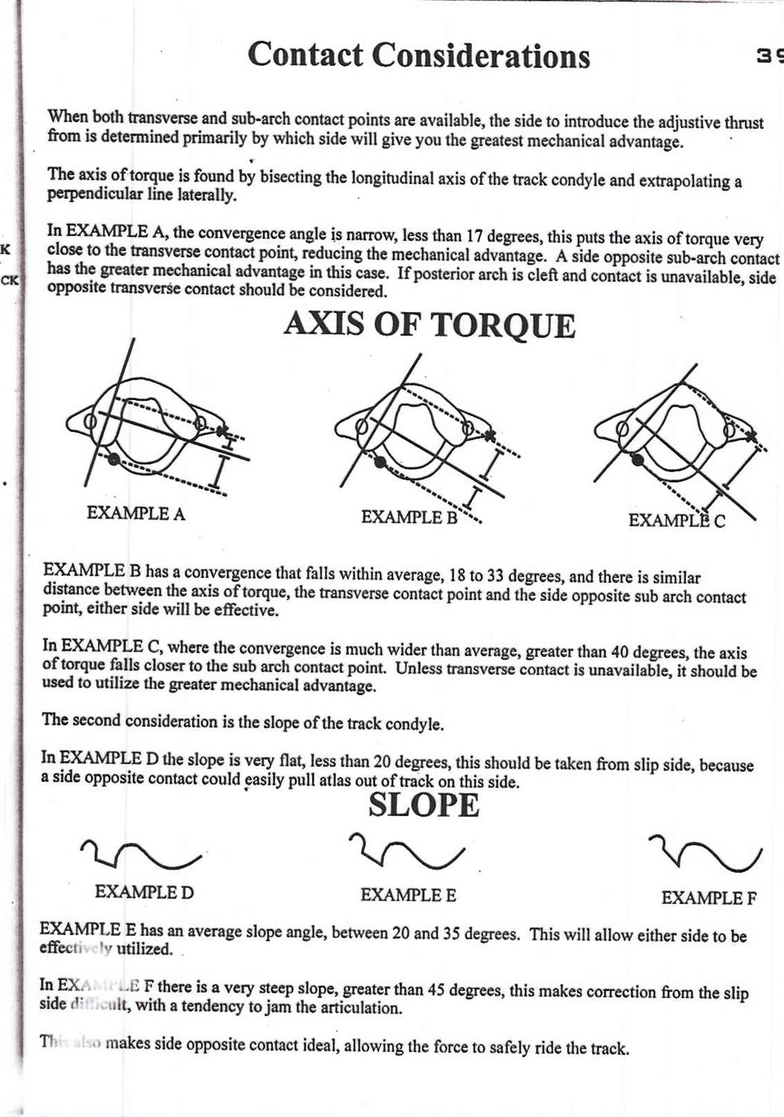

Slide 74
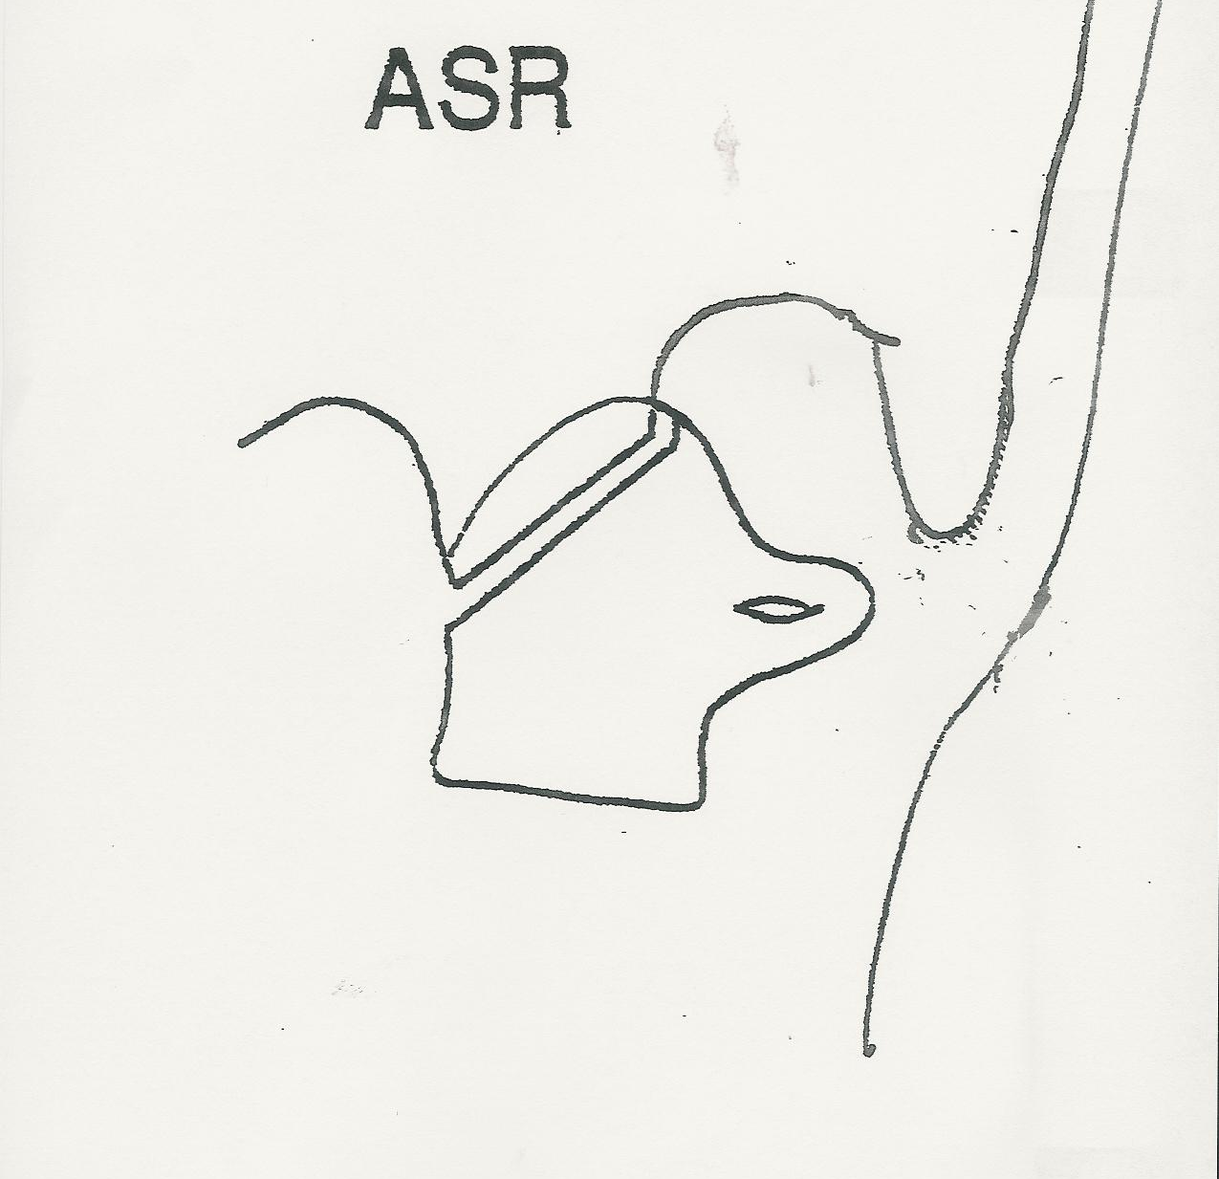
Determining Transverse Process Access
Draw a right lateral mass and transverse process. Then above it draw out the mastoid and occipital condyle as pictured.

Slide 75
Determining Transverse Process Access
Using a BB firmly affixed to the inferior surface of the mastoid, Dr. Blair determined there is 8mm of soft tissue between the skin and bone on an average and a measurement will determine if transverse contact is possible

Slide 76
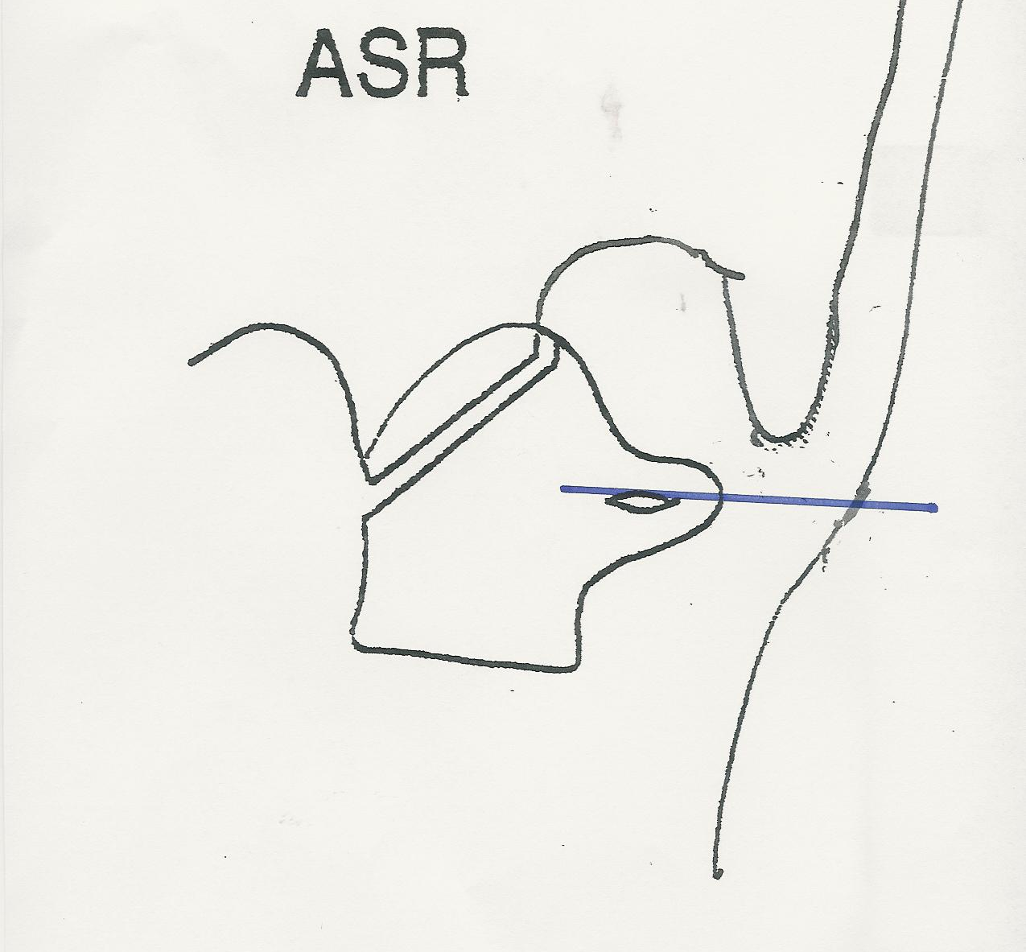
Determining Transverse Process Access
Draw a horizontal line through the mid-point of the atlas transverse process.

Slide 77
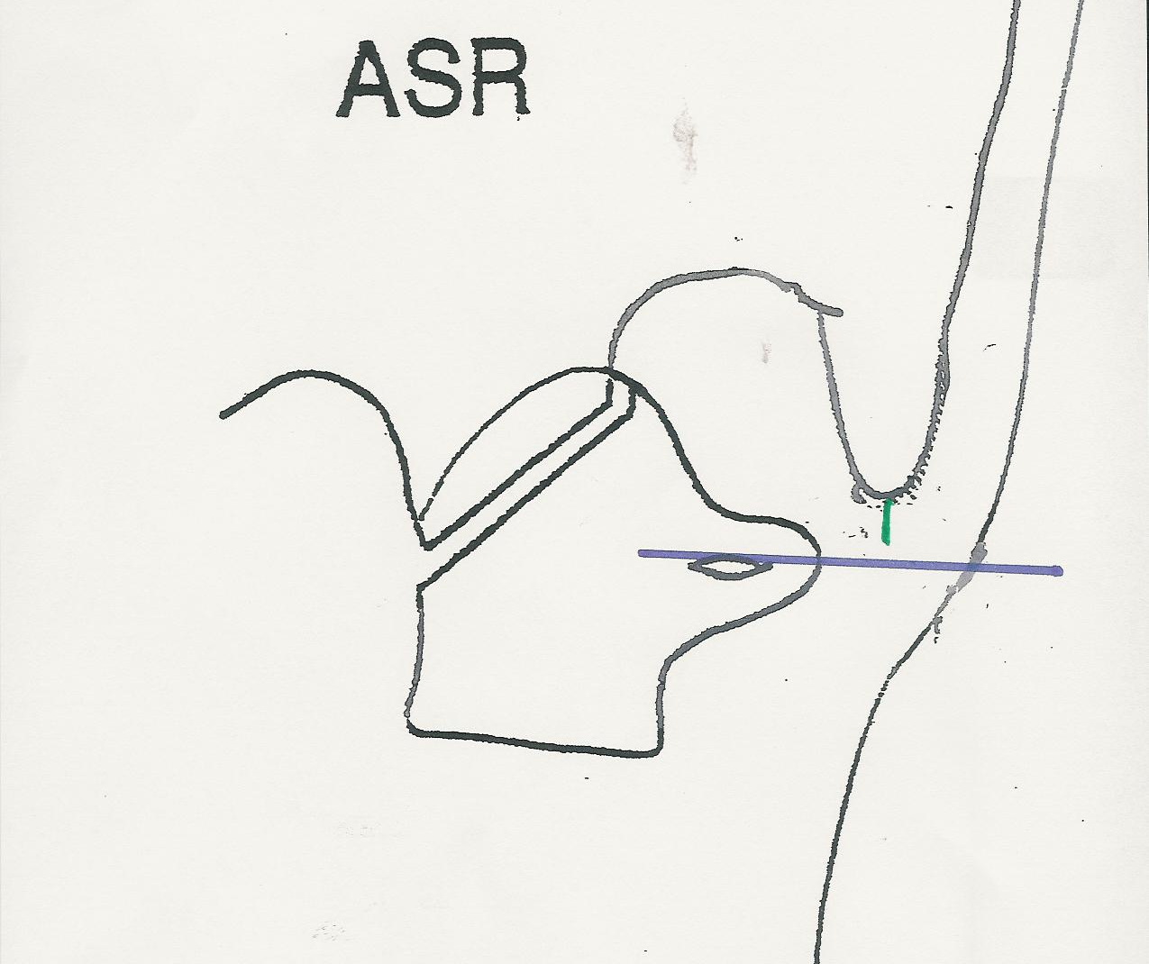
Determining Atlas Transverse Access
Draw a vertical line from the undersurface of the mastoid. If the transverse line is below the mastoid line, you have adequate room to contact that transverse. If not, alternative contact is necessary.

Slide 78
Tissue pull with
L. palp. finger

Slide 79
Thumb on mastoid,
ant. sup. right TP

Slide 80
Fingers of contact
hand gently rest on
patient’s shoulder-
“white knuckles”

Slide 81
Setting up on
ASR(RTC) ,
Ulna 90 degrees
to stance

Slide 82
Dr. Blair wraps L.
stabilization hand
over contact hand
with two lower
fingers retracted

