Slide 1
Marking Blair X-ray Illustrations weekend 2, hour 2 Drs. Campbell and Forest

Slide 2
Blair Listing Sheet

Slide 4
Blair Listing Sheet
19 1/2

Slide 5
Blair Listing Sheet
19 1/2
26

Slide 6
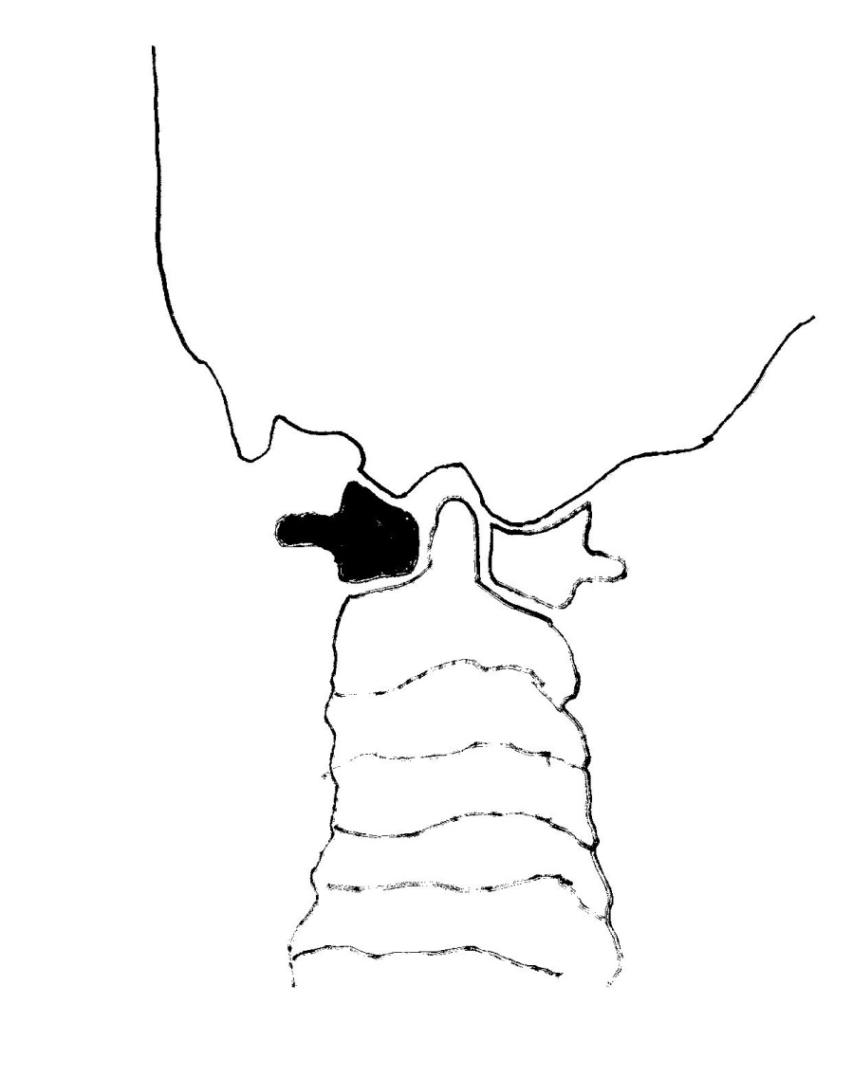
Left slope angle 33 degrees

Slide 7
Blair Listing Sheet
19 1/2
26
33

Slide 8
Right convexity angle 20

Slide 9
Blair Listing Sheet
19 1/2
26
33
20

Slide 10
Left convexity angle 28 degrees

Slide 11
Blair Listing Sheet
19 1/2
26
33
20
28

Slide 12
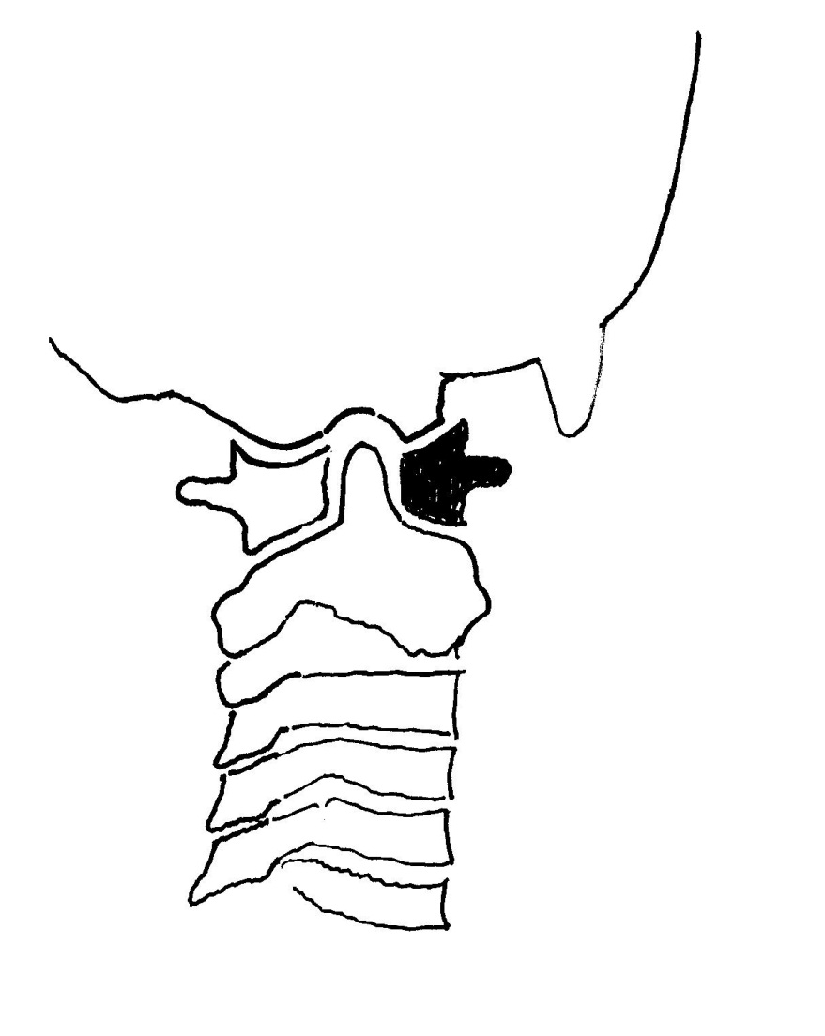
Right slope angle 41 degrees

Slide 13
Blair Listing Sheet
19 1/2
26
33
20
28
41

Slide 14
Based upon the Blair listing below, put the correct angles behind each listing
19 1/2
26

Slide 15
We will now head to the Upper Cervical technique room to demonstrate these adjustments using these same angles.

