Slide 1
Marking Blair X-ray Illustrations
slides are properties of Dr. Thomas Forest & Dr. Dennis Campbell, Certified Advanced Blair Instructors They are not to be copied nor distributed
Weekend 2, hour 3

Slide 2
Blair Listing Sheet
Take out your listing sheet as you will be using it throughout this power point.
We prefer you mark the illustrations with a thick tipped colored marker verses a pen/pencil.
Mark just outside the lines, so the black lines don’t obscure the one you drew.

Slide 3
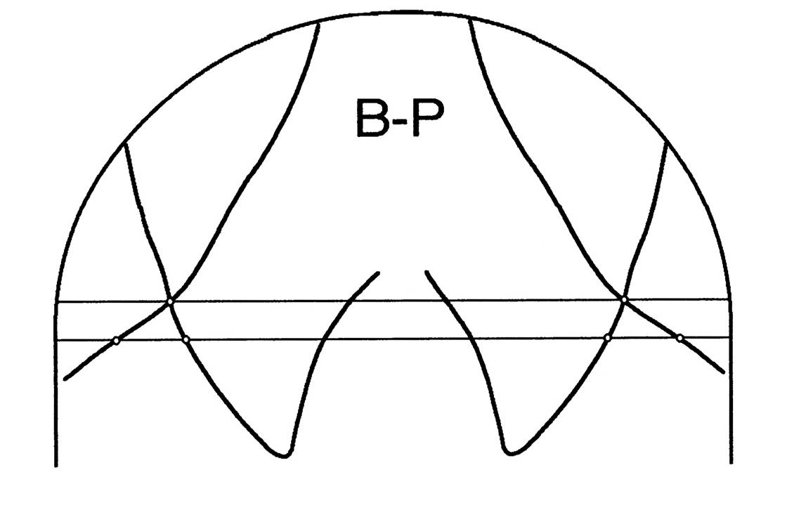
Check head
Tilt - - if more
then 1/8” or 3.2 mm
Retake

Slide 4
.
Follow along the slides explaining the process of marking the base posterior you performed in the last class.
These are sample convergence angles, insert ones you marked from your base posterior

Slide 5
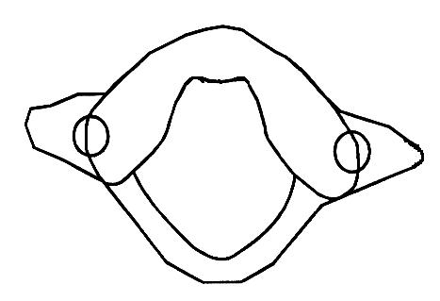
Anterior arch & medial border of lateral mass

Slide 6
Foramen magnum & posterior border of lateral mass

Slide 8
Trace anterior distal margin of lateral margin, stop at transverse foramen.

Slide 9
Mark outer posterior lateral mass to the transverse foramen.

Slide 10
Connect lateral edge of lateral mass at transverse foramen.

Slide 11
Perpendicular from line to distal margin of lateral mass

Slide 12
Bisect points

Slide 15
Longitudinal axis of the condyles

Slide 16
Ear Plug Line

Slide 17
Ear Plug Line

Slide 18
Ear Plug Line

Slide 19
Ear Plug Line
33
35

Slide 20
Ear Plug Line
33
35

Slide 21
Ear Plug Line
33
35

Slide 22
Marking the Base Posterior Place your parallel on the convergence angle and roll it laterally until you reach the outer margin of the lateral mass. Draw a line next to the convergence line to determine if you have a “clear window” to view C-1

Slide 23
Marking the Base Posterior Divide the ocular orbits into four equal sections from medial to lateral. These quadrants will determine the vertical position of your central ray on the Blair protractoviews.

Slide 24
Marking the Base Posterior Divide the ocular orbits into four equal sections from medial to lateral. These quadrants will determine the vertical position of your central ray on the Blair protractoviews.
2
1
1
2
3
3
4
4
17 1/2
25

Slide 25
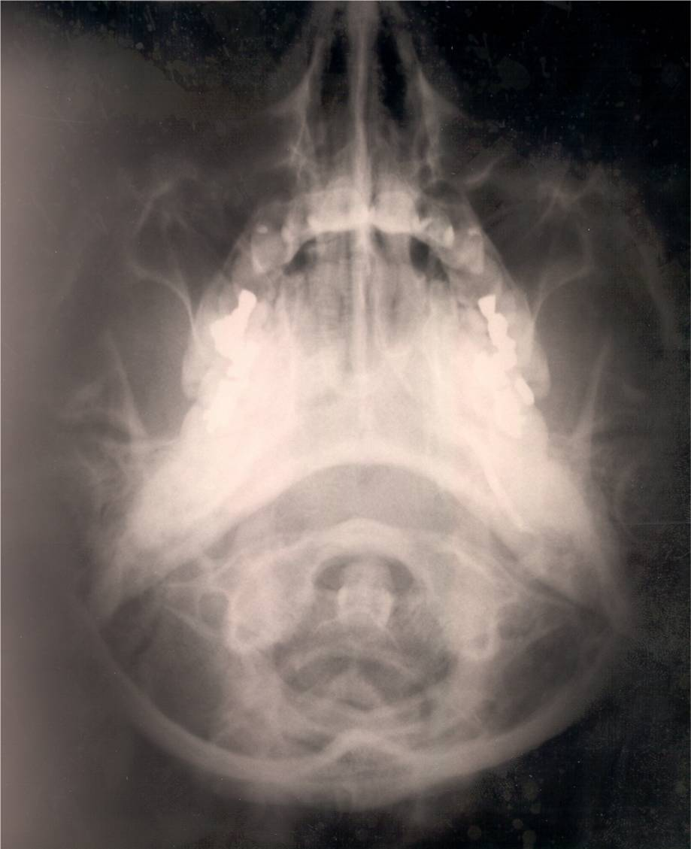
2
1
1
3
2
4
3
4
34
29

Slide 26
Once you have determined which protractoview drawing you have (there are four), try to determine the listing, using the darkened lateral mass as your side of displacement.

Slide 27
View the Blair Protractoviews and determine the listing and mark in large capital letters at the top of the PV the displacement you’ve found.

Slide 28
VIEW THE LEFT & RIGHT PROTRACTOVIEWS.

Slide 29
VIEW THE LEFT & RIGHT PROTRACTOVIEWS.

Slide 30
VIEW THE LEFT & RIGHT PROTRACTOVIEWS.

Slide 31
VIEW THE LEFT & RIGHT PROTRACTOVIEWS.

Slide 32
Now that you have the listing:
Mark these angles in this order:
Left slope angle
Right convexity angle
Left convexity angle
Right slope angle

Slide 33
Marking slope and convexity angles
MARK THE LEFT SLOPE ANGLE ON THE UNDERSURFACE OF THE LEFT C-0-1 JOINT?
(REMEMBER NEVER DRAW A LINE ON THE JOINT, ALWAYS DRAW BELOW IT.)
32

Slide 34
Marking slope and convexity angles
MARK THE RIGHT CONVEXITY ANGLE ON THE UNDERSURFACE OF THE POSTERIOR 1/3RD OF THE C-0-1 JOINT.
39

Slide 35
Marking slope and convexity angles
MEASURE THE LEFT CONVEXITY ANGLE.
26

Slide 36
Marking slope and convexity angles
MEASURE THE RIGHT SLOPE ANGLE.
40

Slide 37
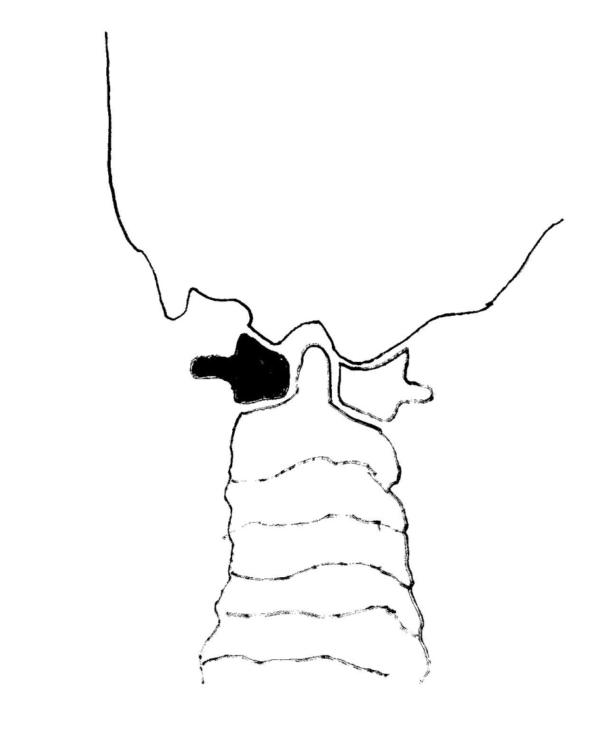
Left slope angle 33 degrees

Slide 38
Right convexity angle 20

Slide 39
Left convexity angle 28 degrees

Slide 40
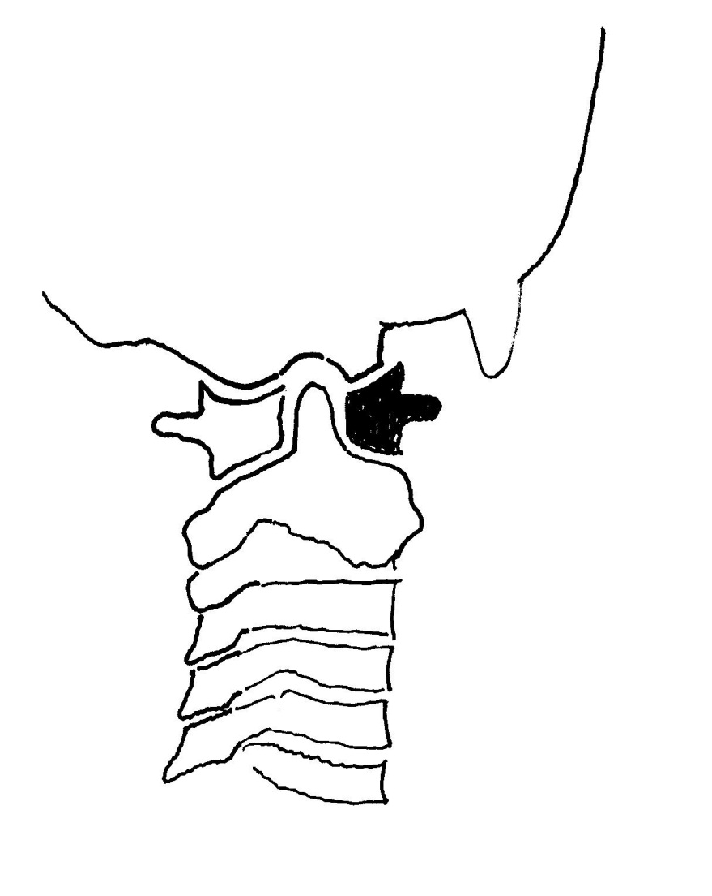
Right slope angle 41 degrees

Slide 41
CAN I CONTACT THE ATLAS?
There is the possibility on one or more of the protactoview illustrations that the transverse process on the side of laterality is inaccessible.
To determine if you can contact that transverse, you must draw the transverse and mastoid lines.

Slide 42
Determining Transverse Process Access Using a BB firmly affixed to the inferior surface of the mastoid, Dr. Blair determined there is 8mm of soft tissue between the skin and bone on an average and a measurement will determine if transverse contact is possible

Slide 43
Determining Transverse Process Access Draw a horizontal line through the mid-point of the atlas transverse process.

Slide 44
Determining Atlas Transverse Access Draw a vertical line from the undersurface of the mastoid. If the transverse line is below the mastoid line, you have adequate room to contact that transverse. If not, alternative contact is necessary.

Slide 45
Optional Blair Leverage Factor
These next few slides explain one is the most effective way of determining which, of the many Blair adjustments, may work most effectively. The leverage factor assists you in measuring the biomechanics of the displaced segment.

Slide 46
LEVERAGE FACTOR
Once you have determined your atlas misalignment, decide which condyle is the TRACK condyle. Then proceed to determine the “leverage factor” to determine the best approach towards unlocking and repositioning the displaced atlas.

Slide 47
On the side of track condyle, draw a short line perpendicular to the convergence line at both the anterior & posterior aspect of the condyle
ANT=1
POST=2
LEVERAGE FACTOR
1
2

Slide 48
Half the distance between lines one and two and place a dot at the midpoint. Then draw a perpendicular line off this dot from the convergence line past the tp on slip side.
ANT=1
POST=2
LEVERAGE FACTOR
1
2
B

Slide 49
Place a bold dot on the lateral anterior aspect of the transverse process on the slip side. Place a second dot at the mid point between the tp and posterior tubercle on the track side.
ANT=1
POST=2
LEVERAGE FACTOR
1
2
B

Slide 50
Draw a line perpendicular to the convergence line through the transverse dot (line A)and another through the arch dot (line C).
ANT=1
POST=2
LEVERAGE FACTOR
A
1
2
B
C

Slide 51
Measure the distance in mm between lines A & B and lines B & C. Which ever gap is larger will give you better leverage on your correction
ANT=1
POST=2
LEVERAGE FACTOR
A
1
2
B
C

Slide 53
Based upon the Blair listing below, put the correct angles behind each listing
19 1/2
26

Slide 54
Blair Listing Sheet – completed except for the listings and the angles needed for the adjustment.
19 1/2
26
33
20
28
41

Slide 55
Now you know the listing-time to adjust
Now we will review the adjustments you learned in the first class. We will then head to the Upper Cervical technique room to demonstrate these adjustments using these same angles.

