Slide 1
Toggle Monitors
Testing your reproducibility skills of your adjustment

Slide 2
There are basically two versions of the toggle monitor

Slide 3
There are basically two versions of the toggle monitor
The ‘torque tester’ evaluates the amount of torque applied, how long you stay on contact, and the depth of the adjustment.

Slide 4
There are basically two versions of the toggle monitor
The torque tester evaluates the amount of torque applied, how long you stay on contact, and the depth of the adjustment.
The computerized Tytron toggle monitor evaluates the speed, and pressure applied on the correction.

Slide 5
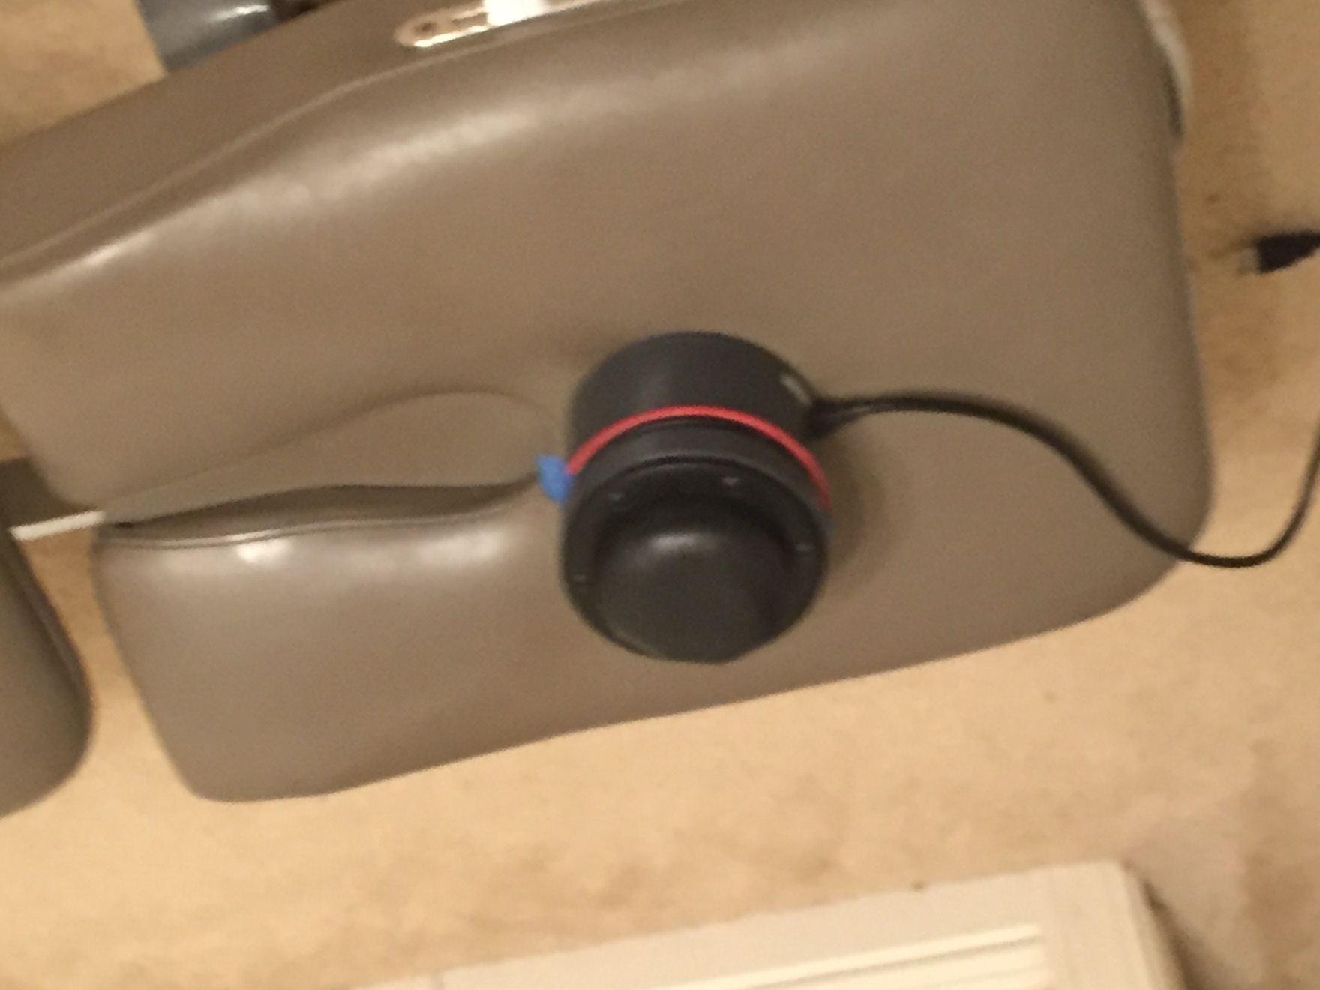
Torque Toggle Monitor

Slide 6
No torque will produce an almost straight up and down line.

Slide 7
An ASL adjustment will usually go straight down, flatten, then drift away slightly to the right.

Slide 8
An ASR adjustment usually drops straight down, flattens, and the rises up moving backwards towards the end.

Slide 9
Keep in mind, even if the last part of the correction doesn’t drift as in the examples, if you get a U shaped pattern on the paper, you accomplished your goal. Stay on contact as long as possible.

Slide 10
Tytron Toggle Monitor
The Tytron toggle monitor will register your pressure and speed. Thus when contacting the sensor device, apply as little pressure as you can before delivering the adjustment. It is an expensive piece of equipment, so use caution and don’t allow it to drop to the floor.

Slide 11
ASR at .038 seconds with16.99 pounds

Slide 12
ASL at .040 seconds with 12.09 pounds

