Slide 1
Viewing Blair Protractoviews
Blair hour 9
slides are properties of
Dr. Thomas Forest & Dr. Dennis Campbell.
Certified Advanced Blair Instructors
They are not to be copied nor distributed

Slide 2
Before we view the blair protraco views, let’s look at the advancements in upper cervical

Slide 3
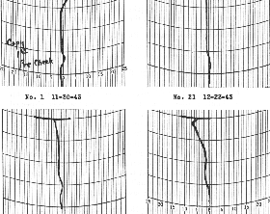
Current Upper Cervical
From this:

Slide 4
Current Upper Cervical
From this:
To this:

Slide 5
Current Upper Cervical
From this:
To this:
To this:

Slide 6
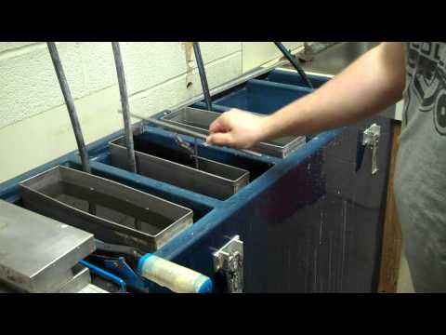
Current Upper Cervical
This:

Slide 7
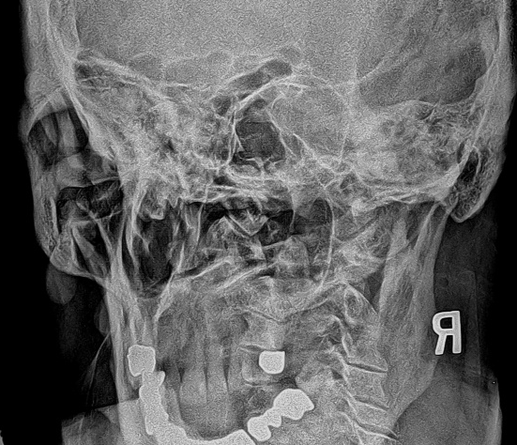
Current Upper Cervical
This:
To this:

Slide 8
Current Upper Cervical
This:
To this:
To this:

Slide 9
Current Upper Cervical
Now we have this:

Slide 10
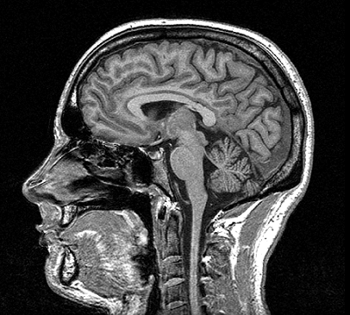
Current Upper Cervical
Now we have this:
and this:

Slide 11
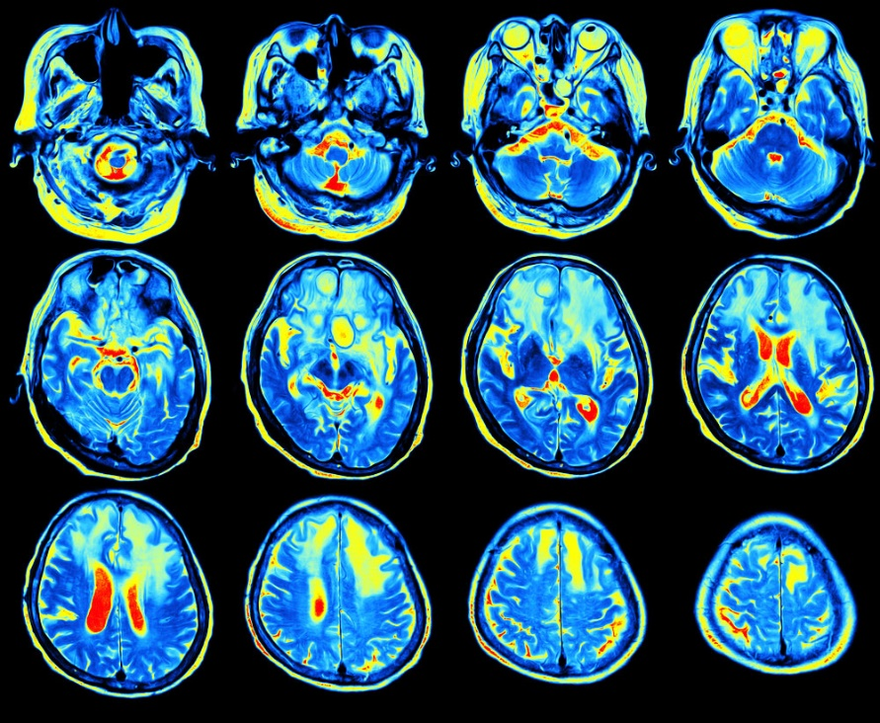
Current Upper Cervical
Now we have this:
and this:
and this:

Slide 12
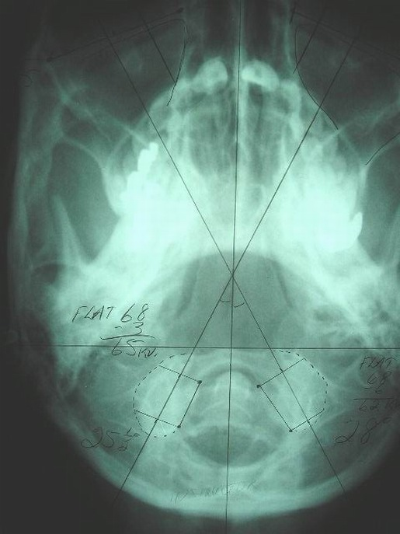
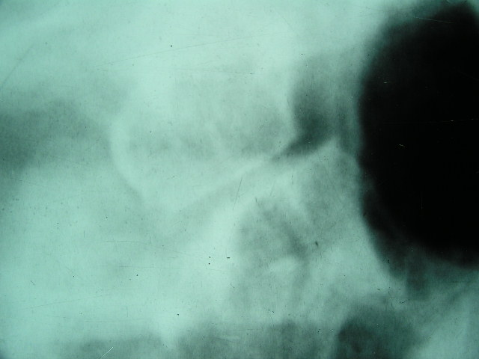
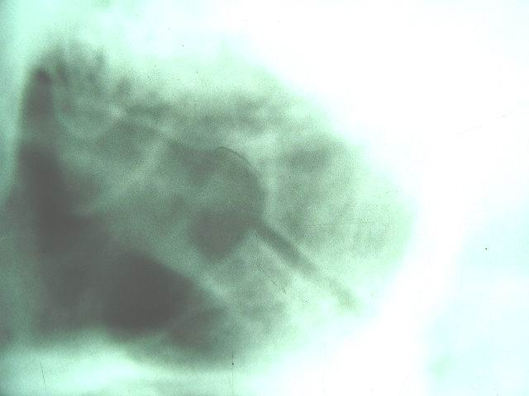
By determining condyle
convergence from the base
posterior
a custom diagonal view
would reveal
misalignment usually
not visible on other views.
overlapped
lined up
25
28

Slide 13
IAS of L. condyle R. CONVEXITY
FORAMEN MAGNUM FORAMEN MAGNUM
IAS OF L. CONDYLE CONVEXITY OF R. CONDYLE

Slide 14
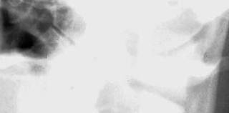
Left Blair Protractoview

Slide 15
Left Blair Protractoview
Right Blair Protractoview

Slide 16
Left Protractoview

Slide 17
Left Protracto view Right Protracto view Note headclamps used to position patient within 1/2 a degree

Slide 18
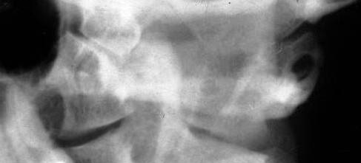
You are now ready to test your skills at interpreting the precise Blair images.
Keep in mind you are viewing from the posterior, so orient yourself to which is a right and which is a left image. On each pic you should either see an overlap, even or underlap and note the listing on your grading sheet.
You will often only see one Blair view. Thus, note the flat slope of the condyle from inferior to superior tells you which joint you are viewing
Example-this is the left A-O joint

Slide 19
L
R
1

Slide 20
2
R

Slide 21
3
R

Slide 22
4

Slide 23
5

Slide 24
6

Slide 25
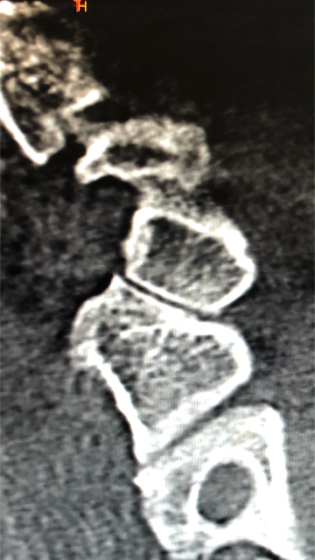
7

Slide 26
8

Slide 27
9
R

Slide 28
10

Slide 29
L
R
1
ASL
EVEN

Slide 30
2
EVEN

Slide 31
3
R
ASR

Slide 32
4
ASR

Slide 33
5
ASL

Slide 34
6
PIL

Slide 35
7
ASL

Slide 36
8
PIL

Slide 37
9
R
ASR

Slide 38
10
ASL

Slide 39
The End…finally

