Slide 1
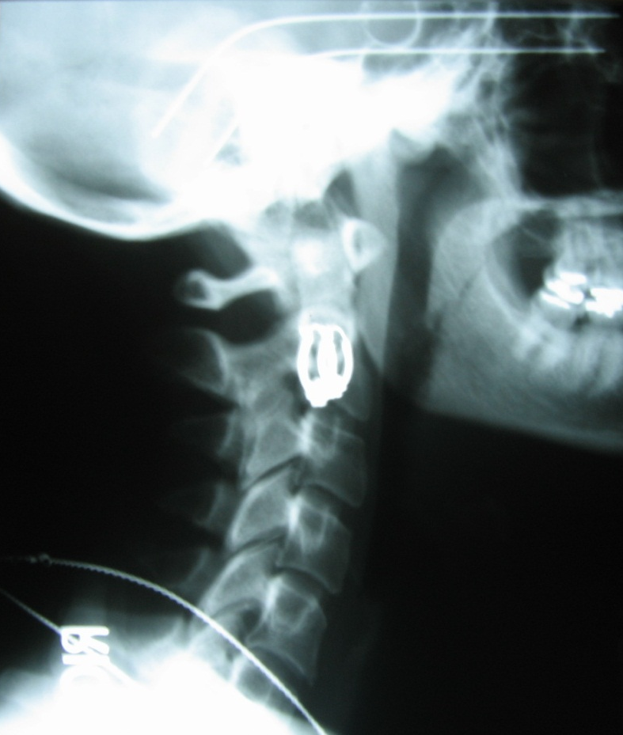
Blair hour 8 Reading Protracto-view images
slides are properties of
Dr. Thomas Forest & Dr. Dennis Campbell.
Certified Advanced Blair Instructors
They are not to be copied nor distributed

Slide 3
DIRECTION OF ATLAS MOTION, BOTH NORMAL AND ABNORMAL.

Slide 4
This “Tracking and Sliding”…
Allows us to see a true overlapping or under lapping at the edge of the articulation not otherwise seen on conventional views.

Slide 5
When the misalignment is to the anterior, it is simultaneously misaligned to the superior and lateral.
ASL
ASR

Slide 6
When the misalignment is to the posterior, it is simultaneously misaligned to the inferior and lateral.
PIL
PIR

Slide 9
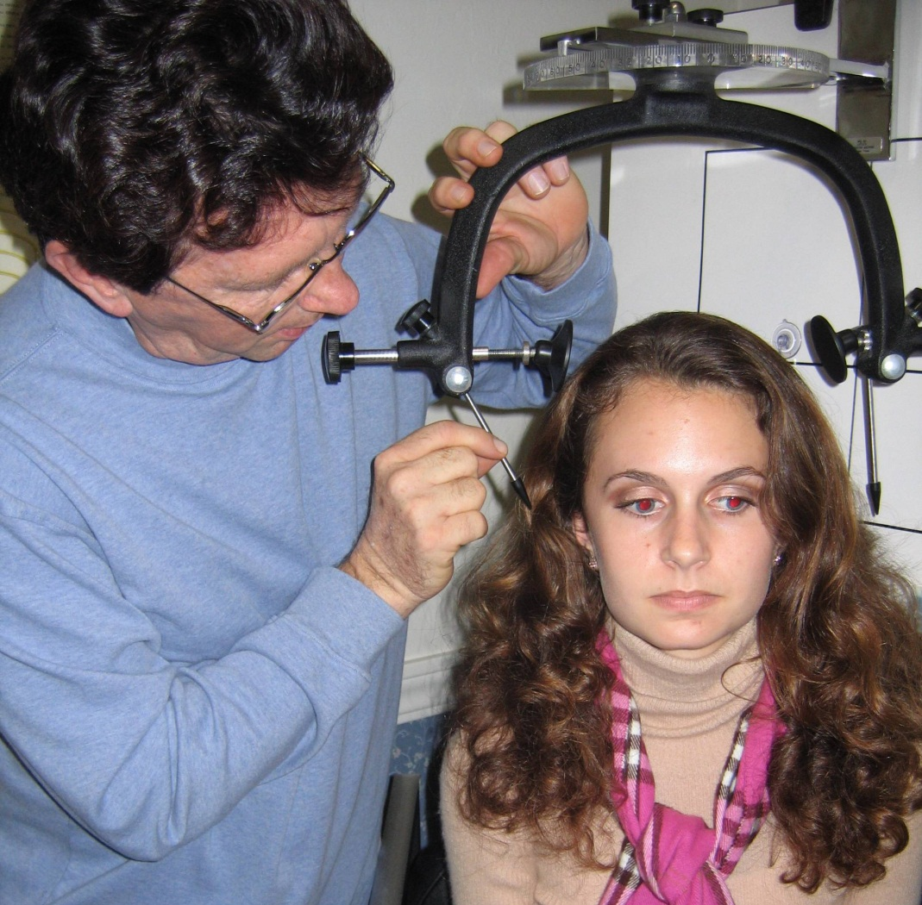
Solving problems with custom made views adds to the excellence we strive
strive
for in
subluxation
correction.

Slide 10
Left Blair
Protracto-
view LPV(semi- oblique) taken through the right maxillary sinus

Slide 11
Right Blair Protracto-view (RPV) taken through the left maxillary sinus.

Slide 12
Blair Protracto View
Taken as an Oblique Nasium.
Oblique angle = convergence angle of condyle from BP.
Slope and Convexity angles are taken from Protracto view
To find the Atlas start at lower spine, move up to dens, move lateral toward chin to find the joint in question.
Left Protracto View

Slide 13
ASR (Anterior Superior Right)
Atlas has moved Anterior Superior and to the right.
Overlap is seen
Use the Anterior tubercle of Atlas as the indicator for labeling the misalignment .
Right Protracto View

Slide 14
PIL (Posterior Inferior Left)
Anterior Tubercle has moved Posterior, Inferior and left.
An underlap is seen on the right Protracto View.
Right Protracto View

Slide 15
Slope and Convexity Angles
The Slope Angles are taken from the Occ-C1 articulation on the Protracto on the same side as the chin rotation.
Convexity angle taken from the posterior-lateral 1/3 of the Occ-C1 articulation opposite of the chin rotation.
Right Protracto View

Slide 16
Atlas Motion
Convexity
Slope

Slide 17
Atlas Motion
1st: name the parts
From the Base Posterior
From the Protracto View
Notes:
Show the 2 moving together and pause them in the ASL and PIR position.

Slide 18
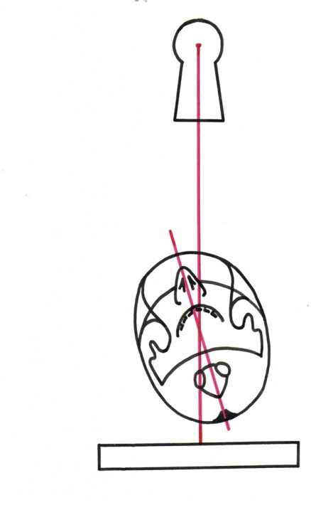
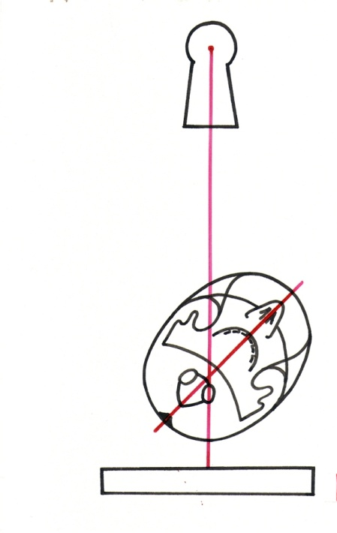
The LATERAL Edge

Slide 19
Vivid example of atlas misalignment via Blair concept

Slide 20
ASR – Right Protracto View

Slide 21
Anterior Superior Right
R

Slide 22
ASL – Left Protracto View

Slide 23
Anterior Superior Left

Slide 24
PIL Right Protracto View

Slide 25
Posterior Inferior Left
R

Slide 26
PIR – Left Protracto View

Slide 27
Posterior Inferior Right

Slide 28
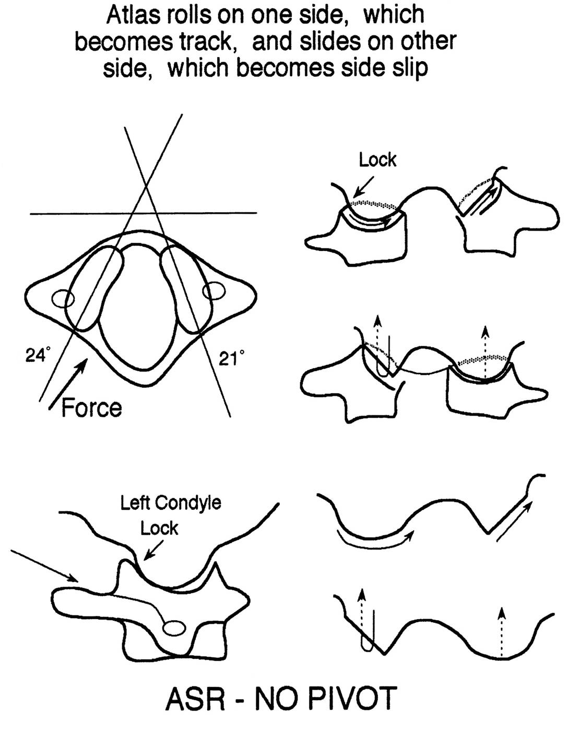
TRAUMA

Slide 29
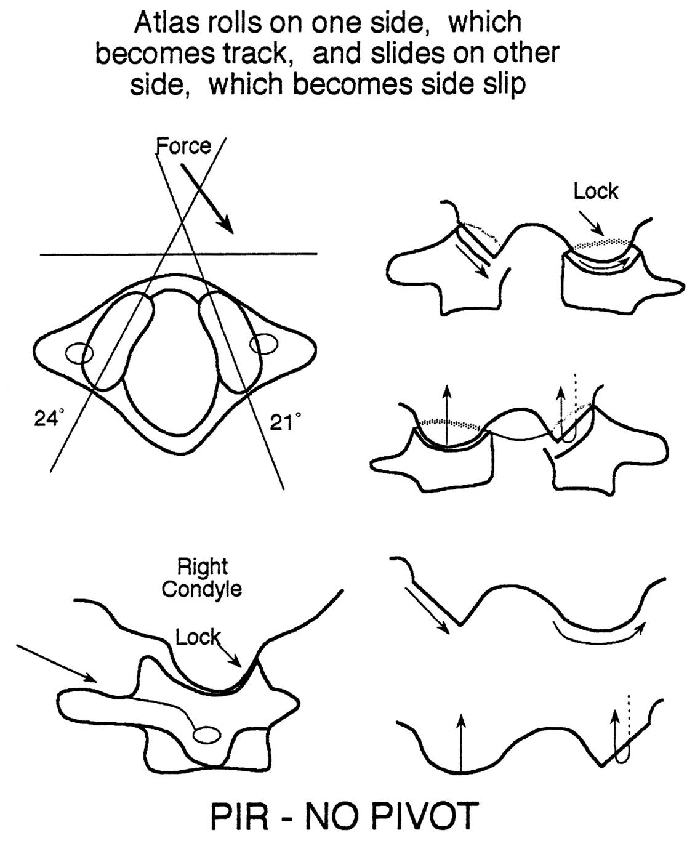
TRAUMA

Slide 30
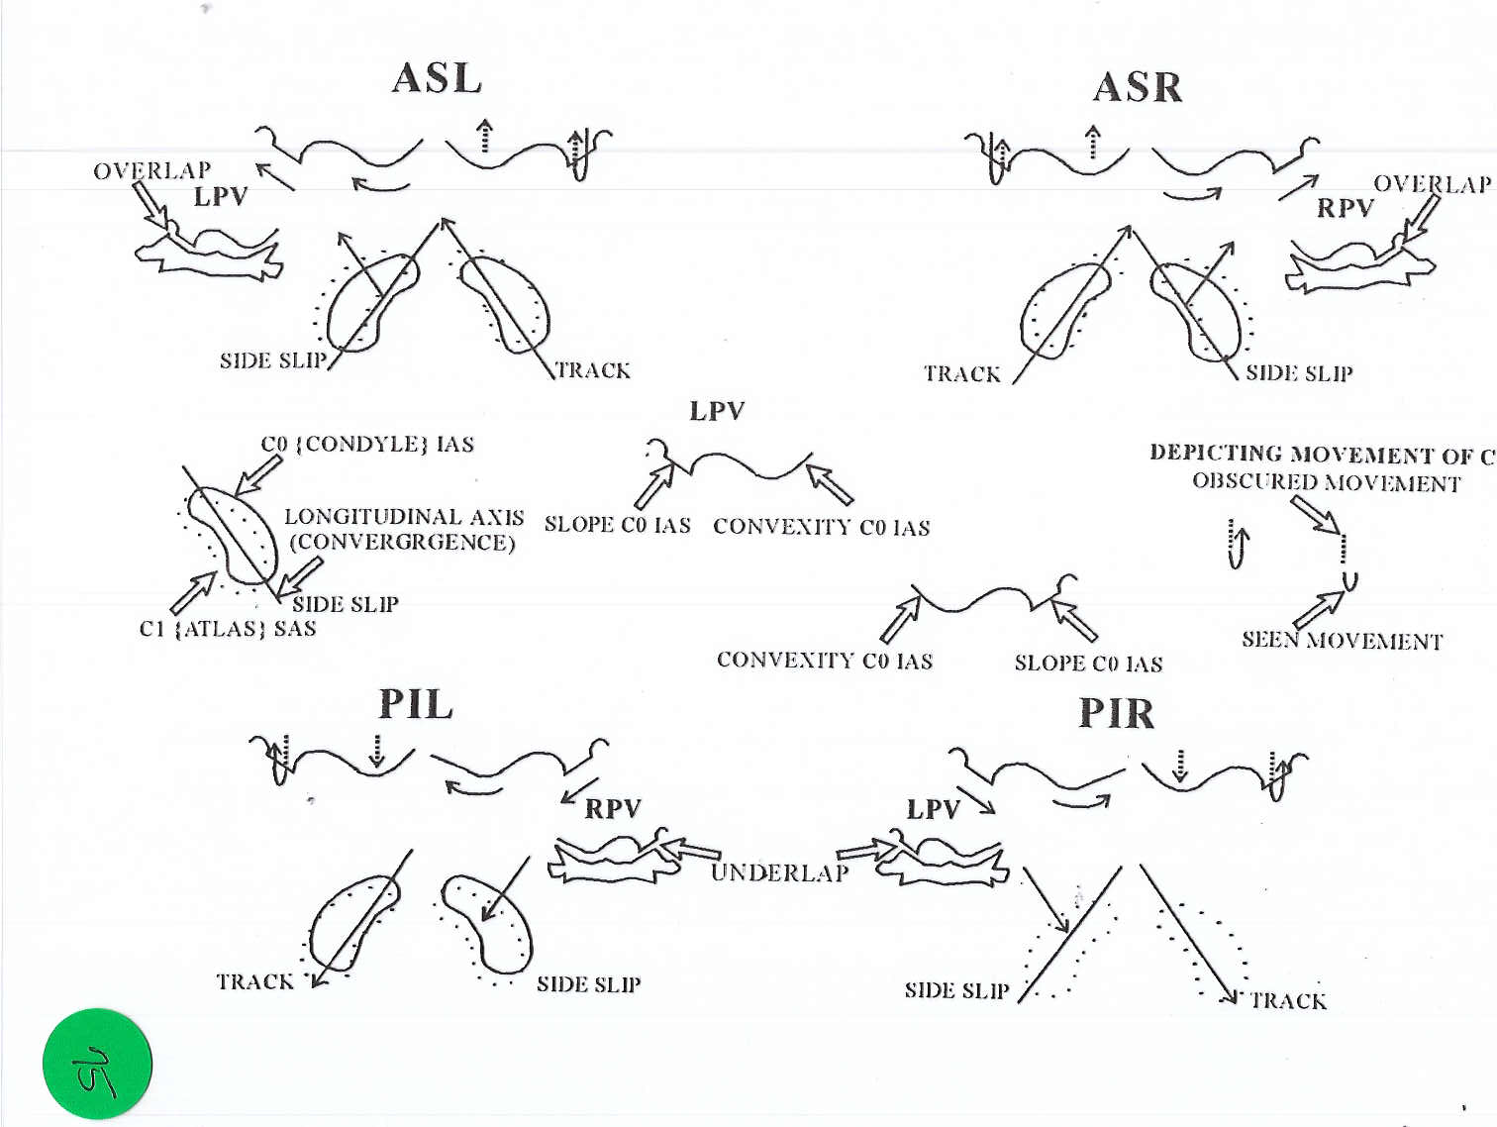

Slide 31
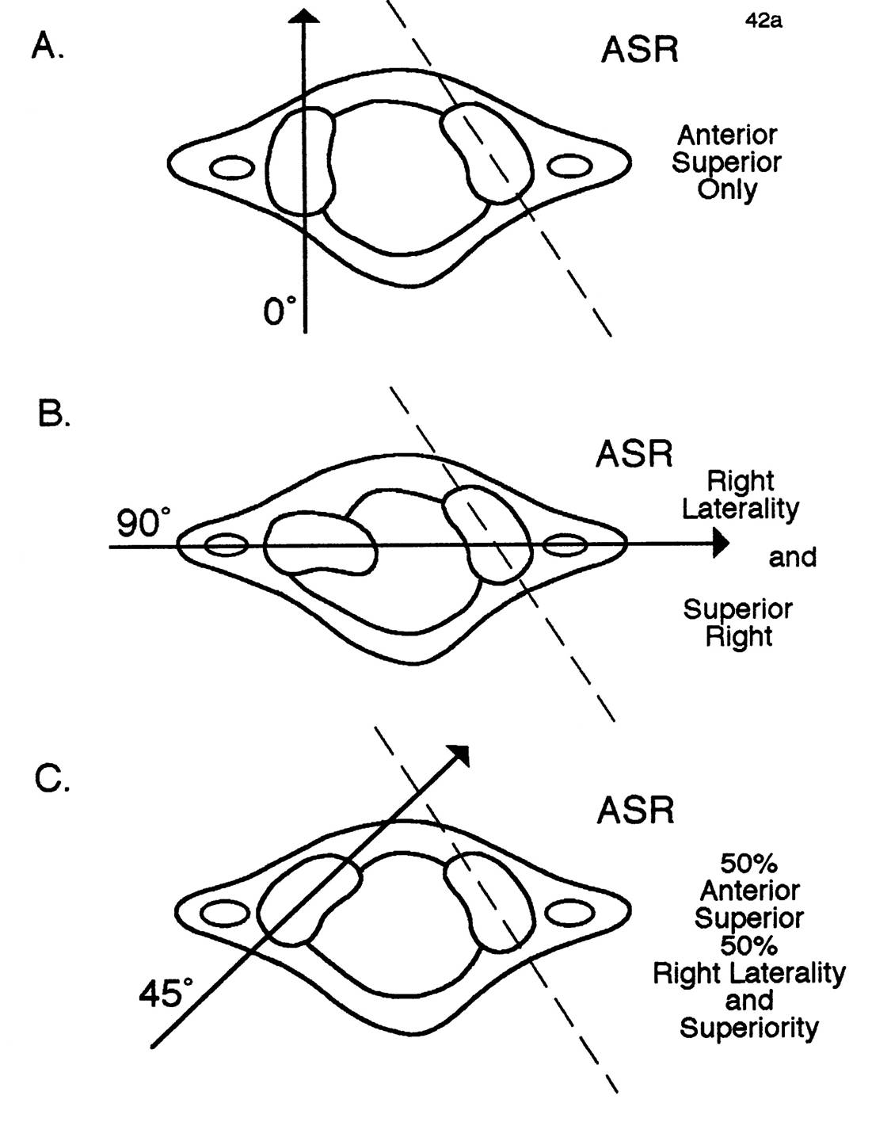

Slide 32
Viewing Blair Protractoviews (Always viewed from the posterior)

Slide 33
Viewing Blair Protractoviews

Slide 34
Viewing Blair Protractoviews

Slide 35
90 degree rule

Slide 36
90 degree rule

Slide 37
Overlap and Underlap
OVERLAP VS. UNDERLAP
An overlap seen on the left ‘must’ be an AS displacement.
An underlap seen on the right ‘must’ be an PI displacement

Slide 38
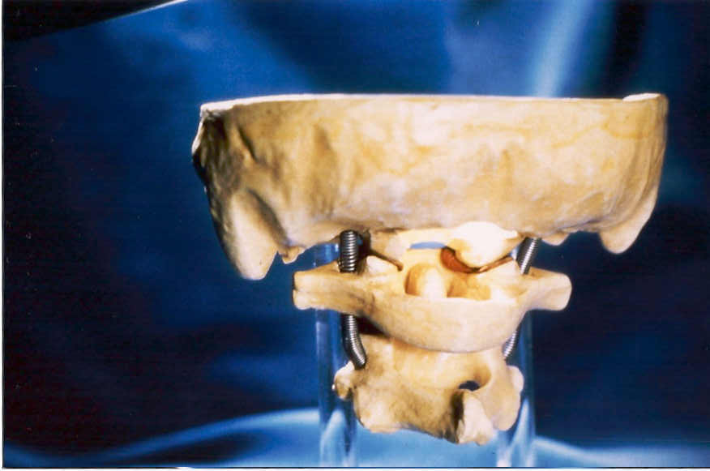
LEFT
OBLIQUE
BLAIR
VIEW

Slide 39
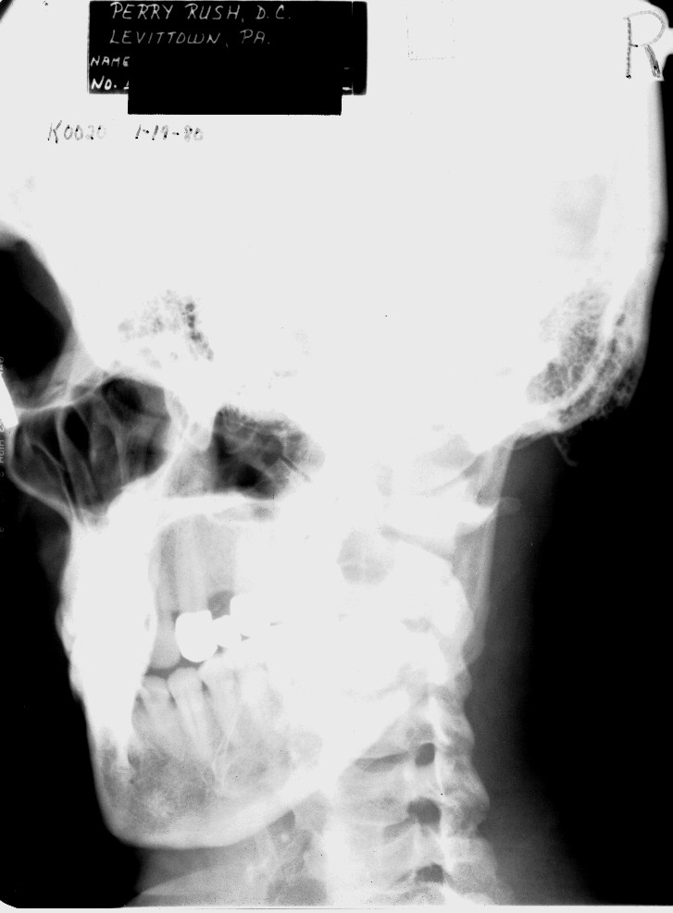
Then the patient is turned to see the true lateral aspect of
the articulation by looking
along the condyle convergence.

Slide 40
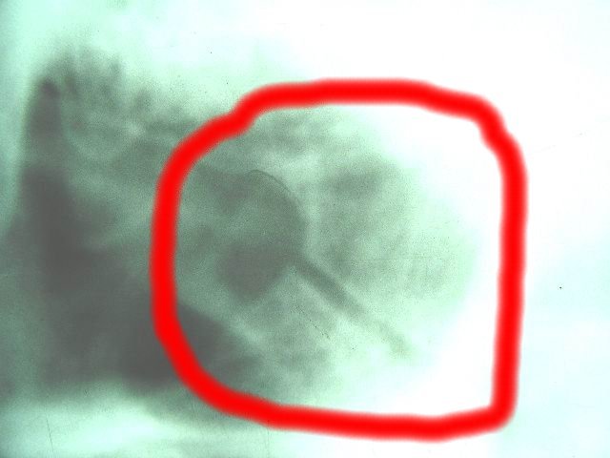
A closer look on one side

Slide 41
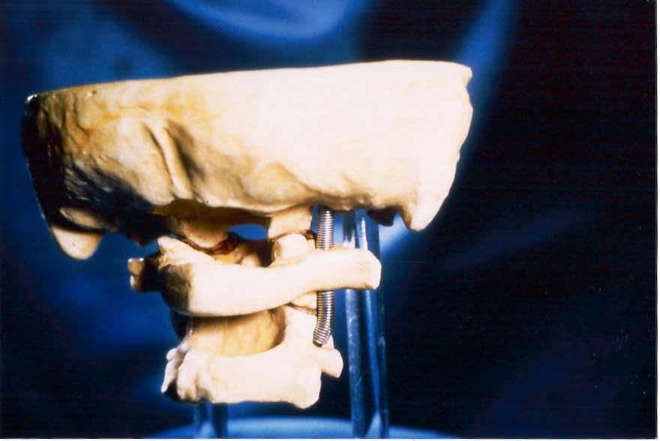
RIGHT
OBLIQUE
BLAIR
VIEW

Slide 42
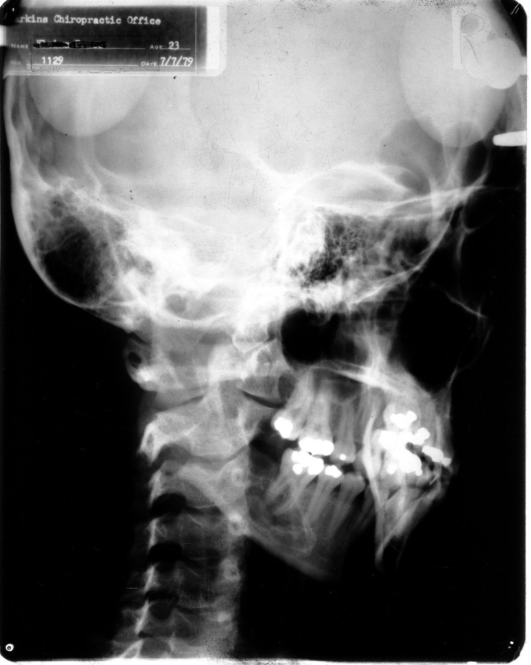
The patient is turned the other way to see the
the true lateral aspect of the other articulation.

Slide 43
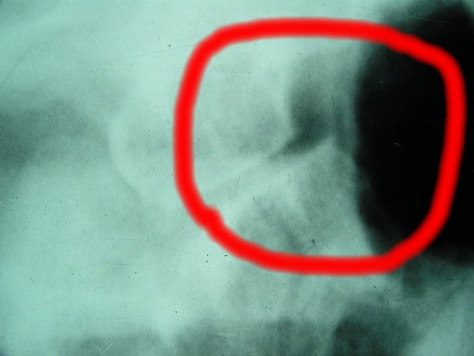
…and a closer
look on this
side

Slide 44
ASR
R
The direction of the arrow corresponds with atlas overlap and underlap. Note, whichever marker to which the arrow points will be the last letter of the listing.
L
PIL

Slide 45
ASL
L
R
PIR

