Slide 1
Blair hour 6 Marking the Base Posterior
The slides are properties of
Dr. Thomas Forest, Dr. Dennis Campbell, &
Dr. Todd Hubbard.
Certified Advanced Blair Instructors
They are not to be copied nor distributed

Slide 2
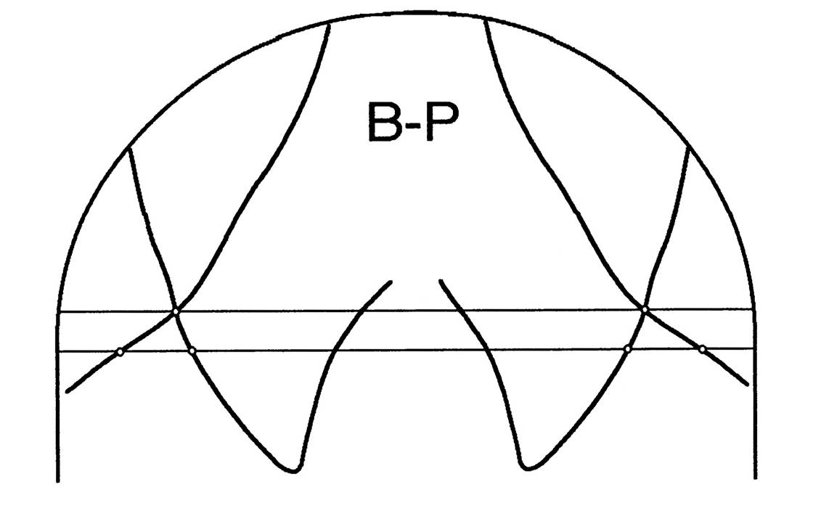
Check head
Tilt - - if more
Than 1/8” or 3.2 mm
Retake

Slide 3
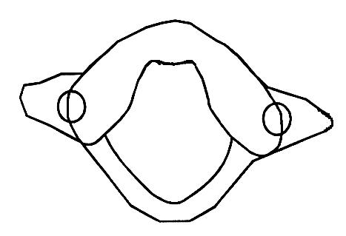

Slide 4
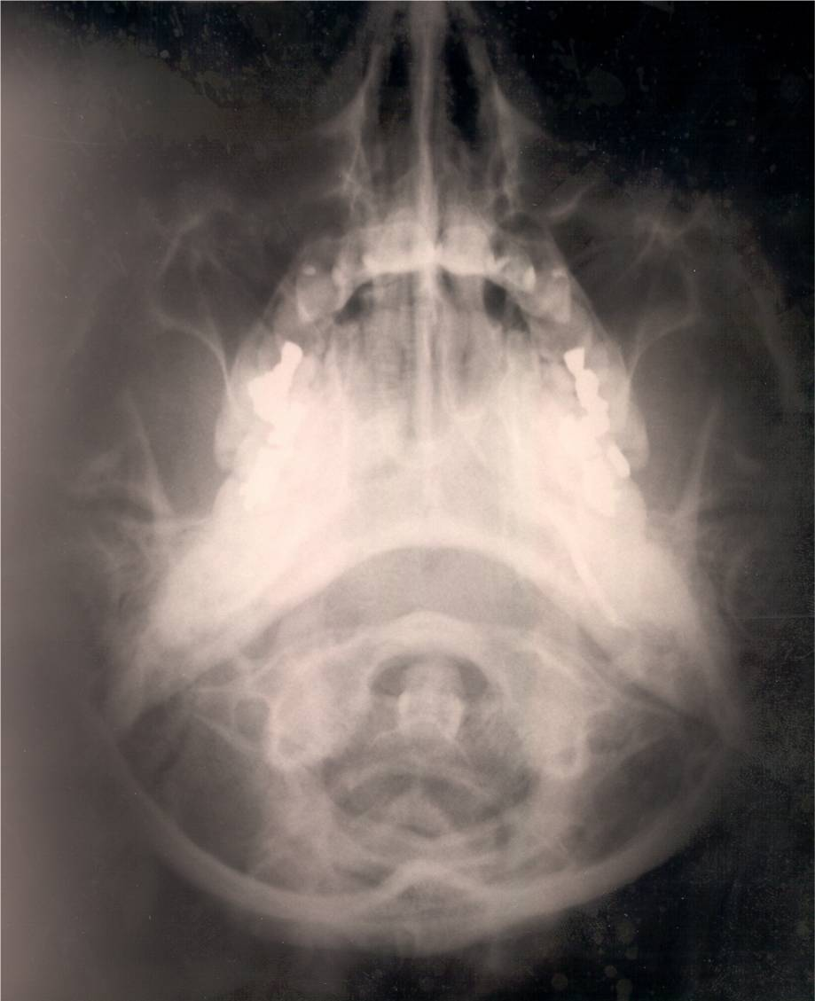

Slide 5
Marking the Base Posterior Place a dot on both the right and left region where the posterior, lateral anterior arch meets the medial, anterior lateral mass. This is anterior point 1.

Slide 6
ANT. PT 1
Anterior arch & medial border of lateral mass

Slide 8
Marking the Base Posterior Place a dot on the right and left area of the film where the medial aspect of the lateral mass meets the posterior arch. This is called posterior point 1.

Slide 9
ANT. PT 1
POST. PT. 1
Foramen magnum & posterior border of lateral mass

Slide 11
Marking the Base Posterior Draw a line connecting anterior point 1 to posterior point 1 and don’t draw beyond the dots.

Slide 14
Marking the Base Posterior Place a dotted line from the outer anterior arch on each side and trace the outer aspect of the lateral mass stopping at the transverse foramen

Slide 15
Trace anterior distal margin of lateral margin, stop at transverse foramen.

Slide 17
Marking the Base Posterior With a dotted line, trace the posterior lateral margin of the lateral mass from posterior point 1 to transverse foramen.

Slide 18
Mark outer posterior lateral mass to the transverse foramen.

Slide 20
Marking the Base Posterior Right where the dotted lines from the anterior & posterior aspects of the lateral mass meet at the transverse foramen, a slightly more opaque area will be seen in the foramen, dot that area to complete the outlining of the lateral mass.

Slide 21
Connect lateral edge of lateral mass at transverse foramen.

Slide 23
Marking the Base Posterior Draw a line perpendicular from anterior point 1 on R. & L. laterally until the line meets the lateral mass outer margin you just outlined. Where this line touches the lateral mass line represents anterior point 2. Do not go beyond the margin. Draw a similar line off of posterior point 1. to meet the lateral mass outer margin and posterior point 2.

Slide 24
Ant. Pt. 2
Post. Pt. 2
Draw a line perpendicular from 1-1 line to distal margin of lateral mass

Slide 26
Marking the Base Posterior Place a millimeter ruler on the anterior 1-2 line and mark the mid point with a dot and do the same with posterior 1-2 line on both sides.

Slide 27
Bisect points

Slide 28
Bisect points

Slide 29
Bisect points

Slide 30
Bisect points

Slide 32
Marking the Base Posterior Extrapolate a line from the inferior portion of your BP directly through the two bisection dots on anterior and posterior 1-2 lines on the right and extent your line through the ocular orbit. Do the same on the left.

Slide 33
Longitudinal axis of the condyles

Slide 36
Marking the Base Posterior Draw a line from ear plug to ear plug and not beyond. Choose like points on the ear plugs.

Slide 37
Ear Plug Line

Slide 39
Marking the Base Posterior Take your parallel and draw a line perpendicular to the ear plug line that crosses through the bisection of the lines drawn through the lateral masses. This line does not bisect the skull.

Slide 40
Ear Plug Line

Slide 41
Ear Plug Line

Slide 42
Ear Plug Line

Slide 43
EAR PLUG LINE

Slide 45
Marking the Base Posterior Taking your protractor, place the 0-0 line on the vertical line you have just drawn and measure the angle where the lateral mass converges to that line. This represent the R&L Convergence Angles. Write the angles on the bottom of the film on the side measured.

Slide 46
Ear Plug Line
33
35

Slide 47
EAR PLUG LINE
35
33

Slide 48
33
35

Slide 49
Marking the Base Posterior Place your parallel on the convergence angle and roll it laterally until you reach the outer margin of the lateral mass. Draw a line next to the convergence line to determine if you have a “clear window” to view C-1

Slide 50
Ear Plug Line
33
35

Slide 51
EAR PLUG LINE
35
33

Slide 52
33
35

Slide 53
Ear Plug Line
33
35

Slide 54
EAR PLUG LINE
35
33

Slide 55
33
35

Slide 63
2
1
3
4

Slide 64
2
1
1
3
2
4
3
4

Slide 67
End of marking bp

