Slide 1
Blair Concepts of Spinal Biomechanics
Atlas and Axis Motion
Argentina Blair class –section 3
Tom Forest

Slide 2
Dr. Blair’s Chiropractic Premises
Dr. Blair’s premise for analyzing the spine the way he did can be summed up in one question.
“If a misalignment happens at the joint,
why not take a picture of the joint to see the misalignment?”

Slide 3
Current Research Supporting the Blair Concept
CONCLUSION: The validity of vertebral joint assessment based on the assumption of facet symmetry is challenged, impugning certain chiropractic theories and/or techniques which rely on symmetry as being "normal." To achieve symmetrical function, the anatomical structure must be symmetrical. Since true structural symmetry does not exist, true symmetry of segmental movement may not be possible.
Absence of symmetry in superior articular facets on the first cervical vertebra in humans: implications for diagnosis and treatment. Gottlieb MS. J Manipulative Physiol Ther. 1994 Jun;17(5):314-20

Slide 4
3-D Torqued Subluxation
The movement of the vertebra toward juxtaposition in the adjustment is
three-dimensional.
The 3 locking mechanisms (slope, convexity and convergence) will cause the 3-D Torque in of the misalignment.

Slide 5
Volume 18
THE ADJUSTMENT SPECIFIC BJ Palmer
"Torqued subluxations" and "torqued alignments" involve THREE directions.
When the Chiropractor studies an A-P and lateral spinograph, and sees a vertebra that is off its natural planes, out of normal levels; is so wrenched, twisted, kinked, that it takes three distorted directions at one and same time - then he sees a "torqued“ subluxation.

Slide 6
BJ Palmer
no ADJUSTMENT is ever given unless THE TORQUED VERTEBRA IS UNTORQUED; until the three-direction locked vertebra is three-directionally unlocked; with its "staying-put value" in exact ratio as the three-directional production is reversed to a three-direction reduction; as the torque is untorqued; as the lock is unlocked.

Slide 7
Locking Mechanisms
Convergence
Slope
Convexity

Slide 8
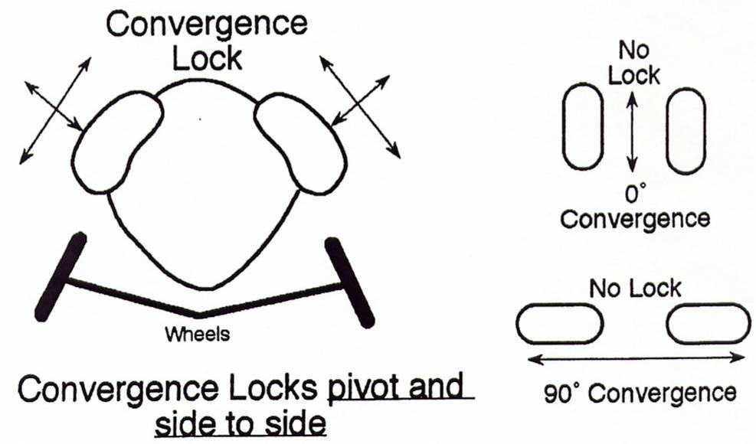
Convergence lock prevents rotation

Slide 9
Normal/Abnormal Motion
In his studies, it became apparent that the primary direction of misalignment of the atlas vertebra is anteriority or posteriority rather than laterally.

Slide 10
Convergence Angles
Atlas will track along the convergence angle when in segmental dysfunction.

Slide 11
Long Axis of Articulation of the Condyle
From Sherman College of Straight Chiropractic Web Site
The Base Posterior radiograph shows the anatomy of the occipital condyles and Atlas Lateral Masses, with the Foramen Magnum.
The Long Axis of the condyle is a straight line down the longest measure of the articulating surface of the condyle.
Right and Left Convergence angles.
Bisecting Long axis of the articulating Condyle.

Slide 12
Measuring the Convergence Angles
L
The long axis of the Occipito-Atlantal articulation.
The Blair Protracto view is taken with the central ray aligned to the respective convergence angle.
Left convergence
Right Convergence

Slide 13
Slope lock prevents lateral movement

Slide 14
Slope Angles
Side slip locking mechanism

Slide 15
Lateral Slope Angles
Lateral Slope angles
Prevent a true lateral
Sliding of the Atlas on
Occipital condyle.

Slide 16
Measuring Slope Angles

Slide 17
Take out your copy of the R & L Blair PVs and your ruler, protractor, and marker.

Slide 18
Measuring Slope Angles
Slope = The lateral locking mechanism of the Occipitoatlantal articulation
Left Protracto View
Right Protracto View
Left Slope Angle
Right Slope Angle
0-0 line
The slope angle will be measured on the side the chin is pointed toward

Slide 19
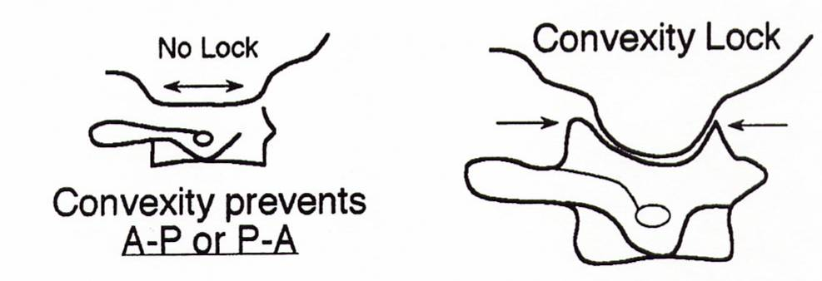
Convexity lock prevents A-P movement

Slide 20
Convexity Angles
Stops the Atlas from moving straight anterior or straight posterior

Slide 21
Occipital Condyle Convexity
Influence of the Anterior and Posterior rotation around the x-axis
Rotates around the x axis

Slide 22
Convexity Angles
Convexity = The Anterior and Posterior locking mechanism of the Occipito-atlantal articulation.
The convexity angle is measured on the side opposite of the chin
Right Convexity Angle
Left Convexity Angle
0-0 line
Left Protracto View
Right Protracto View
Convexity Angle = Posterior 1/3 of the inferior articulating surface of the Occipital Condyle

Slide 23
Blair Concept of Atlas Motion

Slide 24
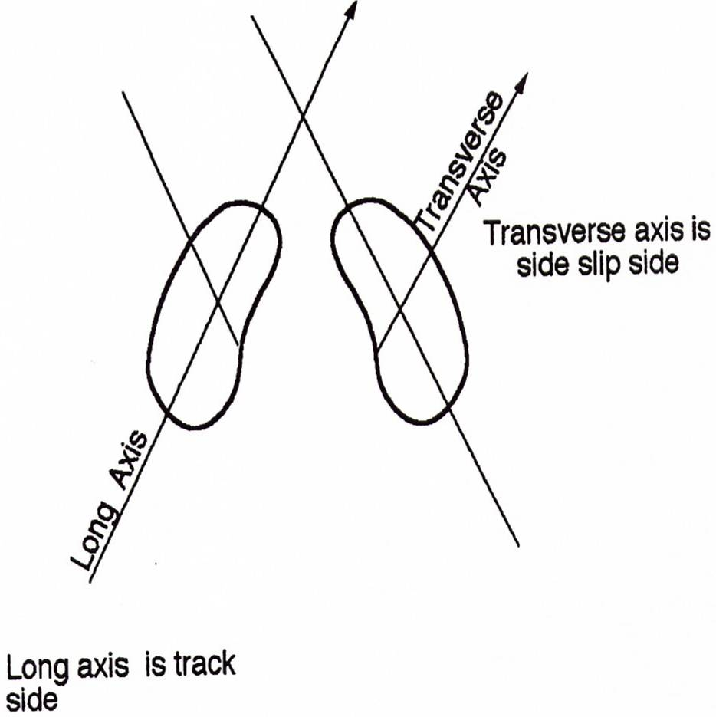
Atlas tracks along one condyle and slips off the other
Notes:
Show overhead after this

Slide 25
The Atlas Track

Slide 26
This “Tracking and Sliding”…
Allows us to see a true overlapping or under lapping at the edge of the articulation not otherwise seen on conventional views.

Slide 27
When the misalignment is to the anterior, it is simultaneously misaligned to the superior and lateral.
ASL
ASR

Slide 28
C-0
When atlas moves
anterior on the occiput
C-1
..it has to move
superior too
...because of the condyle convexity.

Slide 29
When the misalignment is to the posterior, it is simultaneously misaligned to the inferior and lateral.
PIL
PIR

Slide 30
C-0
When atlas moves
posterior on the occiput
C-1
..it has to move
inferior too
...because of the condyle convexity.

Slide 32
Anterior Sup. & Posterior Inf. Motion

Slide 35
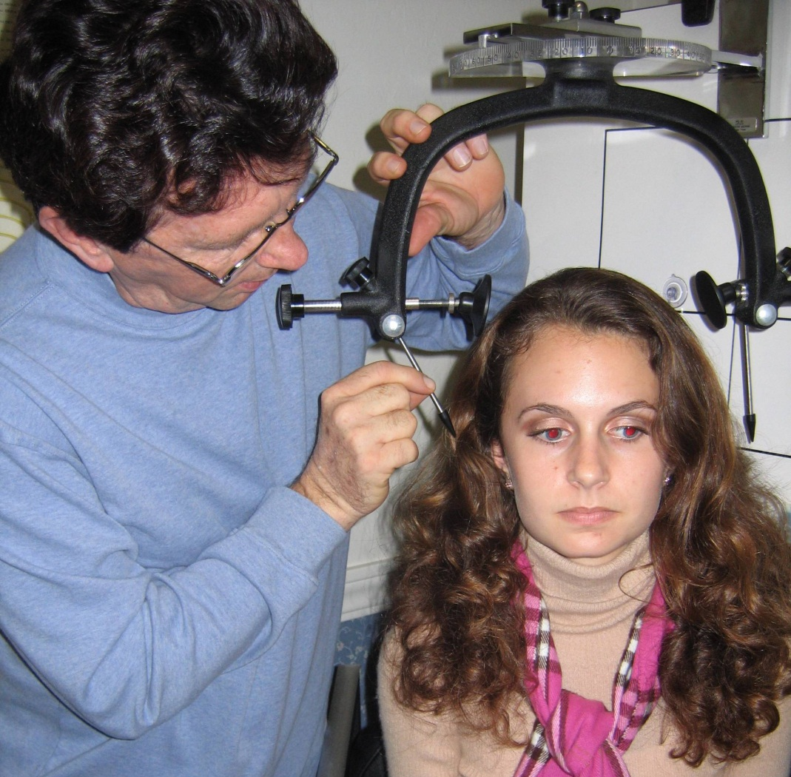
Solving problems with custom made views adds to the excellence we strive
strive
for in
subluxation
correction.

Slide 36
Left Blair
Protracto-
view LPV(semi- oblique) taken through the right maxillary sinus

Slide 37
Right Blair Protracto-view (RPV) taken through the left maxillary sinus.

Slide 38
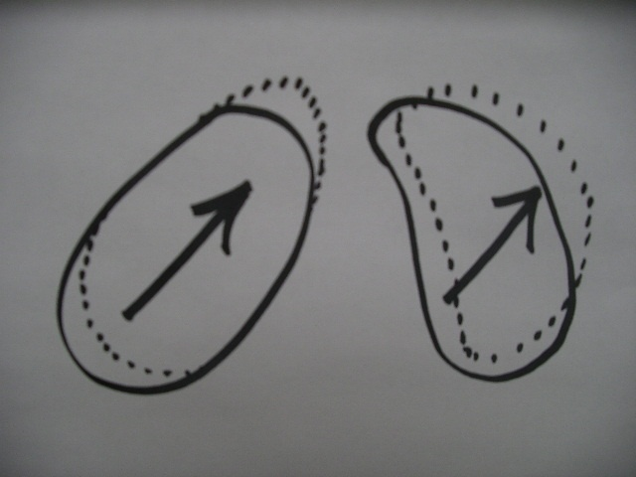

Slide 39
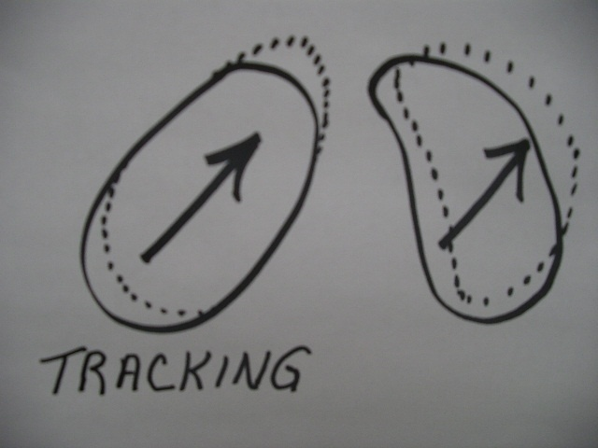

Slide 40
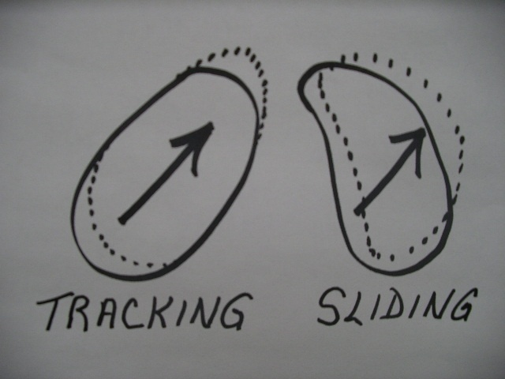

Slide 41
SLIP C-0-1 JOINT WILL SHOW A MEASURABLE DISPLACEMENT ON X-RAY.

Slide 43
TRACK SIDE OF C-0-1 JOINT WILL SHOW NO LATERAL OR MEDIAL OFFSET
AT THE LATERAL MARGIN OF THE ATLANTO-OCCIPITAL ARTICULATION.

Slide 44
TRACK SIDE OF C-0-1 JOINT WILL SHOW NO LATERAL OR MEDIAL OFFSET
AS THE SEGMENT HAS MERELY MOVED ANTERIOR AND SUPERIOR.

Slide 45
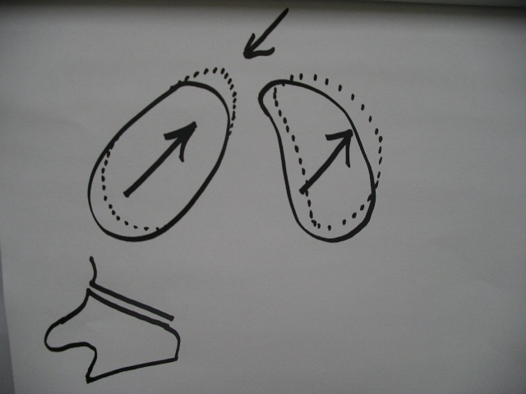

Slide 48
SLIP C-0-1 JOINT WILL SHOW A MEASURABLE DISPLACEMENT ON X-RAY.

Slide 49
SLIP C-0-1 JOINT WILL SHOW A MEASURABLE DISPLACEMENT ON X-RAY AS THE SEGMENT HAS MOVED ANTERIOR, SUPERIOR, AND RIGHT.

Slide 50
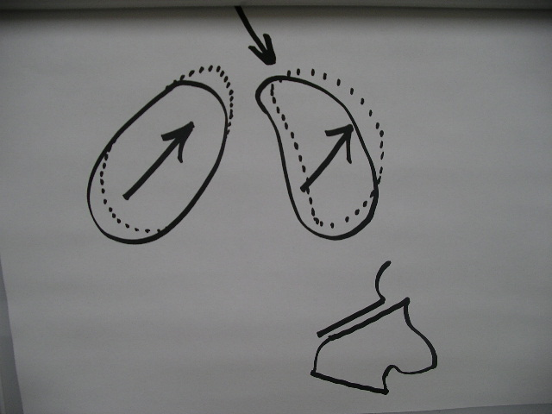

Slide 51
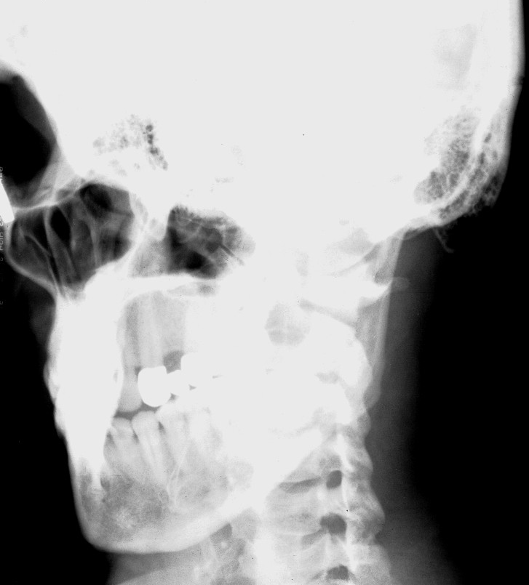
ASL
L
R
PIR

Slide 52
ASR
PIR
PIL
R

Slide 53
50 degree convergence angle

Slide 54
45 degree convergence angle

Slide 55
50 degree convergence angle

Slide 56
45 degree convergence angle

Slide 57
Is it Laterality?
The primary movement of the atlas in subluxation is anteriority and/or posteriority.

Slide 58
APOM
The “Blair” APOM is similar to the PUC open mouth.
Cephalic tube tilt at (about) 10º.
Central ray goes through a point ¼ inch above the lower molar and the transverse process of atlas.

Slide 59
Obstructed TP

Slide 60
Base Posterior
Taken with buckey 90 degrees to tube.
To obtain Convergence angles.
Only film taken where patient can be moved out of normal head tilt.

Slide 61
Marked BP-Convergence Angles
Bisected condyle give convergence angles.
Used for angles to take Protracto View.
Used for Line of Drive adjusting angles for C1.

Slide 62
Taking the Base Posterior
Patient is placed in the posture constant chair with their hips all the way back against the back of the chair.
The knees and ankles are moved to the side posts of the chair to allow room for the tube.

Slide 63
Taking the Base Posterior
Buckey and Tube are 90º to each other.
Tube is at 48 inched FFD.
Absolutely NO head tilt.
Taken with the central ray through the center of the mandible and the EAM.

Slide 64
Finish Biomechanics

