Slide 1
Why Upper Cervical?
Life West, hour 2.5
Drs. Campbell & Forest

Slide 2
Why Upper Cervical?
The upper neck area is the most mobile section of the spine. Increased mobility results in decreased stability. Thus this region is quite prone towards displacing and locking in the wrong position.

Slide 5
WHY IS UPPER CERVICAL SO IMPORTANT?
The top two vertebra in the spine are the only ones that don’t have the means of self-correcting. (This is because the muscle that provide positioning of the atlas and axis receive their nerve supply from nerves that pass through the C-1 & 2 segments)
Segments below axis receive their nerve supply to muscles supporting and surrounding them from segments both above and below and therefore have the means to self correct.

Slide 6
WHY IS UPPER CERVICAL SO IMPORTANT?
In other words, changes that take place in other sections of the body merely represents how the body has been forced to adapt to a neck injury. Rather than repeatedly manipulating a misaligned hip only to have it slip out a few days later, the Upper Cervical adjustment allows the body to reposition the hip to its natural position in the correct sequence and the proper speed, thus the hip stays positioned more permanently.

Slide 7
The C-1 nerve root and it’s relationship to vectored adjusting Hugh Crowe, DC, Keith Crowe, BS, DC, CRJ Vol VI, No. 1, Spring 1999
Although the opening through which C-1 passes is not boney, as it is in other areas of the spine, it still may “traction” or disturb the nerve root sufficiently to affect its function and thus the function of the muscles that move the atlas…
That interference in turn affects the normal action of muscles that hold the atlas in its normal position, resulting in the self-perpetuating subluxation. This subluxation can only be effectively reduced by vectored adjustment.
Since muscle tissue has abundant nerve supply, joint dysfunction can cause muscles to spasm, or become hypertonic, often compensatory for disturbances below, i.e., the entire cervical region with full body implications.

Slide 9
Monkey experiments
Early in practice in an attempt to share with local MD’s that UC displacement can impact the alignment of the pelvis, a neurologist shared a story from his medical college days. He said: “I know exactly what you are talking about. We did research at the university in which we pushed a stylus the size of a pencil into the brain stem of monkeys. In each of them, the arm drew up claw-like across the chest and the pelvis locked in an severely elevated position.” (We’ve all seen people walking down the sidewalk with this syndrome, permanent spinal cord damage).
Then he said, “We took a second group of monkeys and irritated but did not damage the brain stem cell and those monkey had a shoulder contracting and a hip contracting.”...something we see ALL the time.

Slide 10
Monkey experiments
Lesioning Alternative Primate Subcortical Spinal Motor Tracts
The inability to completely paralyze monkeys, even with bilateral pyramidal lesions, suggests the existence of alternative descending pathways that are important for voluntary limb function. 37,38
After the monkeys recovered from bilateral pyramidotomies, Lawrence and Kuypers 37,45 performed additional lesioning of anterior or lateral subcortical spinal pathways to further delineate the influence of these alternative tracts on motor function. Subcortical pathways were separated into medial (eg, vestibular nuclei and pontine/medullary reticular formation) and lateral (eg, pars magnocellularis of the red nucleus) nuclear origins within the brainstem. Terminations of these fiber tracts were on interneurons of the spinal cord. Medial lesions did not worsen distal hand function, whereas lateral lesions exacerbated distal forelimb dysfunction. Remarkably, these monkeys had little difficulty in standing and walking. 37. Lawrence DG, Kuypers HG. The functional organization of the motor system in the monkey. I. The effects of bilateral pyramidal lesions. Brain. 1968;91(1):1-14. 45. Lawrence DG, Kuypers HG. The functional organization of the motor system in the monkey. II. The effects of lesions of the descending brain-stem pathways. Brain. 1968;91(1):15-36.

Slide 11
What is a normal cervical curve? This would be perceived as a hyperlordosis.

Slide 12
What is a normal cervical curve? Note on closer inspection that the articular pillar is malformed producing a hyperlordotic curve that is actually normal for this patient.

Slide 13
What is a normal cervical curve? Note the condyle is posterior causing a normal kyphosis.

Slide 14
What is a normal cervical curve? Note the condlye faces directly down making a hypolordosis normal for this individual.

Slide 15
What is a normal cervical curve? Note the anterior head bearing due to acquired cervical spinal stenosis.

Slide 16
What is a normal cervical curve? Note the superior condyle that creates what appears to be an AS C-1 subluxation and an S shaped curve that may be normal for this individual.

Slide 17
Chiropractic Clinical Controlled Research Volume XXV B.J. Palmer 1951
HEALING TAKES TIME
“As a subluxation produces pressure, inflammation, friction, and adaptative cicatrix or scar secondary pressure-interference is set up, so does a subluxation produce pressure, pathology of the spinal cord, shrinking it in size, shape, circumference…
After which it may take weeks of months for Innate Intelligence to break down scar tissue or rebuild normal size of spinal cord so mental impulses could GET THRU THE SCAR TISSUE.”

Slide 18
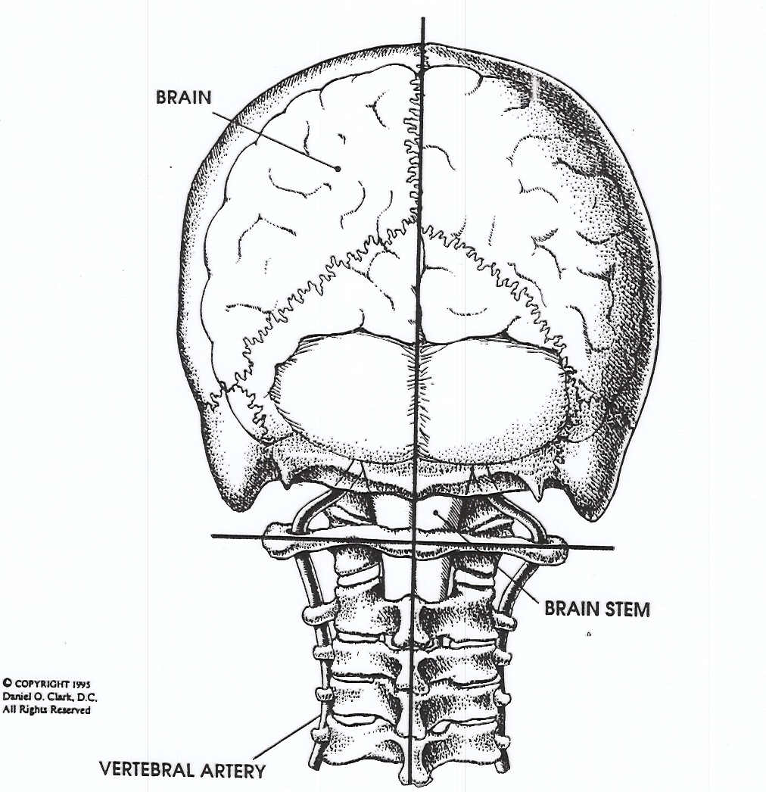
Joint ligaments
are made of
Type 1 collagen
fibers, strongest
in the body.

Slide 19
When stretched
20-40% the fibers
tear and are replaced
by Type III, some of
the weakest supporting fibers in the body.

Slide 20
Structure and Function-The Role of the Nervous System Journal of Orthopaedic Medicine K. Lewit
Asymmetry in vertebra develops during growth as a consequence of asymmetrical muscle pull.”
Lewit states, however, that in understanding function you need to put more emphasis on muscle function, which is under direct control of the nervous system, rather than passive structures such as bone, joints, and ligaments, important though these are also.
Lewit’s colleague Volejnikova H (2001) studied female fertility problems in 166 participants, divided into 5 groups. The first and fifth received spinal manipulation, massage, and stretching. 1st and 5th groups had a 34.3% and 27.4% success in becoming pregnant. The remainder of the groups had an 8.8%, 8.1% and 8.3% success rate. The Chiropractic Report January 2003

Slide 21
Limits to Motion Palpation
Manual palpation techniques have been used for more than a century to assess joint motion. While articular facet asymmetry of the upper cervical spine has been considered in relation to joint disease, the effects of such asymmetry of joint motion requires further investigation. To that end, six human cervical spine specimens explored motion palpation of joint restriction and implied link to disease at the C-1,2 level. Forces (5-23N) were applied around the mediolateral axes and the corresponding displacement along the three axes was recorded.

Slide 22
Results: Each of the six specimens demonstrated different behavior and different degrees of asymmetry; and asymmetrical discontinuous force- displacement correlations were linked to anatomical asymmetry which appeared to be of natural occurrance.
The authors caution that clinicians attempting to palpate vertebral motion should not assume that perceived restriction indicates pathological motion, it may in fact be normal anatomy. The results of this study challenge the assumptions of palpation theory that joints are symmetrical and therefore should feel symmetrical on motion palpation.
Ross JK, Bereznick DE McGill SM “Atlas-axis facet asymmetry: implications in manual palpation” Spine June 15, 1999:24 (12) pp 1203-1209

Slide 23
Cross Section of the Spinal Cord

Slide 24
Dentate Ligament Cord Distortion Hypothesis It is probable that the elasticity of the dentate ligament dissipates with some stress, but chronic tension on a ligament may produced thickening and strengthening of the ligament, decreasing the ligament’s ability to damp the distortive forces before they can deform the cord. Kirk Eriksen, Upper Cervical Subluxation Complex

Slide 25
HERE YOU SEE THE LOCKED ATLAS, COMPRESSED NERVES, AND DAMAGED LIGAMENTS.
When stretched
20-40% the fibers
tear and are replaced
by Type III, some of
the weakest support-
ing fibers in the body.

Slide 26
Why X-ray?
If you can’t see it, you can’t fix it!

Slide 28
NOTE THE ABOVE TITLE OF THE ARTICLE

Slide 29
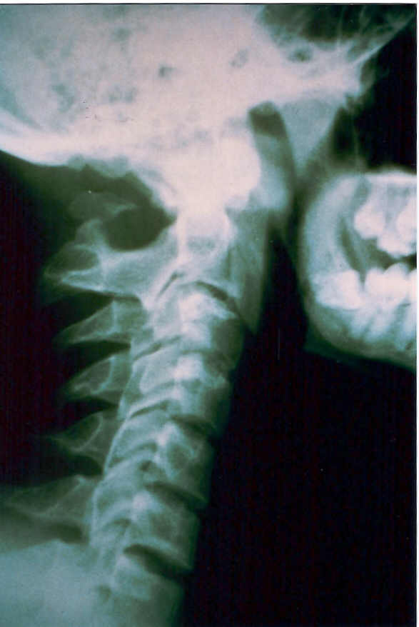
NEUTRAL
LATERAL
X-RAY.
DO YOU SEE
ANY REASON
NOT TO
ADJUST?

Slide 30
NEUTRAL
LATERAL
X-RAY.
DO YOU SEE
ANY REASON
NOT TO
ADJUST?
ABSENT POSTERIOR ARCH WITH POSTERIOR TUBERCLE FUSED TO AXIS SPINOUS.

Slide 31
THIS X-RAY
REVEALS
BOTH A
CLEFT ANT.
AND POST.
ARCH

Slide 32
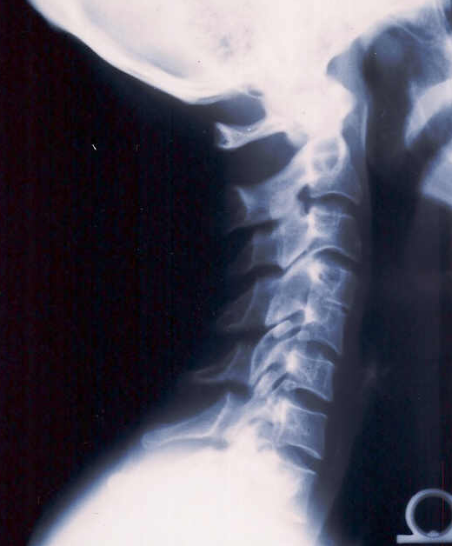
LATERAL
C-SP X-RAY
WITH C-4,5
FUSION

Slide 33
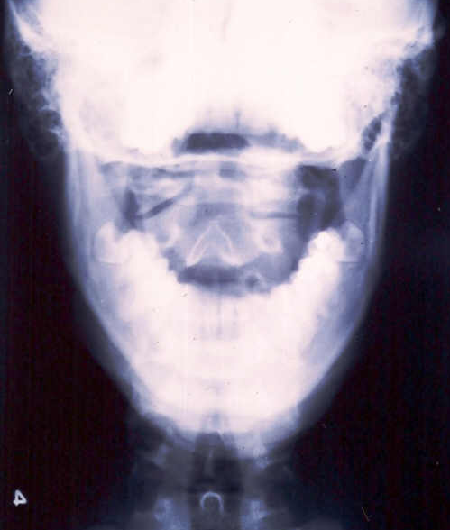
A-P OPEN
MOUTH
WITH A
MALFORMED
R. C-2 BODY

Slide 34
LATERAL
C-SP X-RAY
WITH FX OF
C-2 SPINOUS

Slide 35
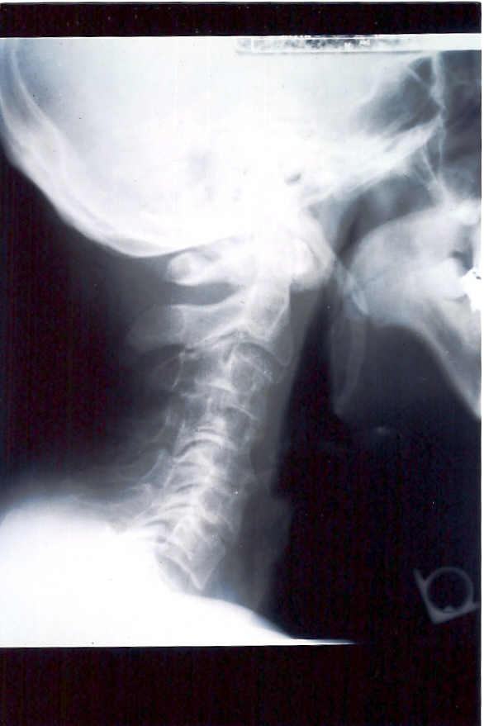
LATERAL
C-SP X-RAY
WITH
ELONGATED
STYLOID
PROCESS

Slide 36
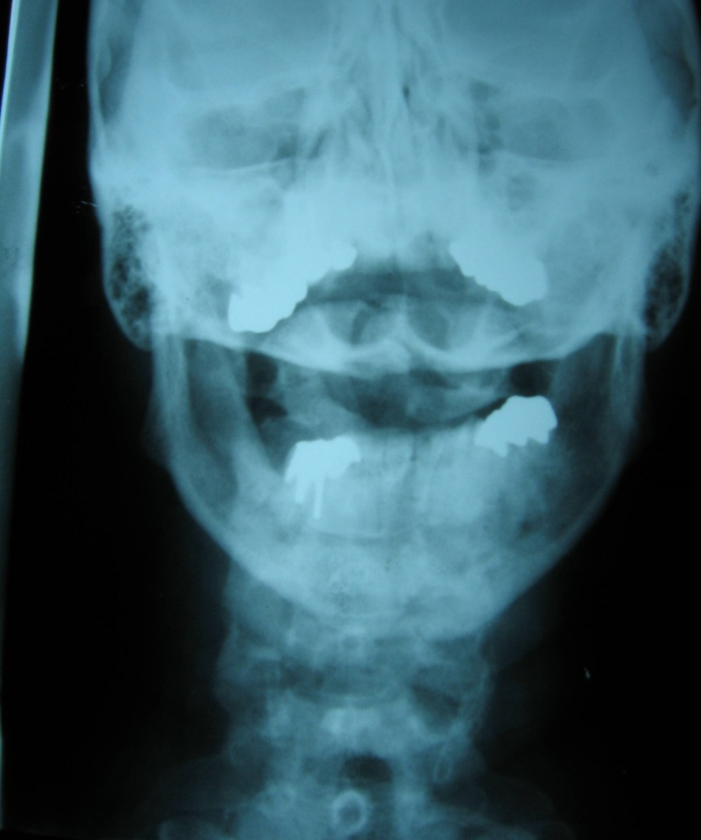
Why x-ray
L. Post. arch
R. Post arch

Slide 37
LATERAL
C-SP X-RAY
WITH FX OF
C-2 SPINOUS

Slide 38
LATERAL
C-SP X-RAY
WITH
ELONGATED
STYLOID
PROCESS

Slide 39
Why x-ray
R. Post arch
L. Post. arch

Slide 40
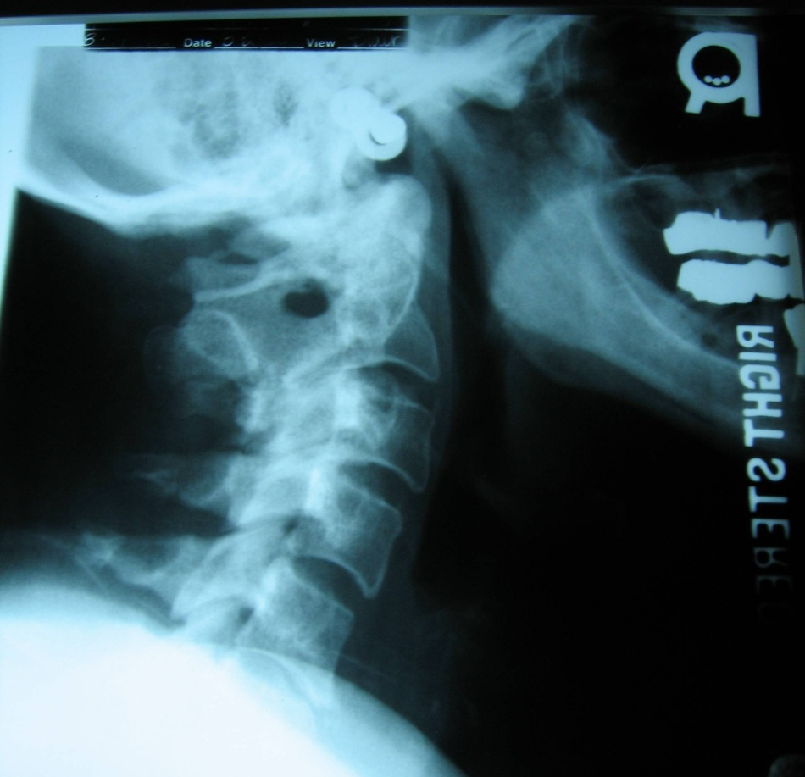
Why x-ray?

Slide 41
Why X-ray?

Slide 42
Why X-ray?

Slide 43
Where do you adjust?

Slide 44
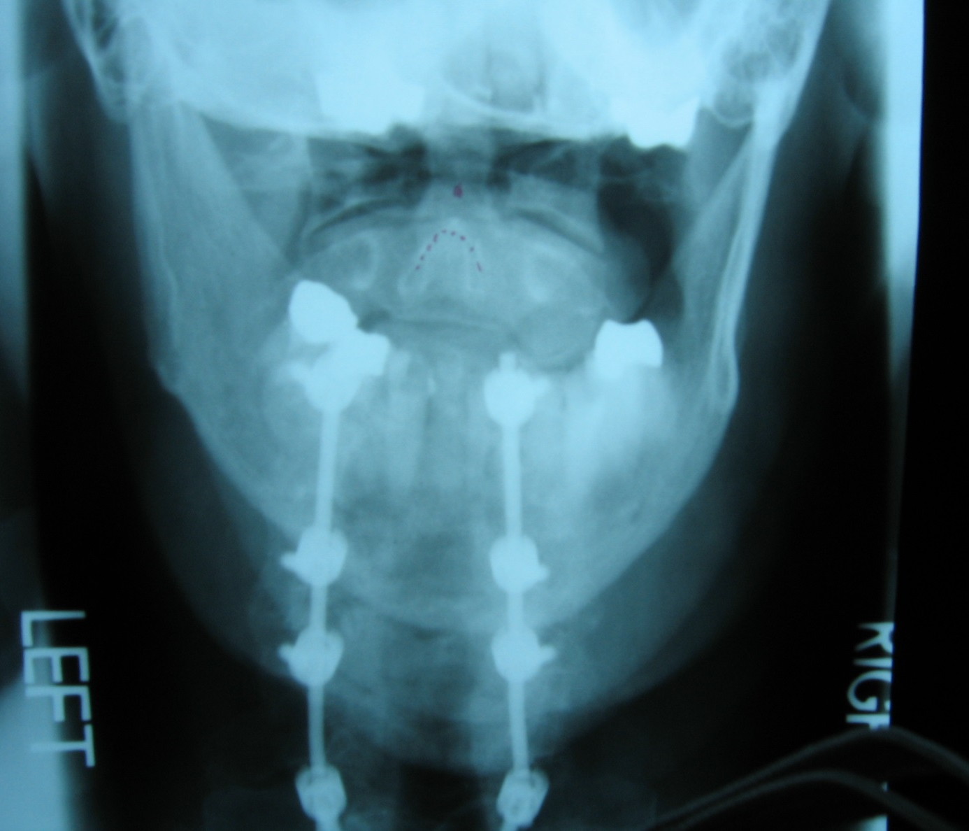
APOM VIEW OF PATIENT WHO HAD STROKE ON THE OPERATING TABLE WHILE HAVING ORTHOPEDIC SURGERY ON HIS CERVICAL SPINE.

Slide 45
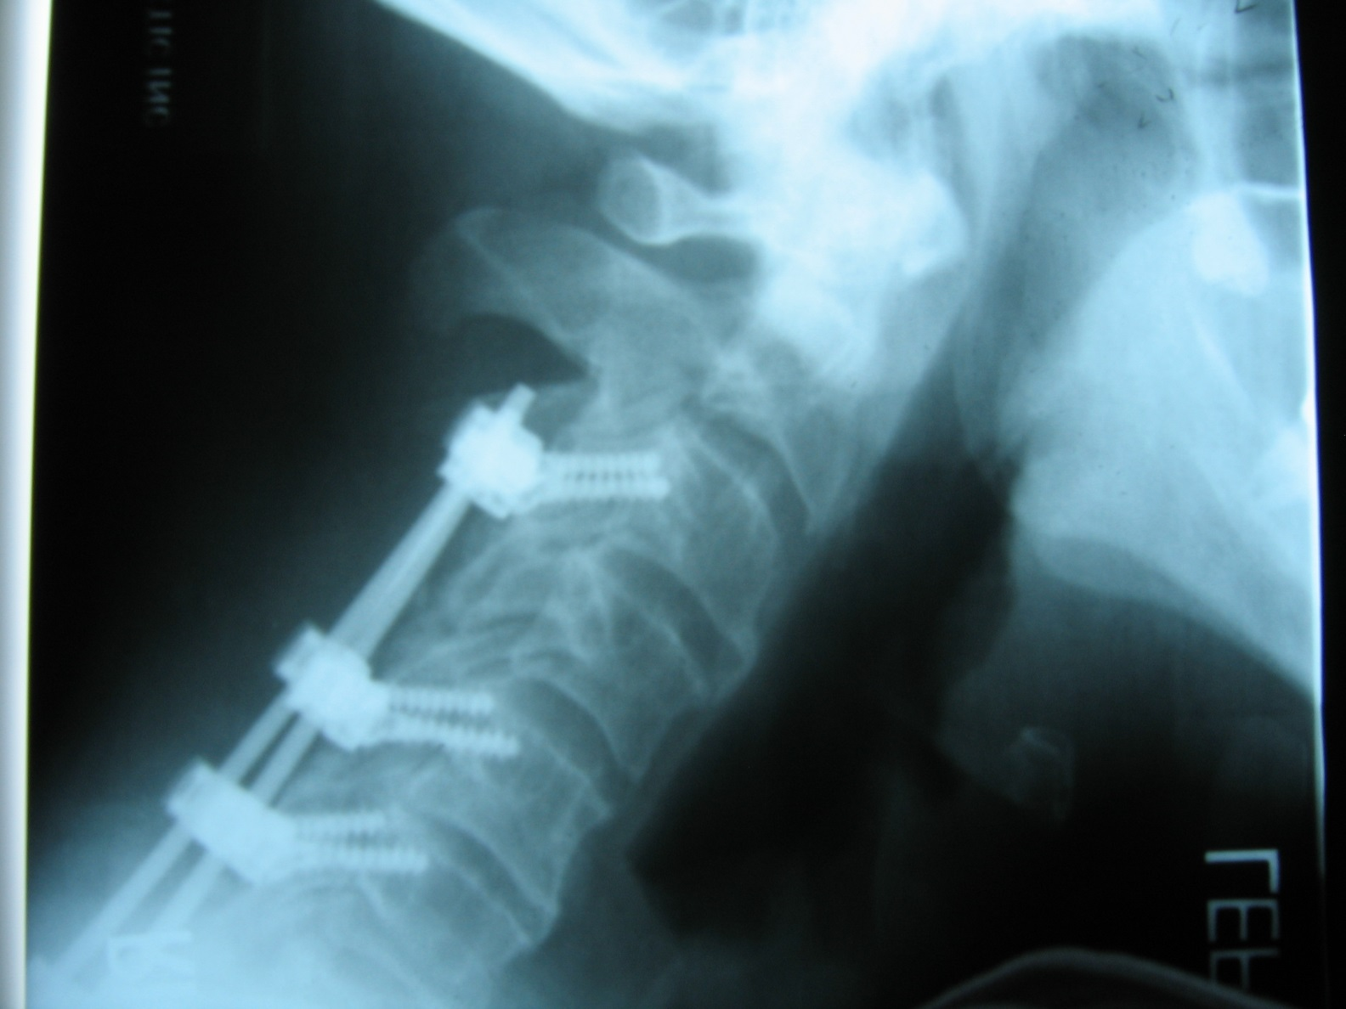
SURGICAL FUSION OF C-3 TO C-7 AIMED AT RESOLVING RIGHT BRACHIAL NEURALGIA, IT DIDN’T! CHIROPRACTIC DID!

Slide 46
Find it, Fix it, and Leave it Alone

