Slide 1
Asymmetry is an Abnormal Finding
The slides are properties of
Dr. Thomas Forest, Dr. Dennis Campbell,
Dr. Todd Hubbard, and Dr. Perry Rush
Certified Advanced Blair Instructors
They are not to be copied nor distributed

Slide 2
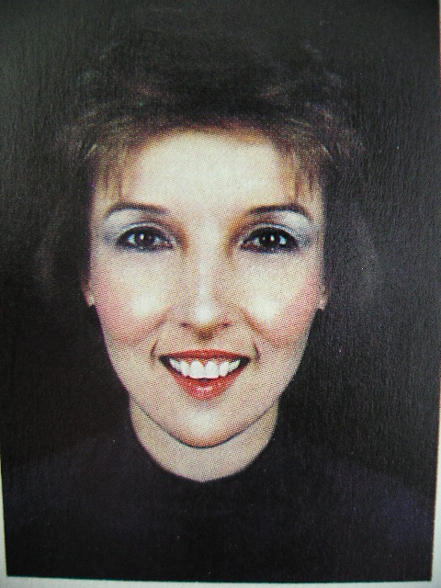
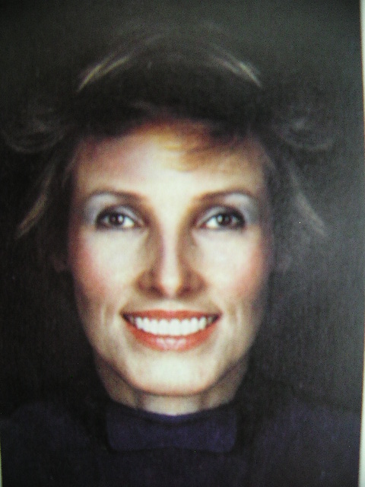
Jenny
Anne

Slide 3
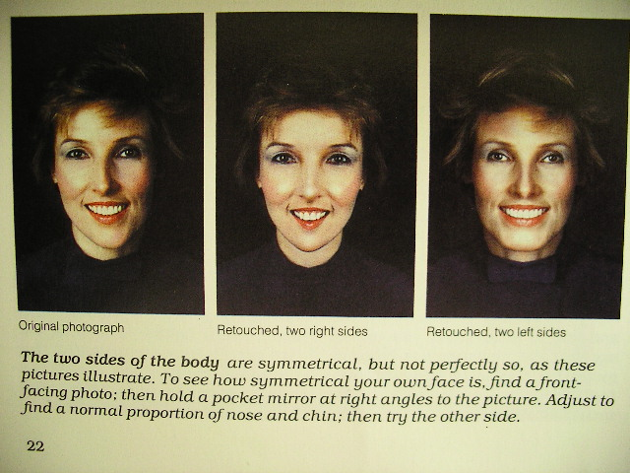
Jenny Anne
Jenny
Anne

Slide 4
Dr. William G. Blair, D.C., Ph.C.
Based on his meticulous x-ray studies, Dr. Blair came to certain conclusions:
The right and left side are not symmetrical.
Opposing surfaces of the joints do match.
Therefore Dr. Blair surmised:
Dottie Blair, Progress in Chiropractic by Steven J. Boyle

Slide 5
Dr. William G. Blair, D.C., Ph.C.
“We are not looking for the perfectly straight spine, we are looking for the perfectly articulated spine.”
Dottie Blair, Progress in Chiropractic by Steven J. Boyle

Slide 6
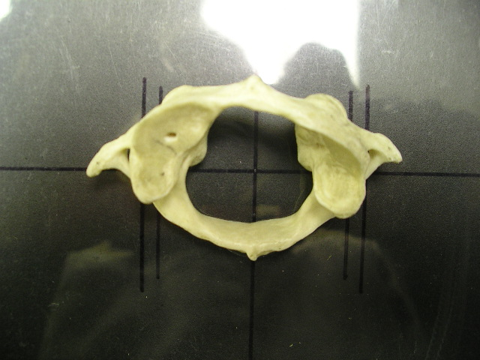
Study this picture!
Notice how asymmetrical the atlas is!

Slide 7
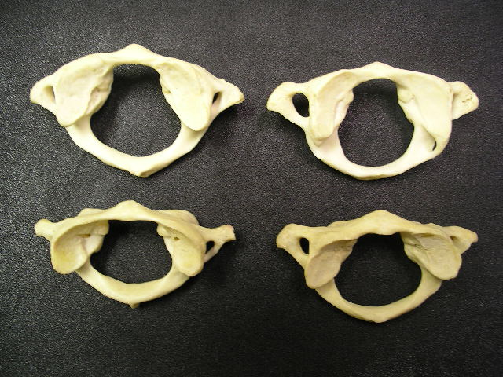
And this picture!
Notice how asymmetrical they are!

Slide 8
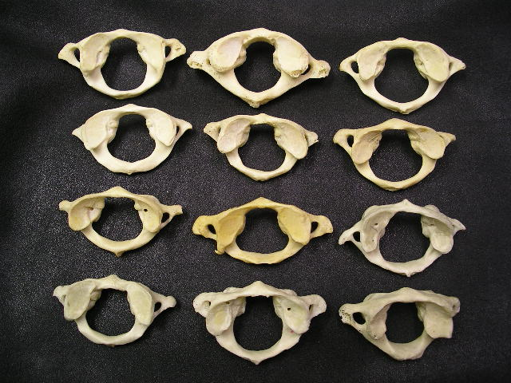
And this picture!

Slide 9
..and the implications to chiropractic
analysis! (X-ray,
boney, muscle,
and motion palpation)

Slide 10
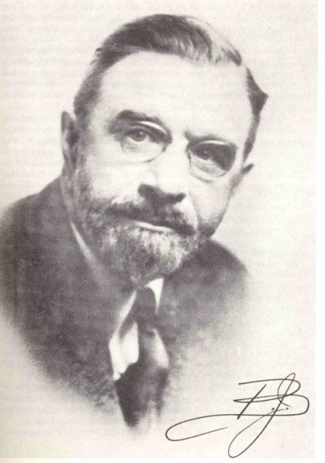
From 1930 until his death
B.J. placed great emphasis on the
upper cervical spine.

Slide 11
B.J. was constantly researching
better ways to improve the
the science of vertebral subluxation
analysis and correction.
The B.J. Palmer Spinographic
Research Department published
numerous articles identifying
the effect of “malformations”
on x-ray misalignment interpretation.

Slide 12
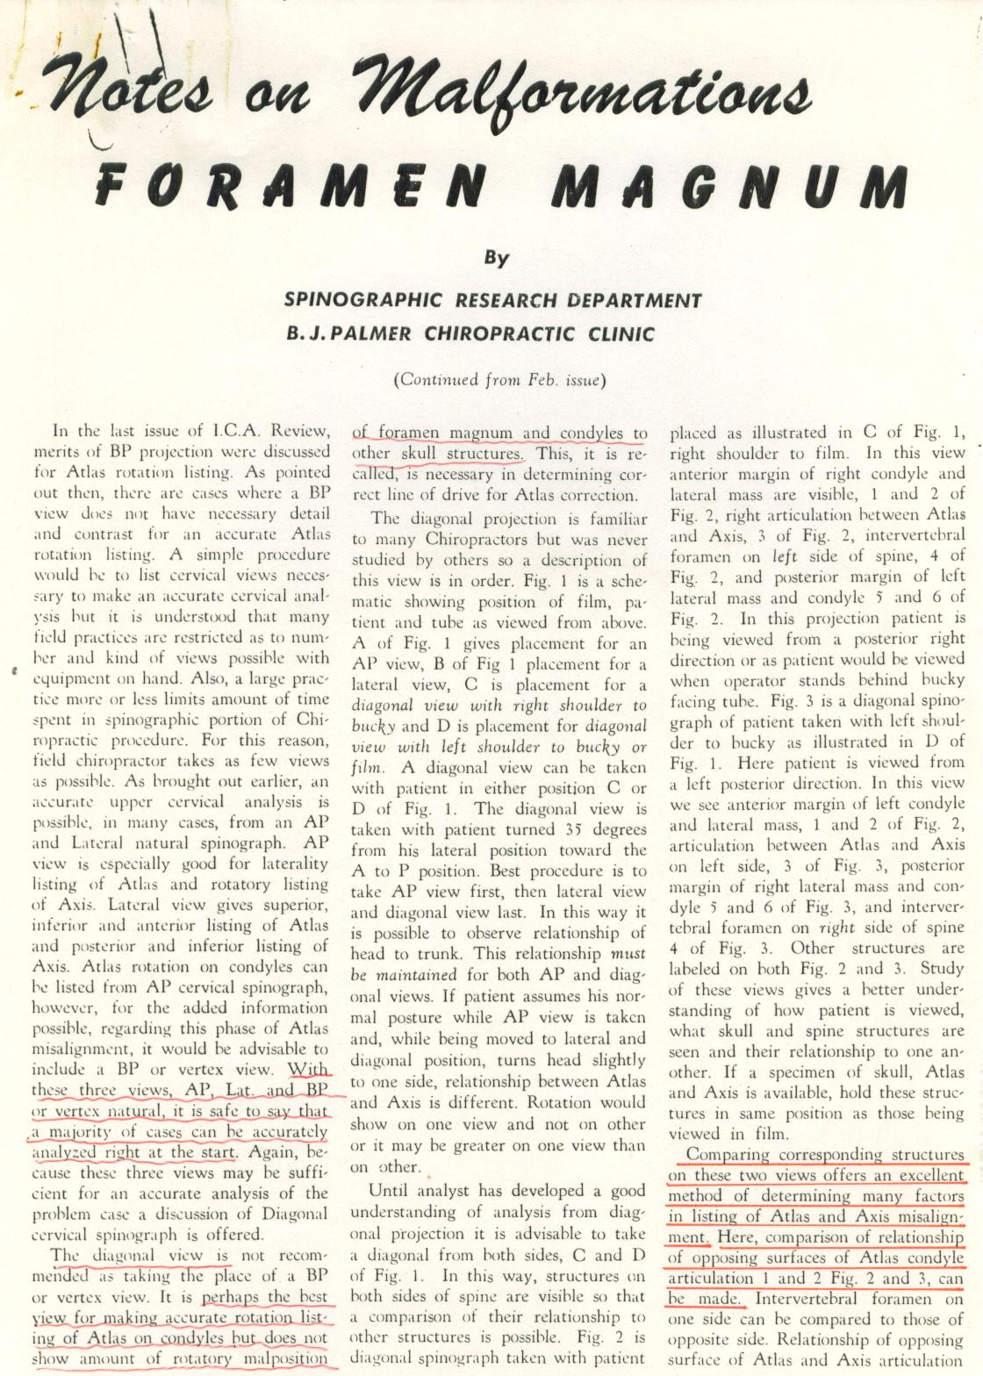
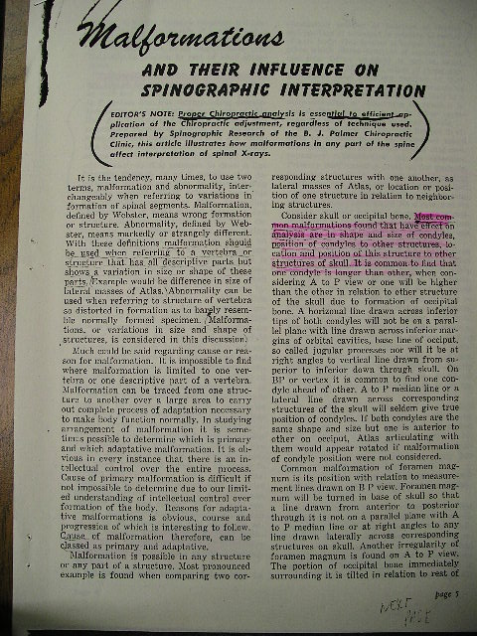
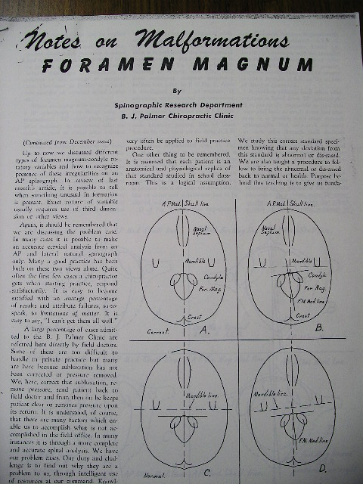
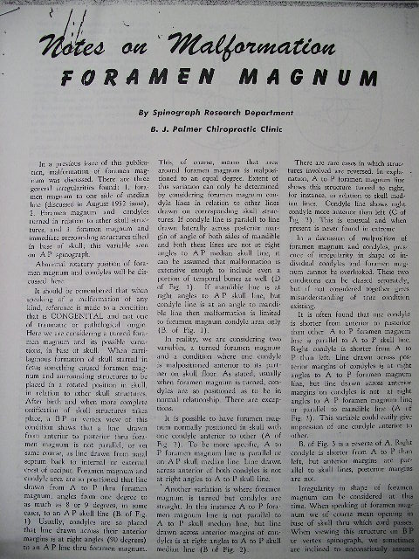
B.J. on Malformations

Slide 13
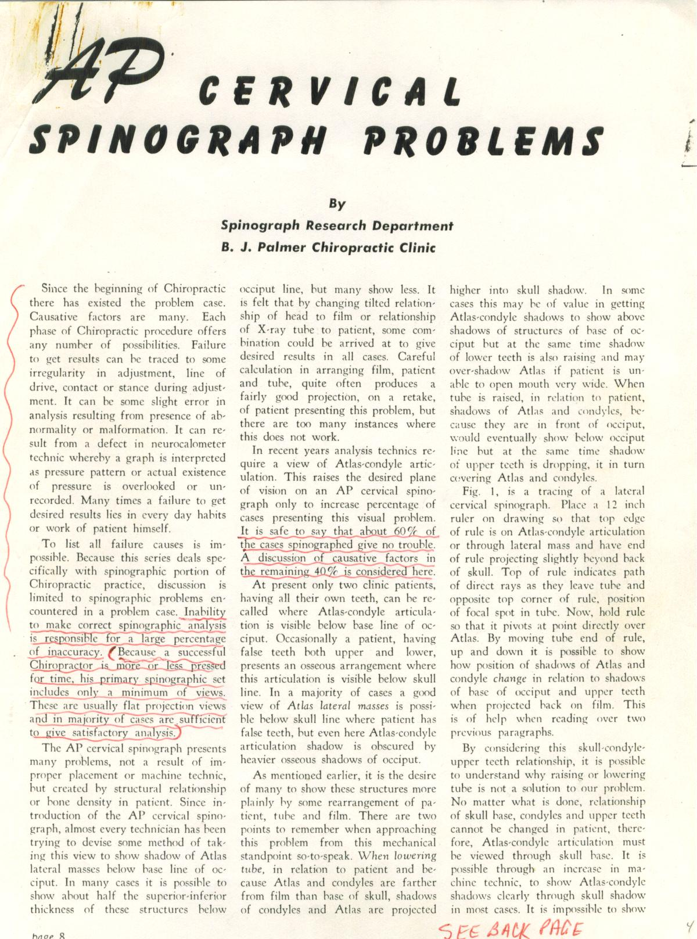
“Inability to make correct
spinographic analysis
is responsible for a large
percentage of inaccuracy”

Slide 14
“It is safe to say that about 60%
of the cases spinographed
give no trouble.”
“A discussion of causative
factors in the remaining
40% is considered here.”

Slide 15
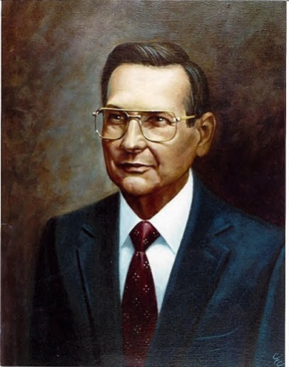
William Blair, D.C.,
continued to research the
influence of malformations
on spinographic interpretation
and developed some promising
solutions.
For his contributions and discoveries
Palmer College awards him:
Daniel David Palmer
Scientific Award
Doctor of Philosophy of
Chiropractic Degree

Slide 16
Malformations of the
Foramen Magnum..
...and their influence on
Vertebral Subluxation analysis

Slide 17
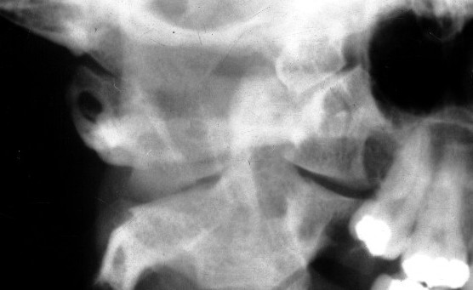
In many ways when two
vertebra meet at the
articulation they are
“many times” mirror
images to each other.
The antero lateral
margins are very reliable
areas for seeing
misalignment but are not
seen on standard x-rays.
The atlanto-occipito joint
will have matching slopes..
and matching convexities/concavities.

Slide 18
Convergences also match:
If the right condyle
converges 30 degrees..
..the right atlas
superior articular
surface will also
converge 30
degrees.

Slide 19
If the left
condyle is small
If the right
condyle is large
The left sas of atlas will
be sized to match it
The right sas of atlas will
be sized to match it.

Slide 20
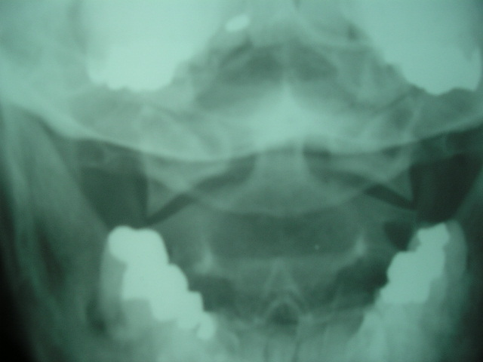
Wedge lines often indicate laterality
(Right atlas laterality)
Some malformations affect the wedge line
and give a false laterality.

Slide 21
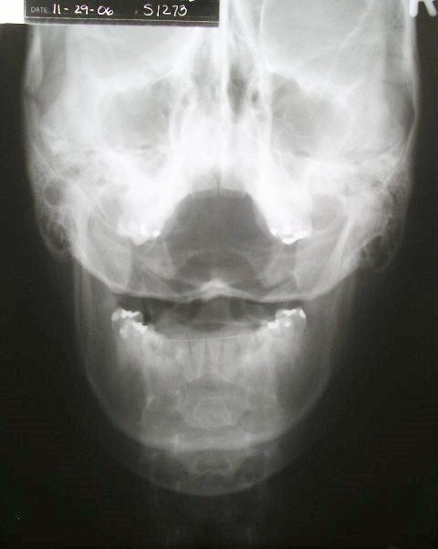
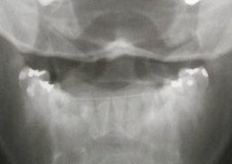
Short condyle
This malformation
affects the wedge
line.
And that affects
laterality (and
rotation)

Slide 22
-B.J.

Slide 23
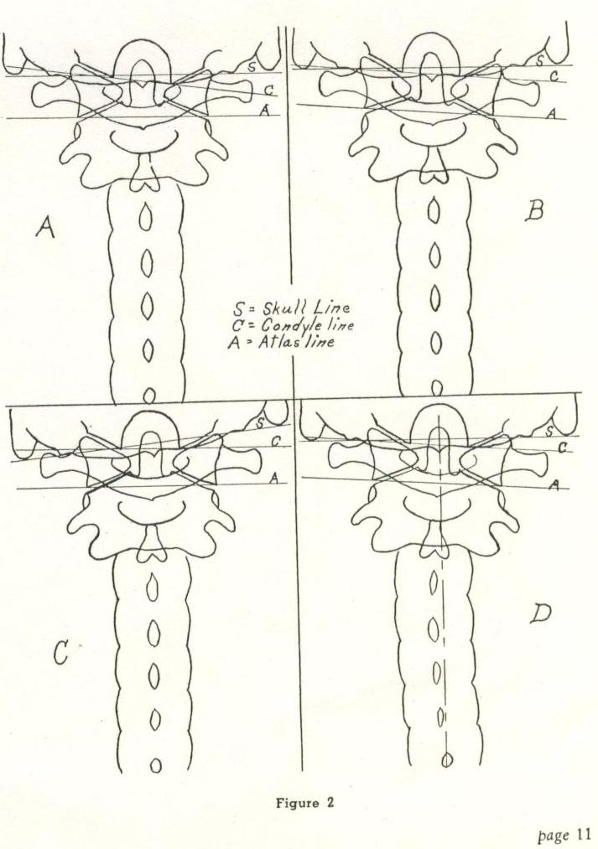
Innate Adaptation to the short condyle
Taller C2
superior
articular
surface on
side of short
condyle
Taller lateral
mass on side
of short
condyle
.
Scoliosis
toward side
of short
condyle
Head tilt to
side of short
condyle
.
.
.
.
.

Slide 25
Malformation of Atlas: Palmer College Study
(Real bone specimens)
Difference in lateral width of lateral masses…..31 of 35
Length of posterior arch different……………………..25 of 35
Length of transverse processes different………..25 of 33
When atlas viewed with no rotation more of
anterior root of transverse was visible on
one side than the other………………………………………….26 of 35

Slide 26
How would this palpate?
Right laterality?

Slide 27
How would this palpate?
Left laterality?

Slide 28
How would this palpate?
Anterior on the left?

Slide 29
Supine Blair CT images
Drs. Dennis Campbell and Tom Forest worked with Truxton Radiology in Southern California in an attempt to take the first CT Blair Images.
Since these types of analytical images of the craniocervical junction (CCJ) had not been taken via CT, a method of garnering Blair protracto views was necessary. A method of 64 slice, .5 mm was utilized on the following images. More recently, seated CBCTs are being used by many Blair doctors.

Slide 30
CT view upright
THE BASE POSTERIOR WAS CUT THROUGH THE CONDYLES.
Flipping the image horizontally allowed for a view of the r. ao joint=rpv

Slide 31
THIS SPECIMEN IS ABOUT AS SYMMETRICAL AS YOU WILL FIND!

Slide 32
THIS SPECIMEN IS ABOUT AS SYMMETRICAL AS YOU WILL FIND!

Slide 34
NOTE ANTERIOR LEFT CONDYLE, UNEVEN CONDYLE CONVERGENCE, AND A TURNED FORAMEN MAGNUM!

Slide 35
Which way will the atlas move, anterior or lateral?

Slide 36
Centered axis spinous

Slide 37
Note spinous of C-2 is left of center, which would coincide with left turned foramen magnum.

Slide 38
Note posterior tubercle is right- aligned with turned foramen magnum, but left C-2 spinous (look at left C-2 ALS) does not align with posterior tubercle.

Slide 39
Note posterior tubercle is right- aligned with turned foramen magnum, but left C-2 spinous (look at left C-2 ALS) does not align with posterior tubercle.

Slide 40
Note posterior tubercle is right- aligned with turned foramen magnum, but left C-2 spinous (look at left C-2 ALS) does not align with posterior tubercle.

Slide 41
Certain parts of the vertebral joint
margin can reveal much
about how the vertebra has
misaligned.
…the body is extremely capable of
precision design…

Slide 42
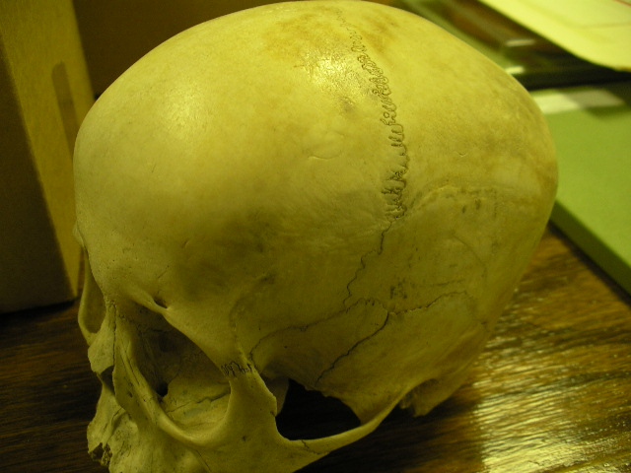
…when putting adjoining
structure together.

Slide 43
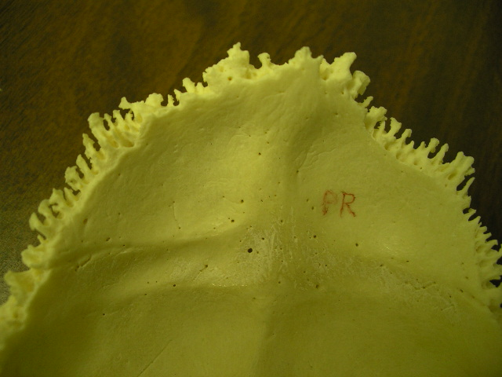
Of billions of skulls on the planet,
will any exactly match this one?

Slide 44
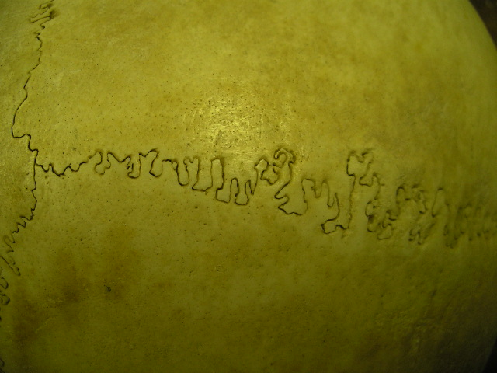
And yet, there are areas where
boney structure comes together
that will match precisely.
Certain areas of vertebral joints
also match precisely.

Slide 45
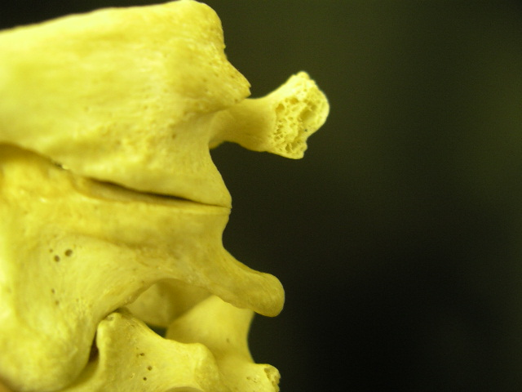
A study of vertebral articulations
reveals examples of matching exactness.

Slide 46
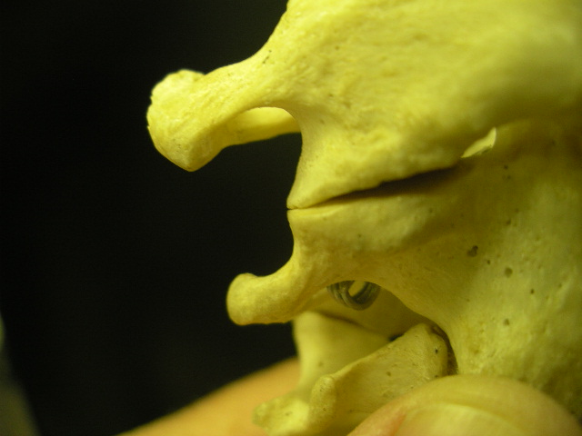

Slide 47
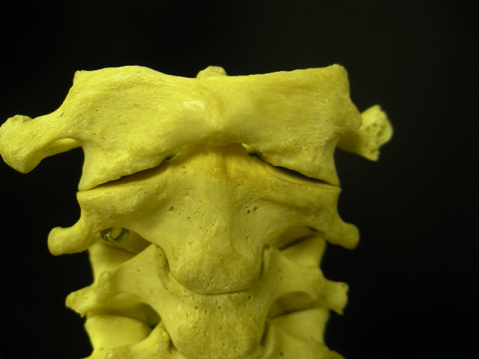

Slide 48
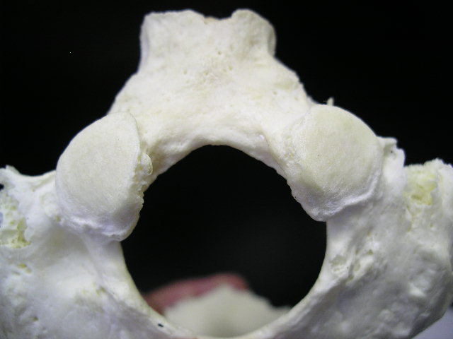
The antero-lateral margin
of occiput to atlas
frequently yields reliable
alignment information…
…and eliminates a myriad of
other malformation factors

Slide 49
But it takes custom x-rays
to see these margins.

Slide 50
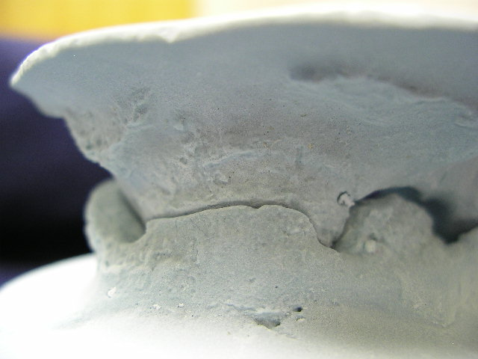
This precise cadaver mold of the
antero lateral margin of atlas to
occiput shows the natural alignment
that occurs at this part of the
articulation.

Slide 51
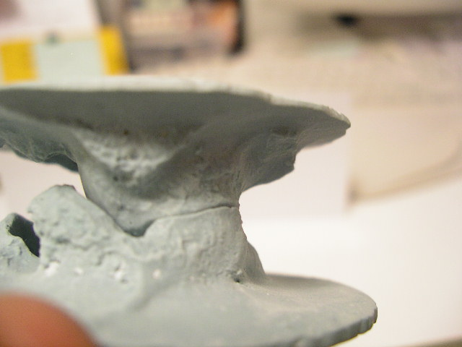
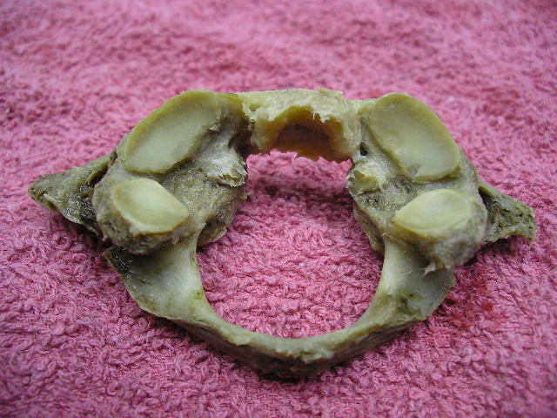
Real bone atlas with matching cadaver mold of
same atlas and partner occiput shows how the
antero lateral margins fit precisely

Slide 52
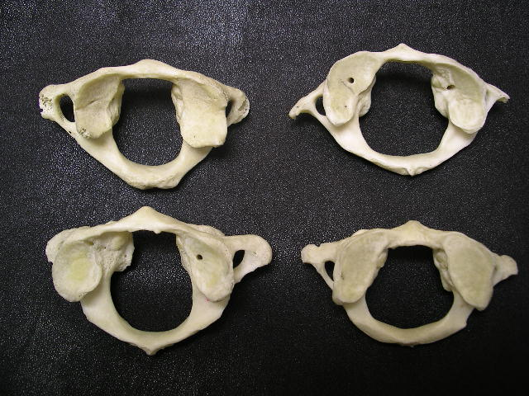
Antero lateral margins

Slide 53
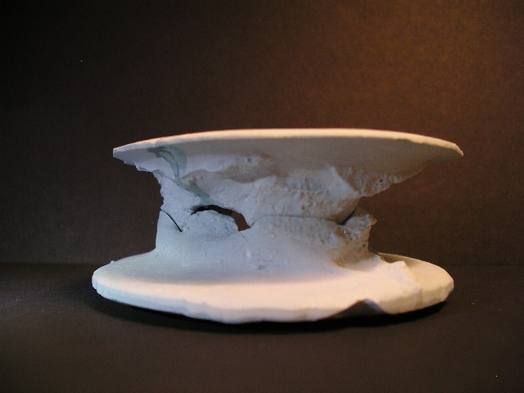

Slide 54
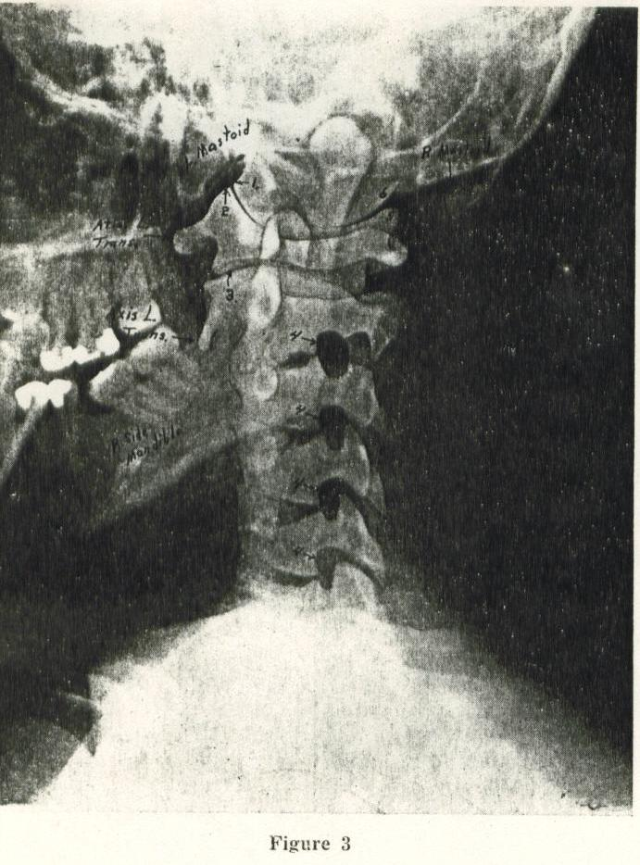
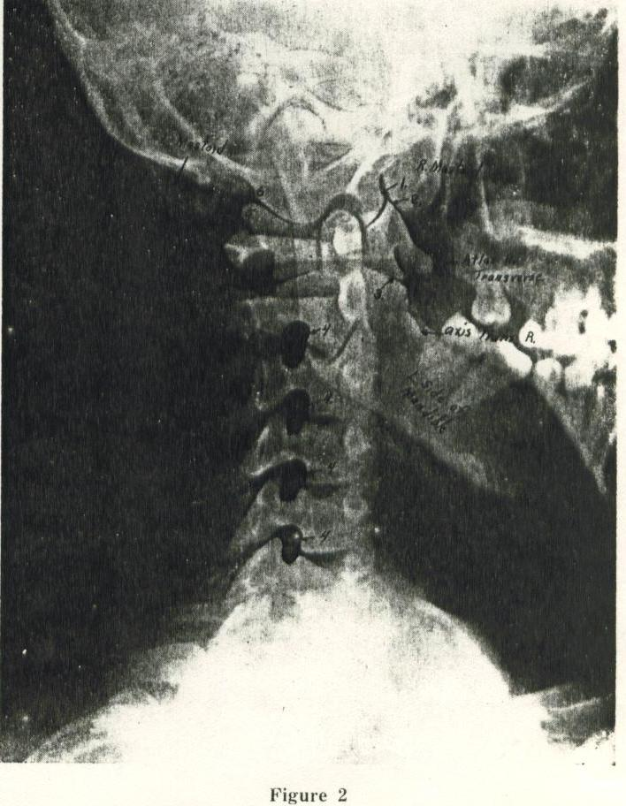
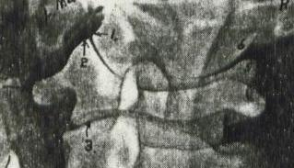
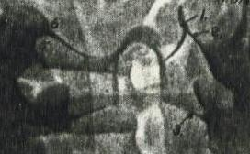
BJ diagonal cervical x-ray
BJ turned the patient a standard 45 degrees
and looked at the lateral aspect of the
atlas /condyle margin for
misalignment information

Slide 55
Since partner condyles usually converge unequally
Dr. Blair began customizing these views to look
specifically along the convergence of
each condyle.

Slide 56
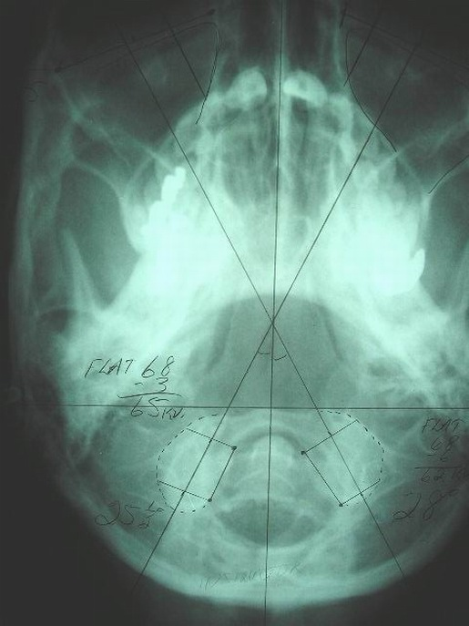
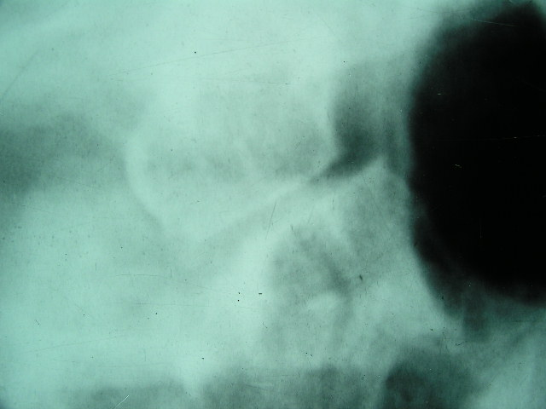
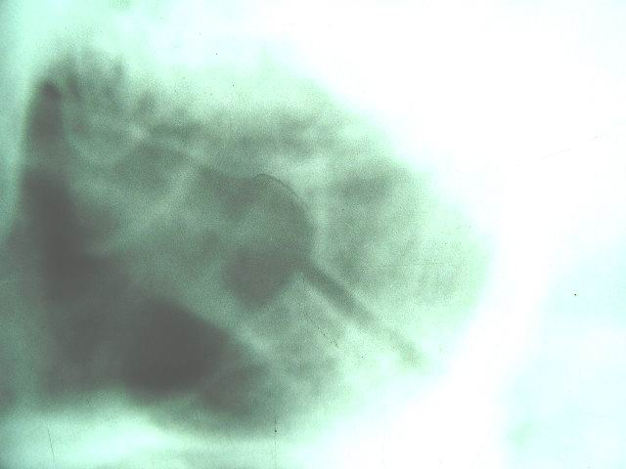
By determining condyle
convergence from the base
posterior
a custom diagonal view
would reveal
misalignment usually
not visible on other views.
overlapped
lined up
25
28

Slide 57
By viewing the articulation
with “custom” made views,
and with the aid
of stereo x-rays,
the “malformation problem”
was significantly minimized.

Slide 58
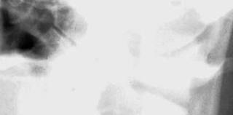
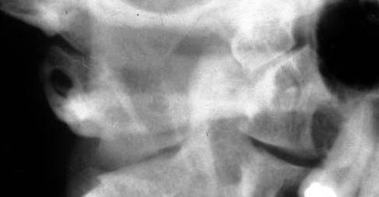
It was discovered that viewing specifically
along each condyle convergence
revealed some very significant information

Slide 59
At first the information did not make sense
Atlas would show misalignment on one side..
..but in many cases
it would appear lined up on the other side
Was this just malformation?

Slide 60
We discovered the atlas moved in a different way
Atlas will track on one side, slip on the other
Because of this newly discovered atlas mechanical
movement, we now need to rethink our adjustments
Blair x-ray analysis will show you exactly
how atlas moves how it should be corrected

Slide 61
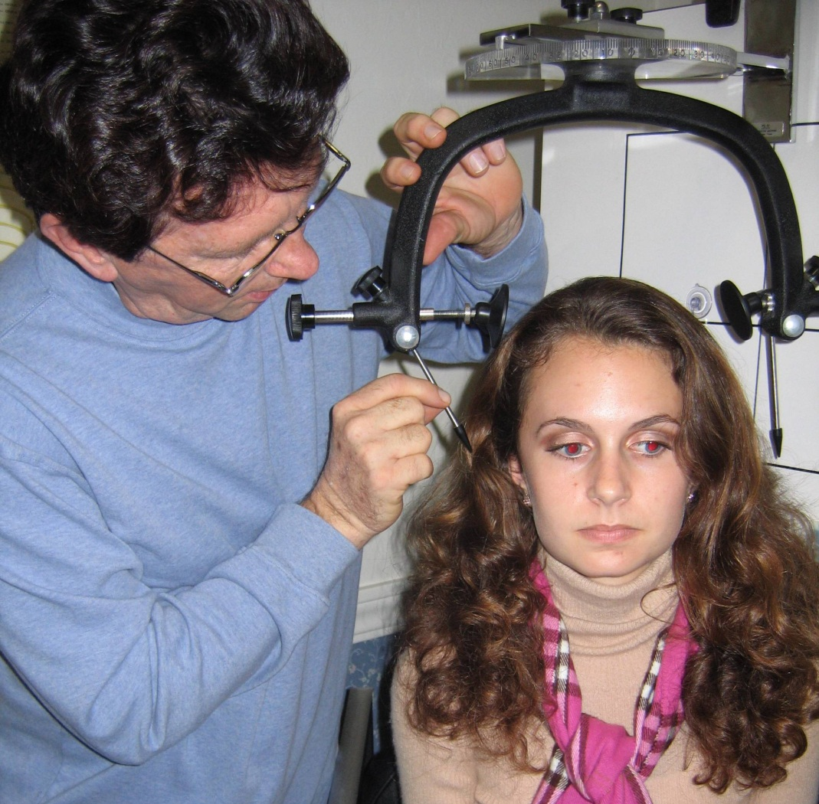
Solving problems with custom made views adds to the excellence we strive
strive
for in
subluxation
correction.

Slide 62
So what are these custom-made views and how do they give us more credible information?

Slide 63
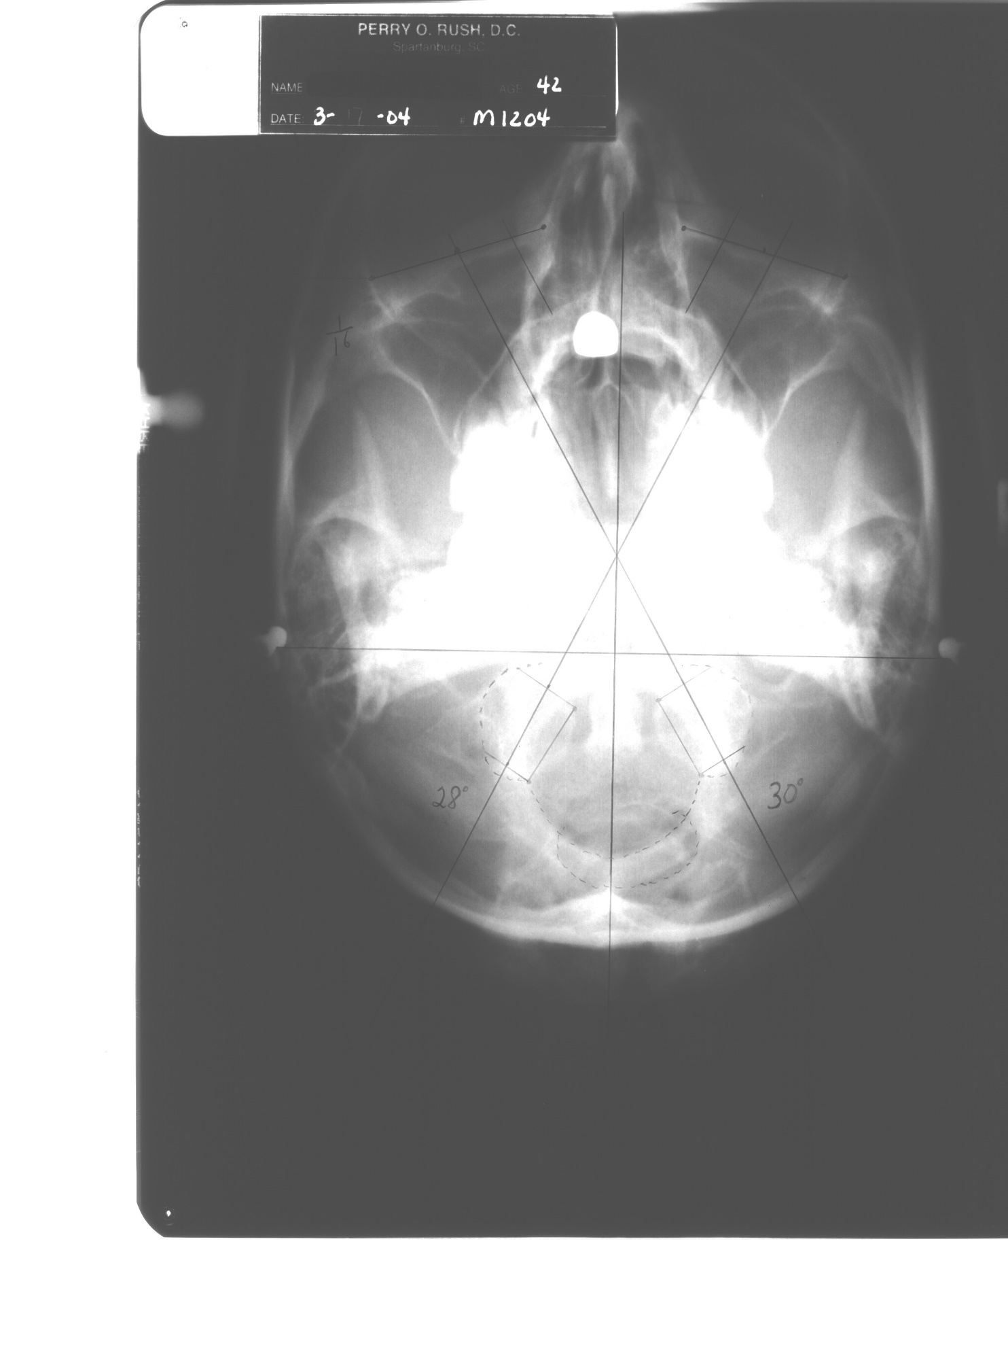
It starts with the base posterior
to determine condyle convergence.
Why?
28 degrees
30 degrees

Slide 64
When a misalignment occurs it does
so at the articulation/joint.
Standard x-rays do not usually
view the joint in such a way
that true misalignment is
properly revealed.

Slide 65
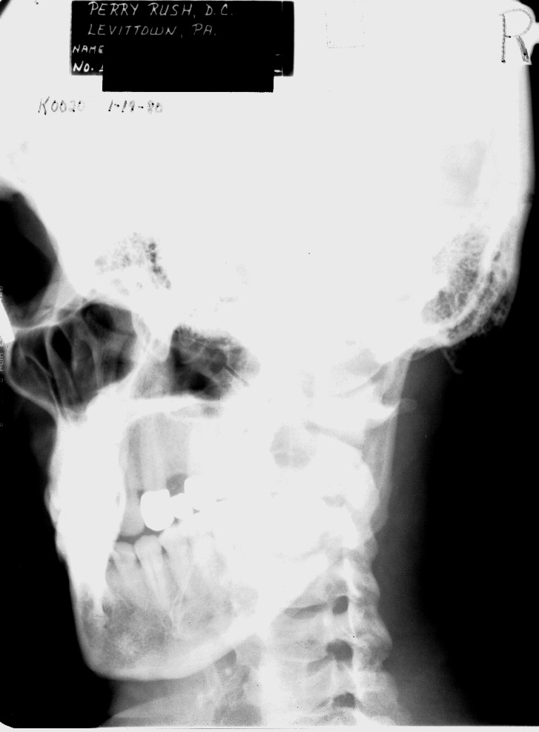
(Blair diagonal)
The patient is turned to see the true lateral aspect of
the articulation by looking
along the condyle convergence.
This area frequently
provides more reliable
misalignment information
than parts of the
vertebra more subject
to malformation .

Slide 66
Here is a close up view

Slide 67
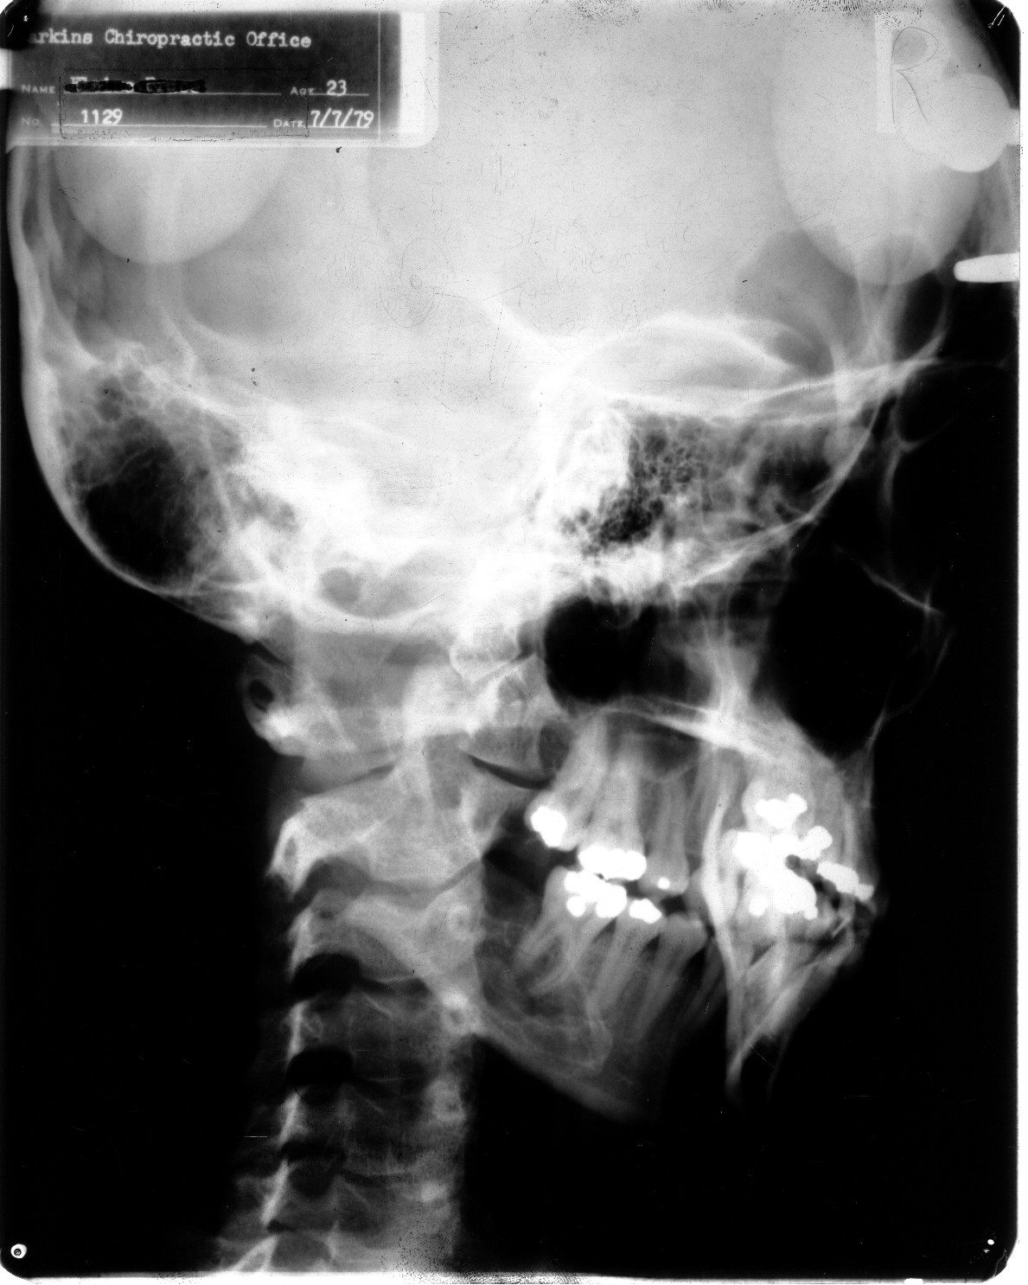
The patient is turned the
other way to see the
true lateral aspect
of the other articulation.

Slide 68
Here is a close up view
of the other side

Slide 69
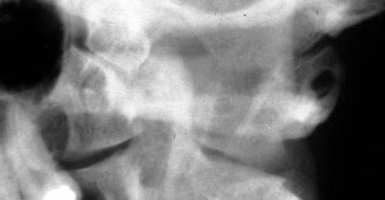
When a custom diagonal
is taken to view the
antero lateral margin..
you will
also see:
Slope of
condyle
Anterior border
of
Foramen magnum
Convexity of
opposite
condyle

Slide 70
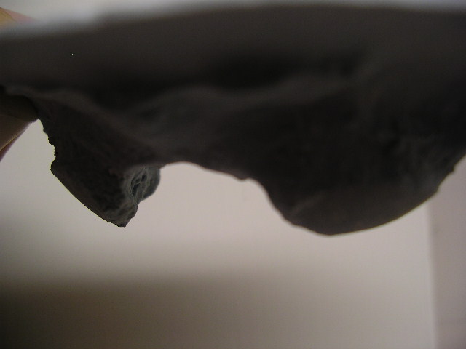
Mold of real occiput turned to
see antero lateral margin
(viewed from the anterior)
Slope of
rt. condyle
Anterior border
of foramen
magnum
Convexity of
left condyle

Slide 71
D.C’s who have studied Blair
Dr BJ Palmer-discoverer of the HIO system.
Dr. Don Kern-past President of Palmer College
Dr. Sid Williams-past President of Life College
Dr. Lyle Sherman-past Director of the BJ Research Clinic
Dr. Peter Martin-past President of Palmer Florida
Dr. Elmer Crowder-B.J. Palmer’s personal chiropractor
Dr. Charlie Ward- Developer of Ward Management Services
Dr. Weldon Muncy-Dr. Blair’s right hand man in research
Dr. Elmer Addington-past Director of the Blair Clinic currently headed by Dr. Gordon Elder.
AND

Slide 72
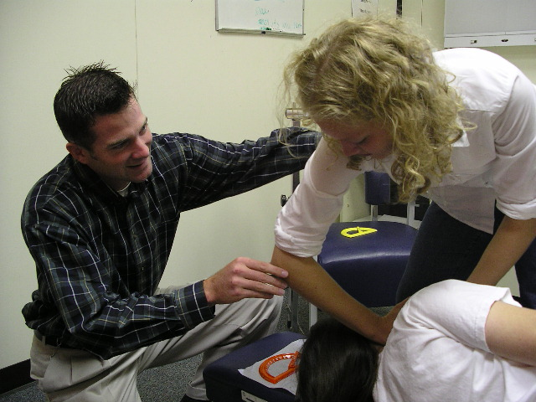
Certified Blair instructor, Dr. Jon Schwarzbauer…
teaches the Blair adjusting course and assists students on the health center floor.

Slide 73
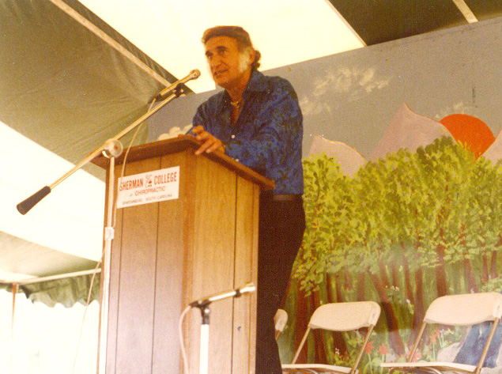
1980 – At Sherman Lyceum
ADIO president, Reggie Gold recruits
Perry Rush, D.C., to teach “Blair” at
ADIO

Slide 74
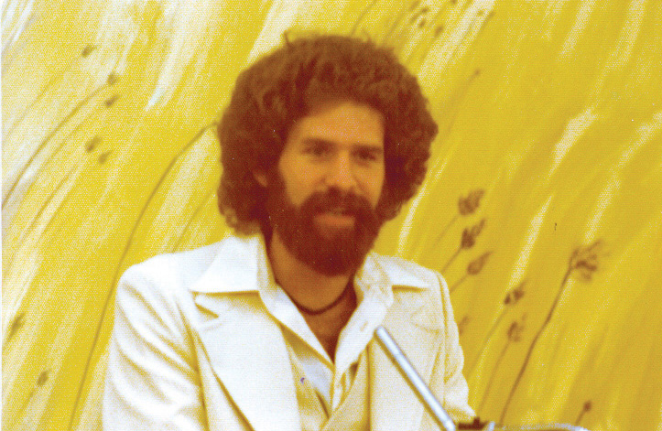
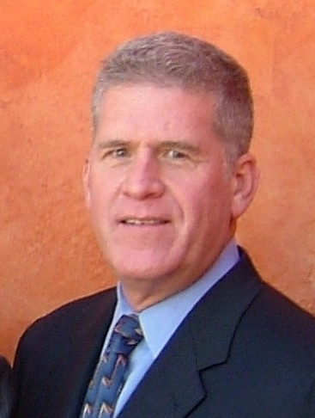
Then…
..and now.
Pres. of Life Chiropractic
College
“Easy” Riekman teaches
Blair course at Sherman
in the early years.

