Slide 1
New Direction in Research
By Charmaine A. Herman, MA, DC
Blair UC Chiropractic Society National Convention
Nashville, TN
October 12, 2018

Slide 2
Education
B.A. in History from University of South Carolina 1991
B.S. in Biology from University of South Carolina 1992
M.A. in History from University of South Carolina 2002
Graduate Certification in Women’s Studies from University of South Carolina 2003
D.C. from Sherman College of Straight Chiropractic 2009

Slide 3
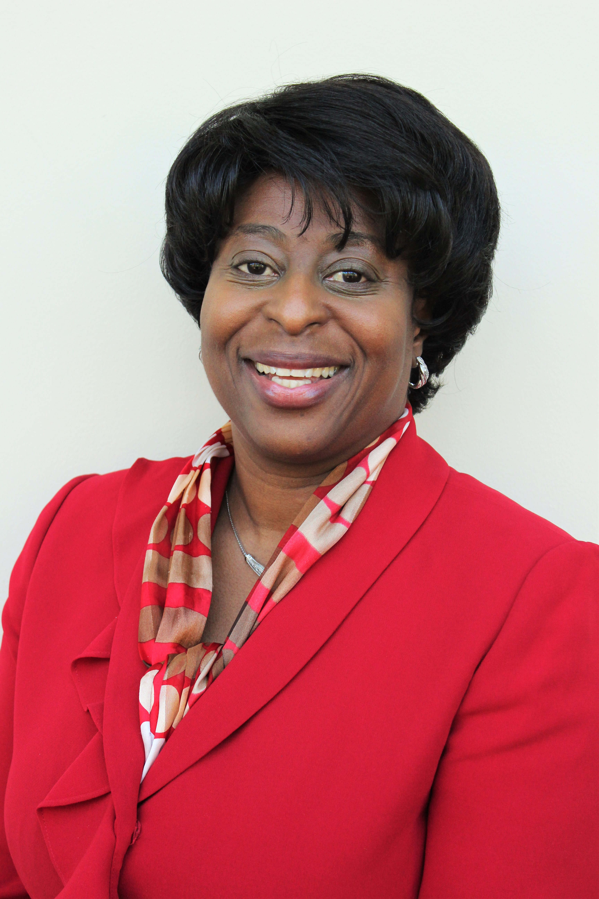
My Two Roles
Associate Professor
Life University College of Chiropractic
charmaine.herman@life.edu
______________________________
Clinic Director
Agape Upper Cervical Health Center – Alpharetta, GA
agapeuc@gmail.com

Slide 4
Practicing and Teaching
Clinic Director, Agape Upper Cervical Health Center, Inc. -Alpharetta, GA opened May 2013
Certified Blair Faculty Instructor October 2013
Assistant Professor at Life University College of Chiropractic - July 2014
Division of Clinical Sciences (Visceral Diagnosis, Orthopedic Diagnosis, Clinical Skills, etc..)
Began teaching Blair Condylar Misalignment and Analysis elective January 2016
Associate Professor Life University College of Chiropractic - October 2018

Slide 5
Awards & Recognition
Faculty Excellence Award – September 2018 LU graduating class
Advisor of the Year (2017-2018)
2018 Top Atlanta Chiropractor Award
Life Univeristy Faculty Research Award (3x)
Life University OSRSA Research Grant Award
Blair Society Chiropractor of the Year –2016
B.J Palmer Philosophy Award for Clinical Excellence
Service Distinction Award from Sherman College
Lyle W. and Eula M. Sherman Upper Cervical Scholarship
Dottie Blair Scholarship awarded by the Blair Upper Cervical Society

Slide 6
Published Case Studies/Reports
Herman C, Harris J. Resolution of Neck Pain, Upper Extremity Paresthesia & Dysautonomia in a 46-year-ld Female with Loss of Cervical Curve and Spinal Degeneration Using Blair Upper Cervical Technique: A Case Study & Review of the Literature. J of Upper Cervical Chiropr Res. 2018 July 9 3:26-32.
Herman C, Pitts M. Resolution of Neck Pain and Upper Extremity Paresthesia in a 28-year-old Male Following Blair Upper Cervical Chiropractic Care to Reduce Vertebral Subluxation: A Case Study & Review of the Literature. J of Upper Cervical Chiropr Res. 2018 May 3:19-25.
Herman C, Rallings A. Resolution of Cervicalgia Following Blair Upper Cervical Technique: A Case Study & Review of the Literature. J of Upper Cervical Chiropr Res. 2017 December 2:58-64.
Herman C. Resolution of low back pain in an 8-year-old patient following Blair upper cervical chiropractic care: a case report. J of Upper Cervical Chiropr Res. 2016 July 28:24-30.
Herman C. Resolution of low back pain and gastro-esophageal reflux disease in a 29 year old male patient following upper cervical chiropractic care: a case report. J Chiropr Edu. 2016 30(1):73. (Abstract)
Herman C. The improvement of a 40 year-old male patient exhibiting anxiety and depression disorder following Blair upper cervical chiropractic care: a case study. 12th International Research and Philosophy Symposium (IRAPS) Sherman College of Chiropractic Spartanburg, SC October 10-11, 2015. A. Vertebral Subluxation Res. 2015 Nov 27:188-90. (Abstract)
Herman CA, Amilcar CP. Chiropractic management of an infant with paroxysmal tonic upgaze syndrome, congenital torticollis and upper cervical subluxation following birth trauma: a case report. J of Upper Cervical Chiropr Res. 2015 June 29:19-23

Slide 7
WHY A NEW DIRECTION?
I am lead instructor for CLET 3826 Head and Neck Clinical Case Integration
Chiropractic management of neck/arm complaints, headaches, hearing loss, tinnitus, TBI, VBAI, etc..
Great platform to mention Blair and stir up interest
Students required to submit a 6 page literature review using a head and neck complaint or technique
Common question after doing at literature search…..

Slide 8
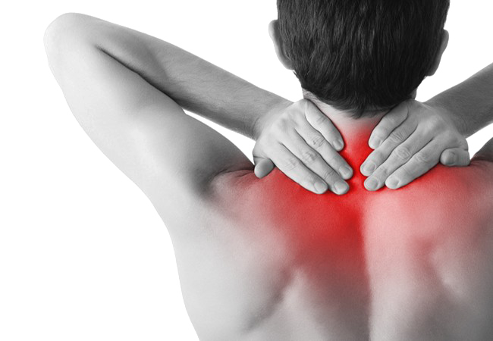
DOES BLAIR HELP PATIENTS WITH NECK PAIN?

Slide 9
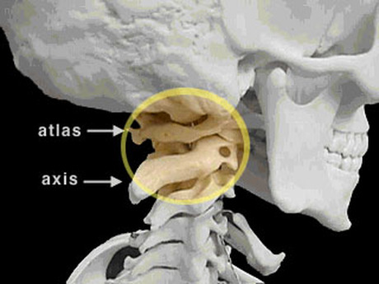
Answer…
“Of course Blair works on neck pain and associated problems because we remove the primary subluxation!”
But the peer reviewed research did not show that!!

Slide 10
Not enough Blair articles on musculoskeletal neck complaints!!!

Slide 11
Blair Published Research Topics
Published Blair UC peer-reviewed articles include topics such as:
Meniere’s Disease (Burcon)
Infertility (Hilpisch & Stenberg)
Complex Regional Pain Syndrome (Milman, Forest & Hubbard)
Ankylosing Spondylitis (Wells & Williams)
Myoclonic Seizures (Hubbard & Kane)
Epilepsy (Hooper & Manis)
Tremor and Migraine (Hubbard & Kane)
Low back pain (Herman)
Migraines (Verderame & Hollowell)
Inter and Intra Protractoview Reliability Studies (Hubbard, Vowles, Forest)
Heart Rate Variability – (Burcon)

Slide 12
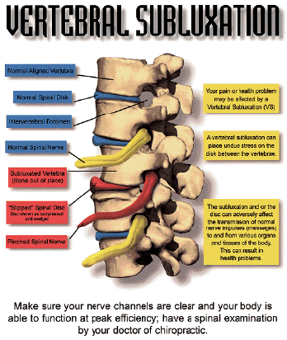
Chiropractic Vitalistic Principles in Education
Subluxation Centered vs Symptom Centered
Addressing the Vertebral Subluxation Complex (VSC)
Kinesiopathology
Myopathology
Histopatholgy
Neuropathophysiology
Biochemical Changes
Causes of the VSC
trauma, emotional stress, chemical stress
Avoid diagnosing conditions

Slide 13
Students Wanted More from Blair UC
But what about Blair and neck pain?
Can it help patients with cervical radiculopathies or TOS?
Did Blair only help the obscure patient?
Can Blair affect a neck that has lost its cervical curve?
Techniques like CBP emphasized exercises and therapeutic modalities for cervical curve restoration
Students wanted to know what Blair could do for the cervical curve?
I provided a few examples….

Slide 15
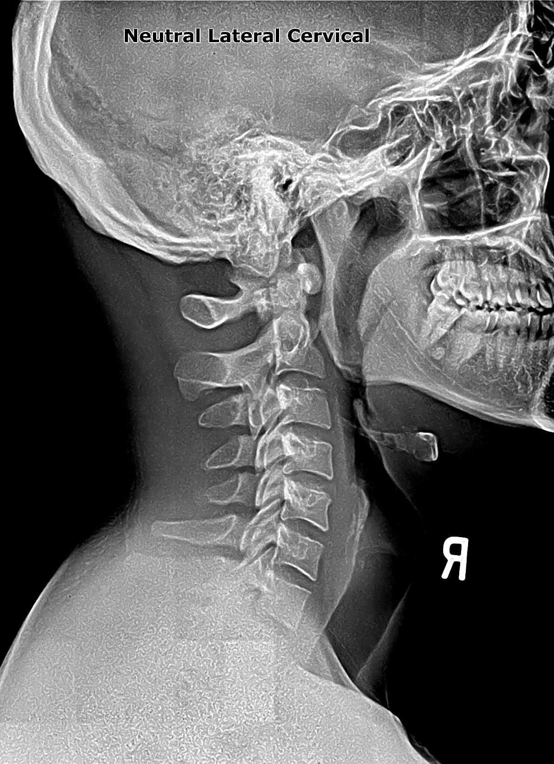

Slide 16
Opportunity Knocked!!
Students needed case studies for their senior research projects
Used this opportunity to provide my Blair neck pain complaints
This produced three (3) articles for publication

Slide 17
Thank you McCoy Press!!!

Slide 18
Three Published Peer Review Articles
Herman C, Harris J. Resolution of Neck Pain, Upper Extremity Paresthesia & Dysautonomia in a 46-year-ld Female with Loss of Cervical Curve and Spinal Degeneration Using Blair Upper Cervical Technique: A Case Study & Review of the Literature. J of Upper Cervical Chiropr Res. 2018 July 9 3:26-32.
Herman C, Pitts M. Resolution of Neck Pain and Upper Extremity Paresthesia in a 28-year-old Male Following Blair Upper Cervical Chiropractic Care to Reduce Vertebral Subluxation: A Case Study & Review of the Literature. J of Upper Cervical Chiropr Res. 2018 May 3:19-25.
Herman C, Rallings A. Resolution of Cervicalgia Following Blair Upper Cervical Technique: A Case Study & Review of the Literature. J of Upper Cervical Chiropr Res. 2017 December 2:58-64.

Slide 19
Resolution of Cervicalgia Following Blair Upper Cervical Technique: A Case Study & Review of the Literature
By Charmaine Herman, D.C. & Ashia Rallings, D.C.
Objective: The purpose of this case study is to evaluate and discuss the use of Blair Upper Cervical technique in a 55-year-old female with cervicalgia and spinal stenosis.
Clinical Features: The patient is a 55-year-old female who presented with a chief complaint of neck pain and spinal stenosis, exacerbated by prolonged sitting and standing. The patient also presented with reduced cervical range-of-motion (ROM), spasms and tenderness of the left cervical paraspinal muscles, and postural abnormalities.
Intervention and Outcomes: A patient health history and chiropractic examination was performed. Blair Upper Cervical technique was utilized to identify the area of involvement. This case study shows improvements in the patient’s condition after one month of care. During that time period, the patient received chiropractic adjustments in accordance with Blair Upper Cervical technique protocol. By the end of care, the patient’s Verbal Pain Scale score went from a 5/10 pain level to 0/10 pain level. Other outcome assessments used in this case study include Tytron thermography scanning.
Conclusions: The findings presented in this case study suggest that chiropractic adjustments using Blair Upper Cervical technique may provide some benefit in the management of neck pain and spinal stenosis.

Slide 20
Resolution of Neck Pain and Upper Extremity Paresthesia in a 28-year-old Male Following Blair Upper Cervical Chiropractic Care to Reduce Vertebral Subluxation: A Case Study & Review of the Literature
By Charmaine Herman, D.C. & Miracle Pitts, D.C.
Objective: To evaluate and discuss the effects of upper cervical chiropractic care on a 28-year-old male patient with neck pain and upper extremity paresthesia.
Clinical Features: The patient is a 28-year-old male that presented to the office with neck pain and associated right hand paresthesia. The patient presented to the office 5 months after the initial onset of symptoms.
Intervention & Outcomes: A case history and chiropractic examination was performed and it was determined that the patient had a subluxation of the C1 (atlas) vertebra, as well as the C2 and C5 vertebra on a subsequent visit. The patient received chiropractic care following the Blair Upper Cervical protocol. The care went for nine visits over the course of 1.5 months. At each visit, he was checked for vertebral subluxation via Blair Upper Cervical protocol and was adjusted a total of 7 times. The patient reported resolution of both the neck pain and hand paresthesia at the eighth visit.
Conclusion: This case study demonstrates successful management of a 28-year-old male patient suffering from neck pain and paresthesia, who was managed with specific Blair upper cervical protocol. Further research with regards to how specific Blair upper cervical protocol may benefit patients is suggested.

Slide 21
Resolution of Neck Pain, Upper Extremity Paresthesia & Dysautonomia in a 46-year-old Female with Loss of Cervical Curve and Spinal Degeneration Using Blair Upper Cervical Technique: A Case Study & Review of the Literature
By Charmaine Herman, D.C. & Jessica Harris, D.C.
Objective: To report on the health outcomes in a 46-year-old woman with neck pain and hand numbness undergoing chiropractic care for the management of upper cervical vertebral subluxation.
Clinical Features: The patient is a 46-year-old woman that presented to the office with neck pain and hand numbness. She was examined and found to have upper cervical subluxation and dysautonomia along with a loss of the normal cervical curve and cervical spine degeneration.
Intervention and Outcome: The patient received specific chiropractic adjustments using the Blair Upper Cervical chiropractic technique protocol. Eight adjustments were administered over a 4-month period. At each visit, the patient was evaluated for subluxation using thermography, palpation and leg length inequality. Neck pain was decreased from 4/10 to 0/10 on a verbal pain scale. There was improvement in her neck pain and hand numbness after her initial adjustment and resolution of neck pain and hand numbness after two months of care.
Conclusion: This case study demonstrated successful management of a 46-year-old woman with neck pain, spinal degeneration, hand numbness and dysautonomia managed with upper cervical chiropractic care. Due to the natural limitations of a case study, more research is needed to examine how upper cervical chiropractic care benefits patients suffering with neck pain and paresthesias.

Slide 22
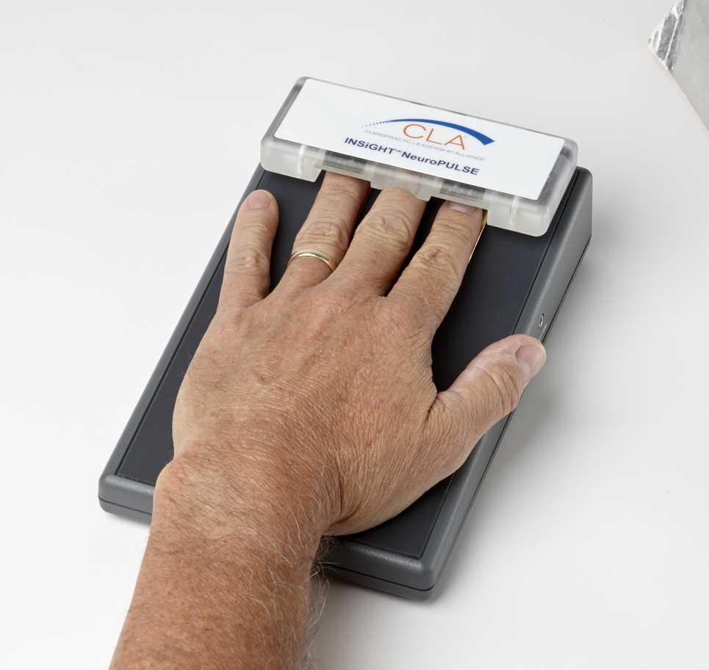
Other New Directions

Slide 23
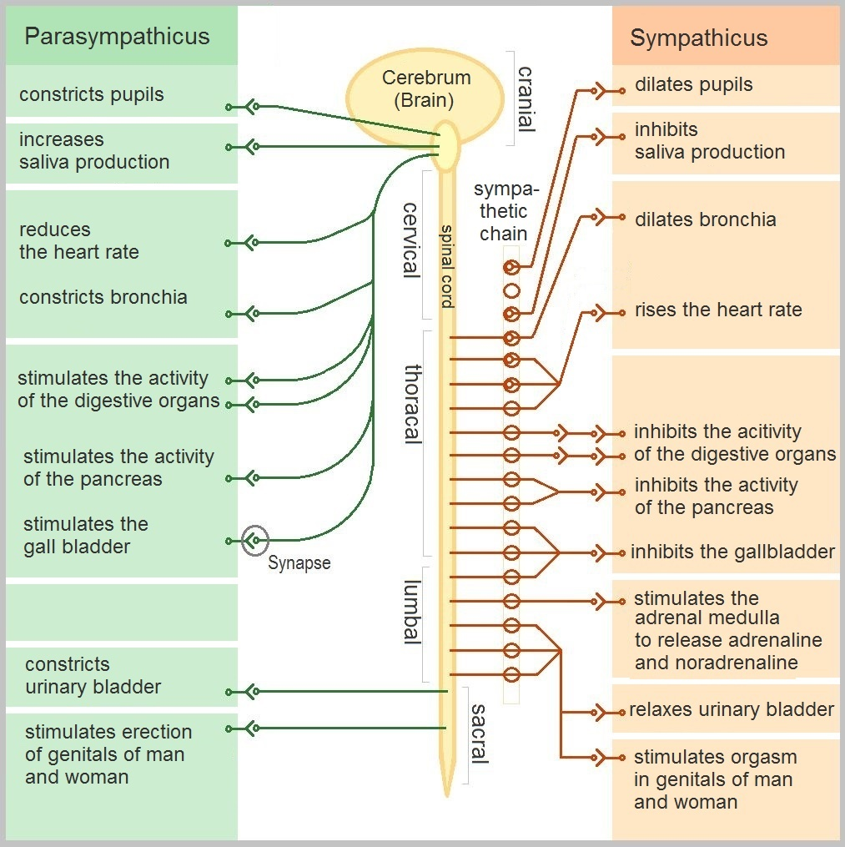
Dysautonomia
Dysautonomia refers to a disorder of autonomic nervous system (ANS) function that generally involves failure of the sympathetic or parasympathetic components of the ANS, but dysautonomia involving excessive or overactive ANS actions also can occur

Slide 24
Symptoms of Dysautomonia
Symptoms in individuals with dysautonomia include:
Anhydrosis
Anxiety
Double vision or Tunnel vision
Bowel incontinence
Brain fog
Difficulty swallowing
Chronic fatigue
Hypotension
Orthostatic Hypotension
Syncope
Tachycardia
Vertigo
Urinary incontinence or retention
Vertigo
Weakness

Slide 25
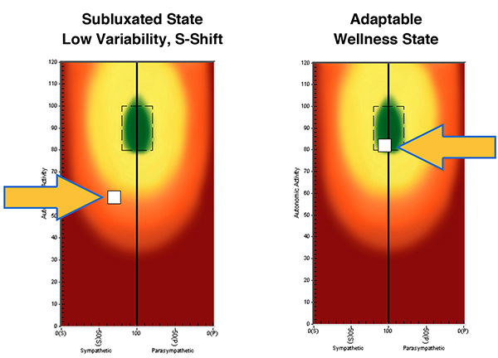
Thermography, HRV and Dysautonomia

Slide 26
QUESTIONS?

