Slide 1
Asymmetry is an Abnormal Finding
Blair Upper Cervical
Hour 1
Chiropractic Technique
Instructors- Drs. Dennis Campbell & Tom Forest

Slide 2
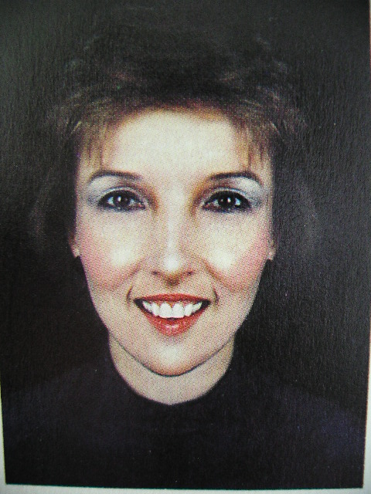

Jenny
Anne

Slide 3
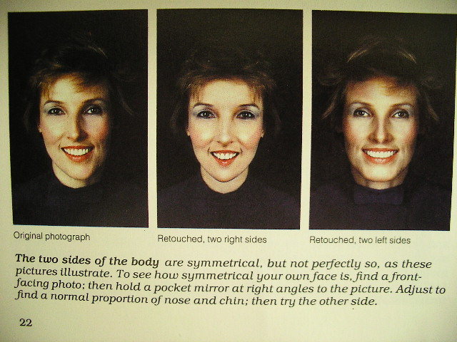
Jenny Anne
Jenny
Anne

Slide 4
Dr. William G. Blair, D.C., Ph.C.
Based on his meticulous x-ray studies, Dr. Blair came to certain conclusions:
The right and left side are not symmetrical.
Opposing surfaces of the joints do match.
Therefore Dr. Blair surmised:
Dottie Blair, Progress in Chiropractic by Steven J. Boyle

Slide 5
Dr. William G. Blair, D.C., Ph.C.
“We are not looking for the perfectly straight spine, we are looking for the perfectly articulated spine.”
Dottie Blair, Progress in Chiropractic by Steven J. Boyle

Slide 6
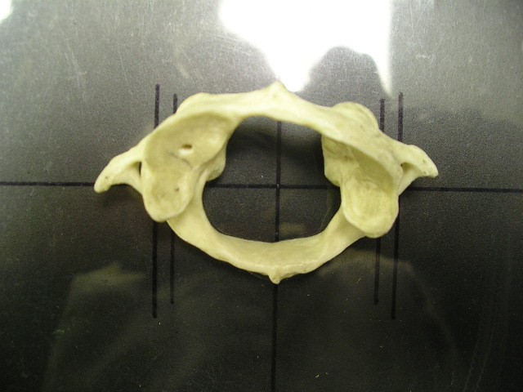
Study this picture!
Notice how asymmetrical the atlas is!

Slide 7
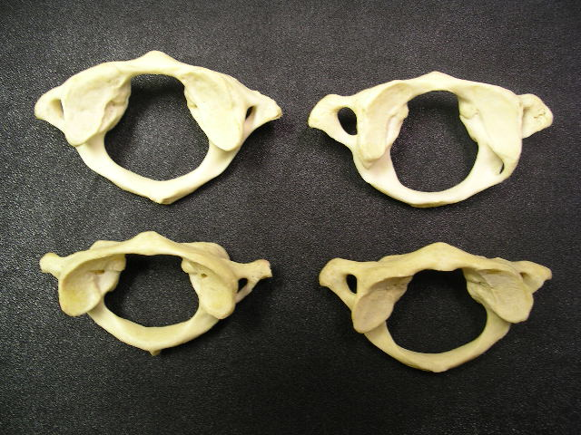
And this picture!
Notice how asymmetrical they are!

Slide 8
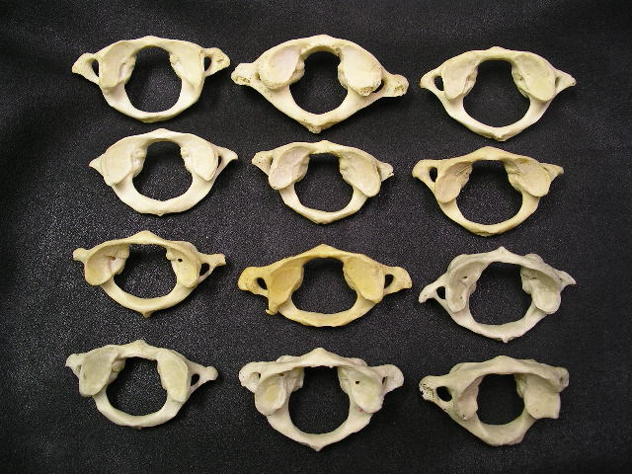
And this picture!

Slide 9
..and the implications to chiropractic
analysis! (X-ray,
boney, muscle,
and motion palpation)

Slide 10
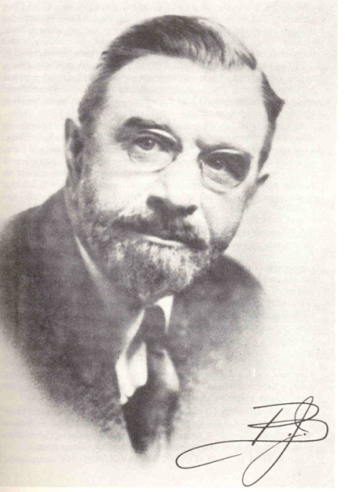
From 1930 until his death
B.J. placed great emphasis on the
upper cervical spine.

Slide 11
B.J. was constantly researching
better ways to improve the
the science of vertebral subluxation
analysis and correction.
The B.J. Palmer Spinographic
Research Department published
numerous articles identifying
the effect of “malformations”
on x-ray misalignment interpretation.

Slide 12
…in the great majority of cases where pressure cannot be removed or where pressure keeps returning, malformations present in the spine are at fault.”
Malformations lead to wrong listings.
-Malformations AND THEIR INFLUENCE ON SPINOGRAPHIC INTERPRETATION –BJ PALMER SPINOGRAPHIC RESEARCH CLINIC
Printed in the ICA Review - early 1950’s.

Slide 13
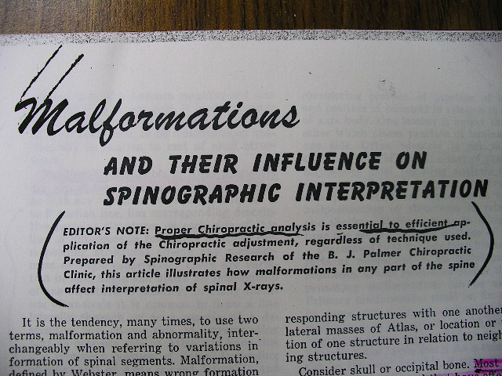
Each month a new article was sent out
by B.J. instructing chiropractors:

Slide 14
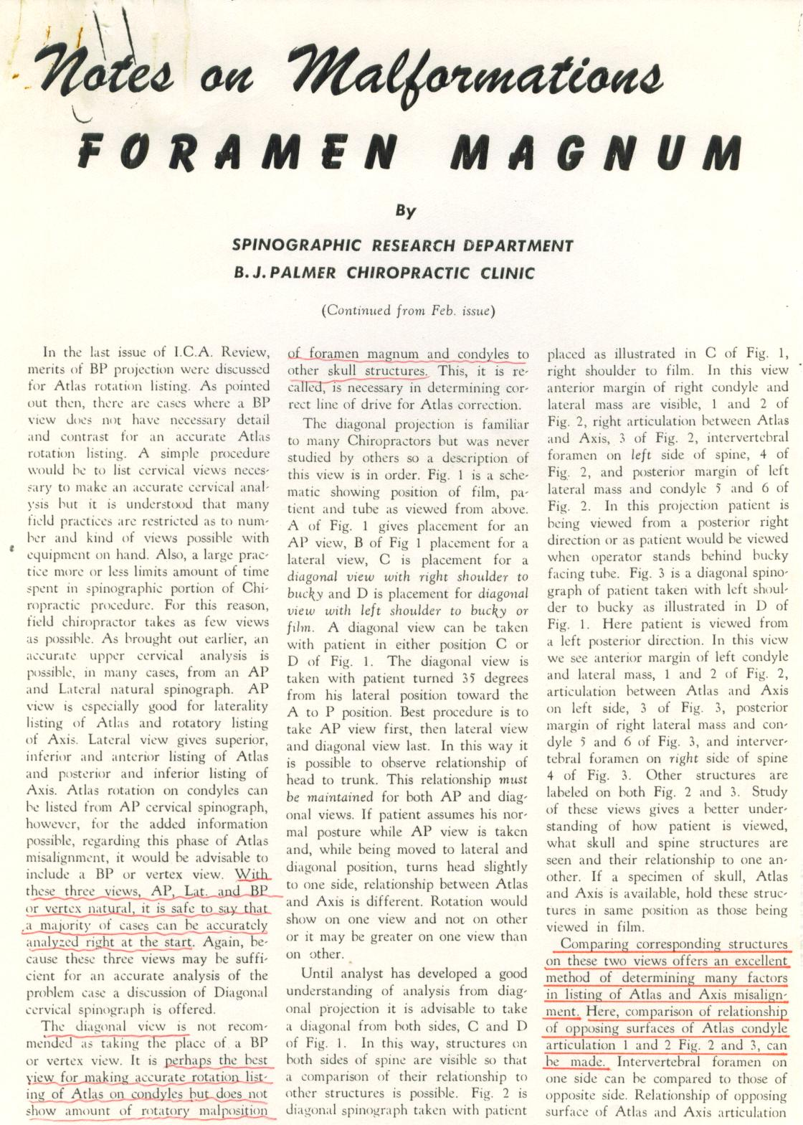
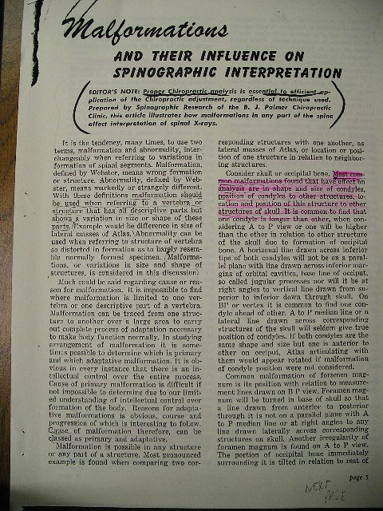
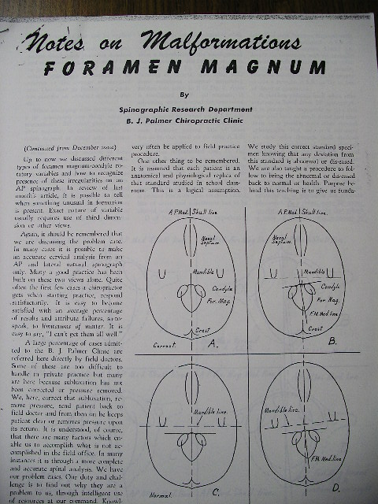
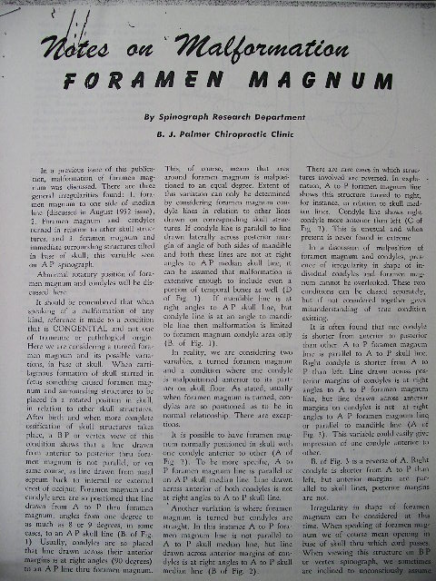
B.J. on Malformations

Slide 15
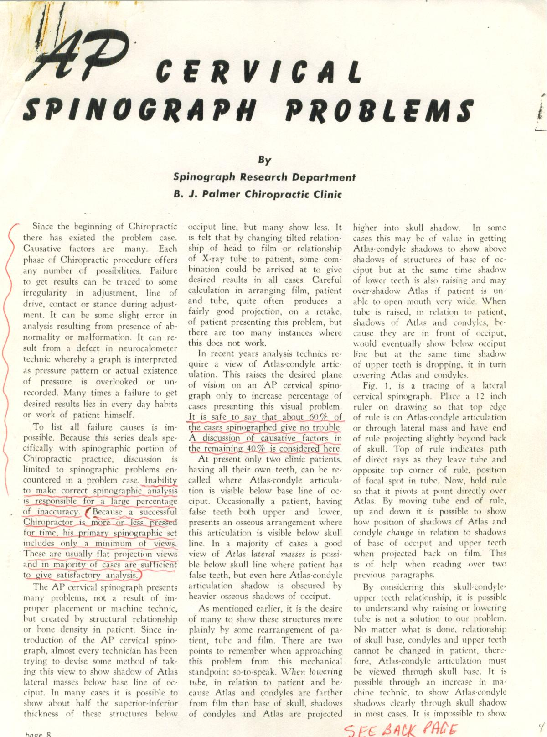
“Inability to make correct
spinographic analysis
is responsible for a large
percentage of inaccuracy”

Slide 16
“It is safe to say that about 60%
of the cases spinographed
give no trouble.”
“A discussion of causative
factors in the remaining
40% is considered here.”

Slide 17
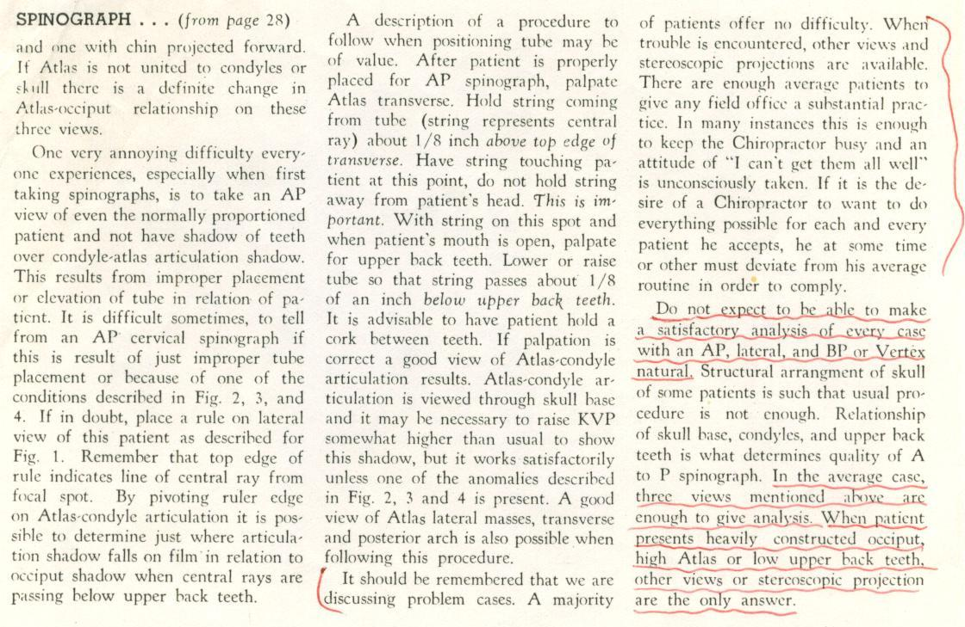
“Do not expect to be able to make
a satisfactory analysis of every
case with an AP, lateral, and BP…
(when problems are encountered)
…other views and stereoscopic
projection are the only answer.”

Slide 18
B.J. and Blair recognized a
“Log Jam” in chiropractic:
..the inability of the of the average
chiropractor to
properly analyze and properly
adjust the upper cervical
subluxation.

Slide 19
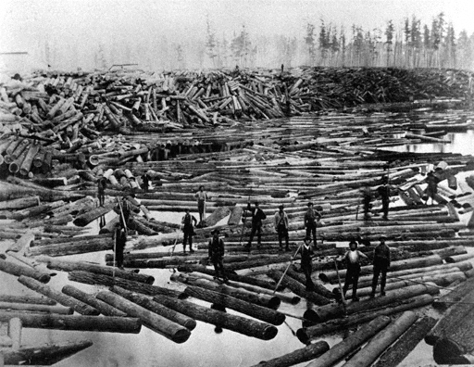
Log Jam

Slide 20
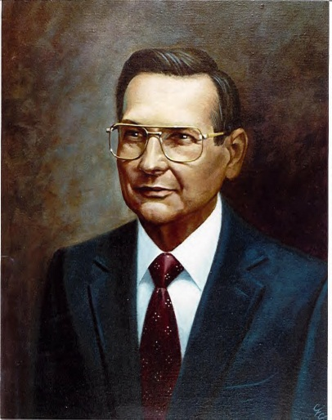
William Blair, D.C.,
continued to research the
influence of malformations
on spinographic interpretation
and developed some promising
solutions.
For his contributions and discoveries
Palmer College awards him:
Daniel David Palmer
Scientific Award
Doctor of Philosophy of
Chiropractic Degree

Slide 21
To understand BJ’s concern
about the influence of
malformations on vertebral listings
and why the Blair work
answers many of these questions…
..let’s examine how listings are
determined.

Slide 22
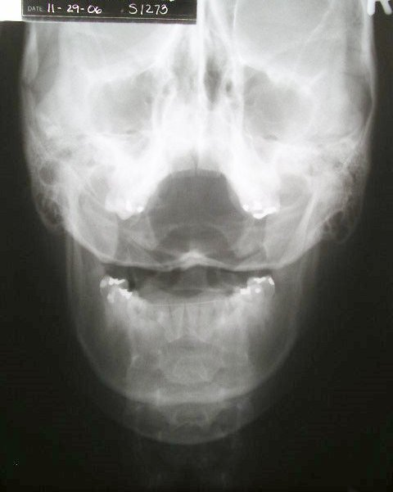
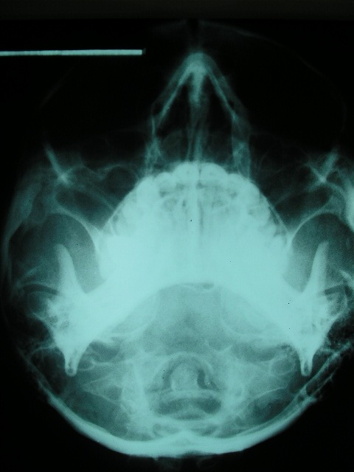
X-rays let us see inside and give much information
about how a vertebra has misaligned.
No misalignment
No misalignment

Slide 23
We learn to interpret the direction
of misalignment to give a proper adjustment
(ASR-A)
(ASR-A)

Slide 24
ASR-A
1 Lateral mass wider on right
2 Lateral inferior tip smaller on right
3 Posterior tubercle moves toward right
4 Transverse foramen smaller on right
5 Transverse process shorter on right

Slide 25
No misalignment
Anterior rotation on right
How would this
palpate?
How would this
palpate?

Slide 26
Anterior rotation on right
We analyze listings by:
X-ray
Palpation: motion
muscle
B.J. taught us how malformations
lead us to wrong conclusions and
the importance of recognizing them.

Slide 27
So how do we overcome the role malformation plays in determining ‘exactly’ how atlas displaces?

Slide 28
Malformations of the
Foramen Magnum..
...and their influence on
Vertebral Subluxation analysis

Slide 29
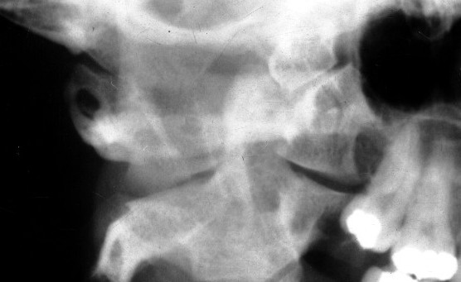
In many ways when two
vertebra meet at the
articulation they are
“many times” mirror
images to each other.
The antero lateral
margins are very reliable
areas for seeing
misalignment but are not
seen on standard x-rays.
The atlanto-occipito joint
will have matching slopes..
and matching convexities/concavities.

Slide 30
Convergences also match:
If the right condyle
converges 30 degrees..
..the right atlas
superior articular
surface will also
converge 30
degrees.

Slide 31
If the left
condyle is small
If the right
condyle is large
The left sas of atlas will
be sized to match it
The right sas of atlas will
be sized to match it.

Slide 32
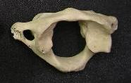
Which condyle would be larger? Right or left?

Slide 33
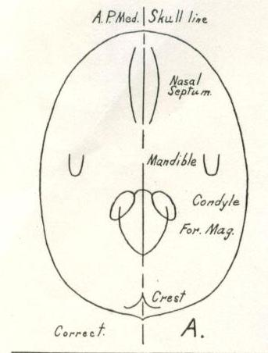
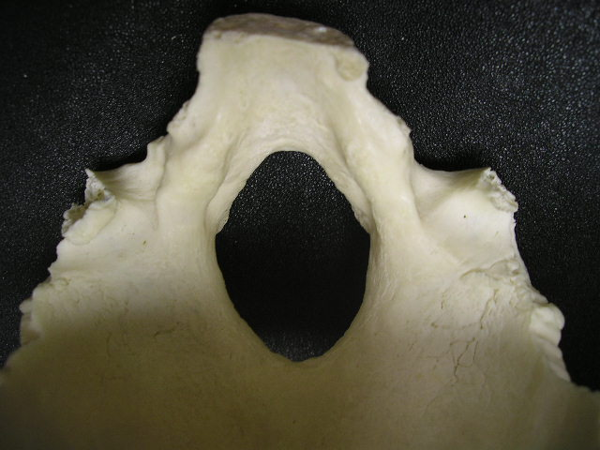
Normal (symmetrical)
condyles and
foramen magnum

Slide 34
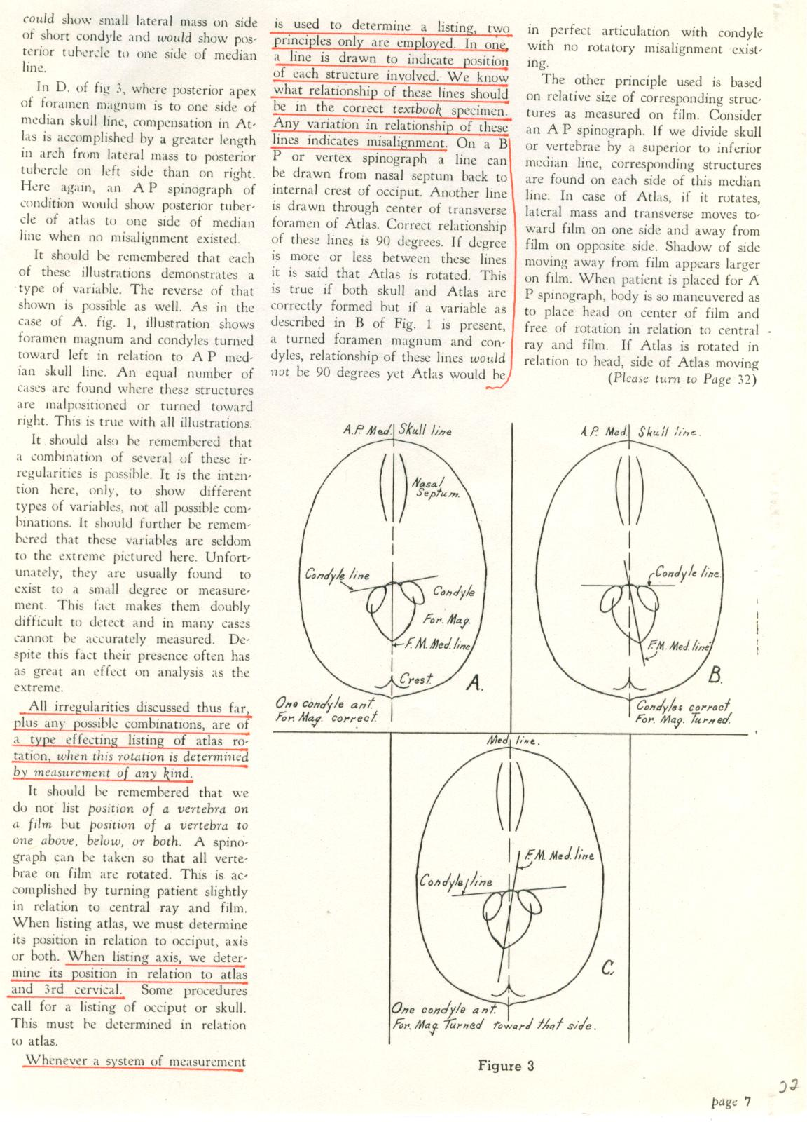
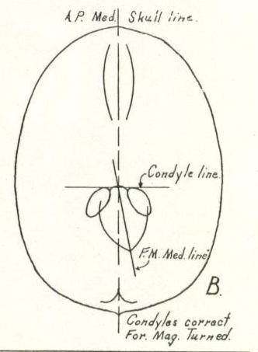
BJ drawing of turned foramen magnum
on the base posterior x-ray
Affects atlas listing
Present in many skulls

Slide 35
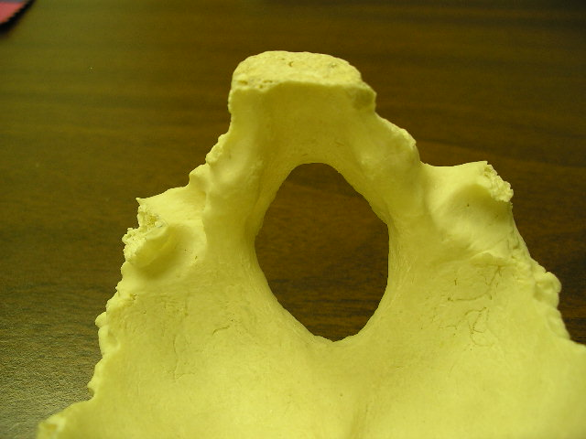
Turned foramen magnum

Slide 36
An atlas in juxta position
to this turned foramen
magnum…
..will appear:
..rotated anterior on
the right when it is not!
Superior articular
surface of C1
on bottom of
occiput
(Turned FM: Present in many skulls)

Slide 37
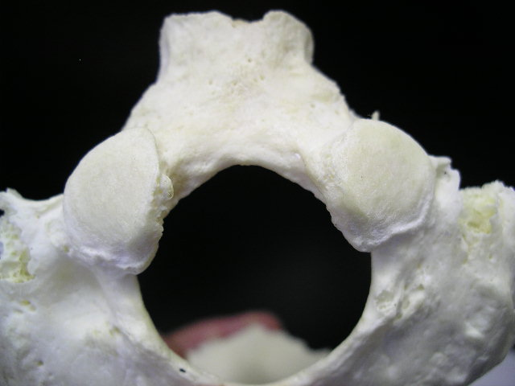
Anterior condyle

Slide 38
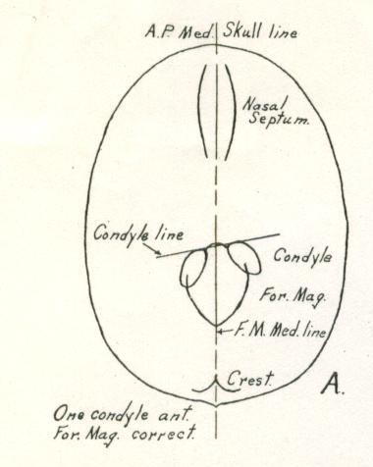
What will atlas look like
if it is properly lined up
to this foramen magnum
and condyles?
Remember, atlas is in
juxta position!
The malformation makes
it look misaligned.

Slide 40
Note transverse foramen on right seems rotated to the anterior

Slide 41
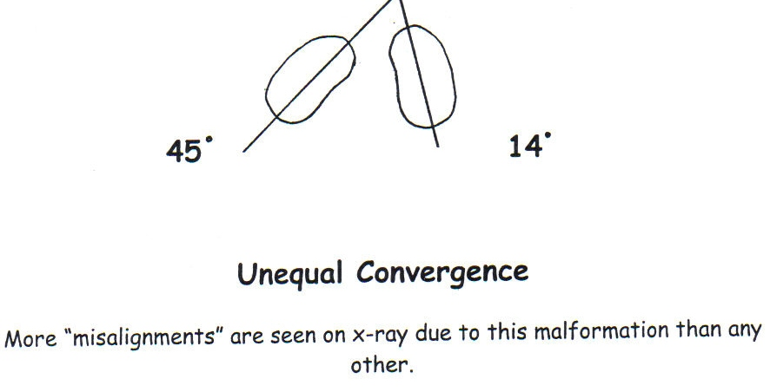
of Condyles
-William Blair, D.C.

Slide 42
This will be wrongly
interpreted as
rotation of atlas
of Condyles
The greater the condyle convergence
the larger the lateral mass will appear on an
A-P cervical x-ray

Slide 43
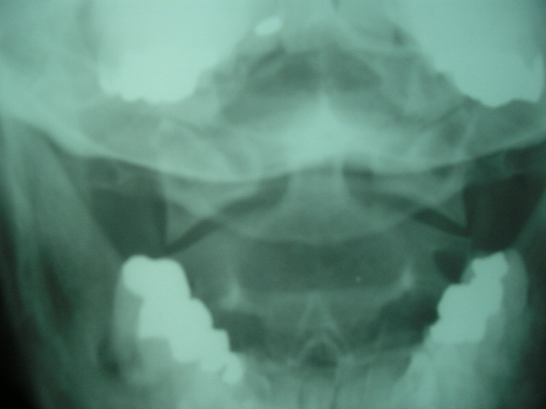
Wedge lines often indicate laterality
(Right atlas laterality)
Some malformations affect the wedge line
and give a false laterality.

Slide 44
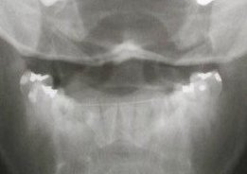
Short condyle
This malformation
affects the wedge
line.
And that affects
laterality (and
rotation)

Slide 45
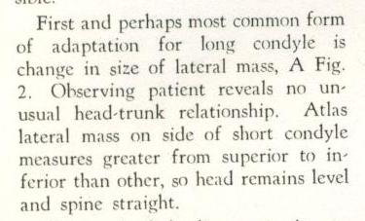
-B.J.

Slide 46
-B.J.

Slide 47
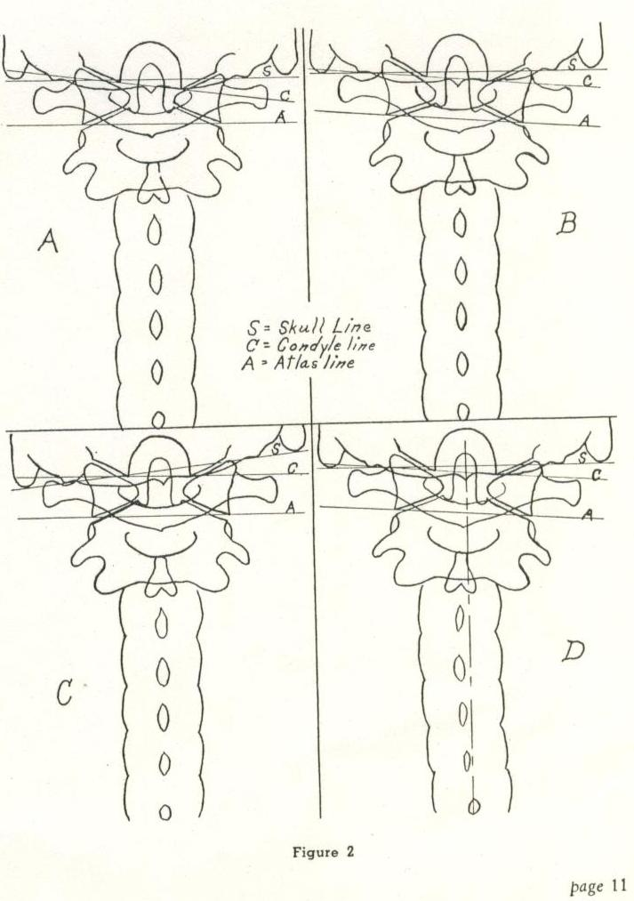
Innate Adaptation to the short condyle
Taller C2
superior
articular
surface on
side of short
condyle
Taller lateral
mass on side
of short
condyle
.
Scoliosis
toward side
of short
condyle
Head tilt to
side of short
condyle
.
.
.
.
.

Slide 49
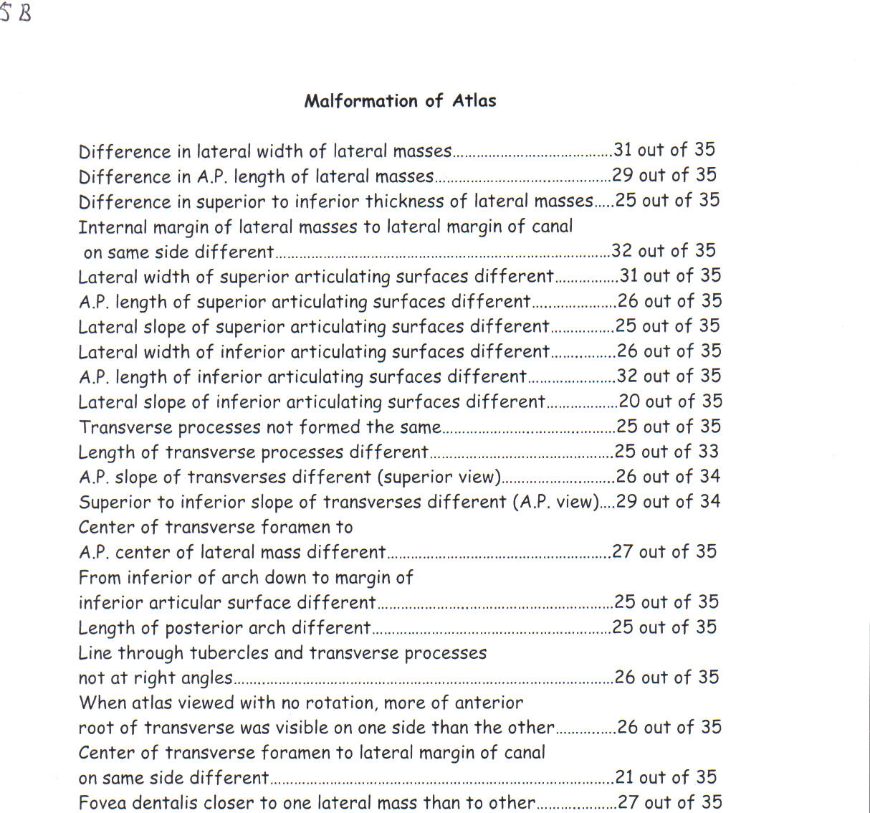

Slide 50
Malformation of Atlas: Palmer College Study
(Real bone specimens)
Difference in lateral width of lateral masses…..31 of 35
Length of posterior arch different……………………..25 of 35
Length of transverse processes different………..25 of 33
When atlas viewed with no rotation more of
anterior root of transverse was visible on
one side than the other………………………………………….26 of 35

Slide 51
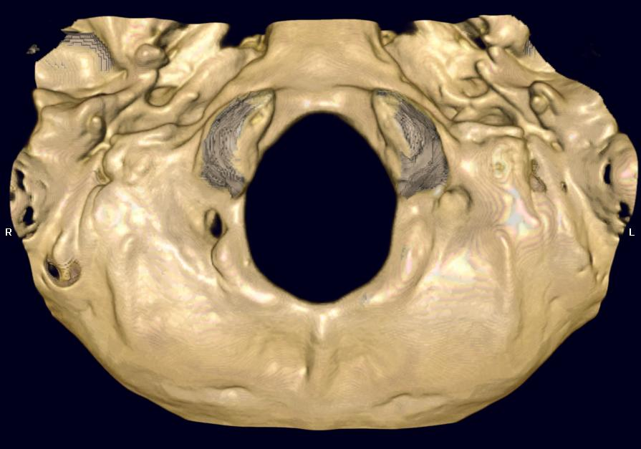
THIS SPECIMEN IS ABOUT AS SYMMETRICAL AS YOU WILL FIND!

Slide 52
THIS SPECIMEN IS ABOUT AS SYMMETRICAL AS YOU WILL FIND!

Slide 53
THIS SPECIMEN IS ABOUT AS SYMMETRICAL AS YOU WILL FIND!

Slide 54
THIS SPECIMEN IS ABOUT AS SYMMETRICAL AS YOU WILL FIND!

Slide 55
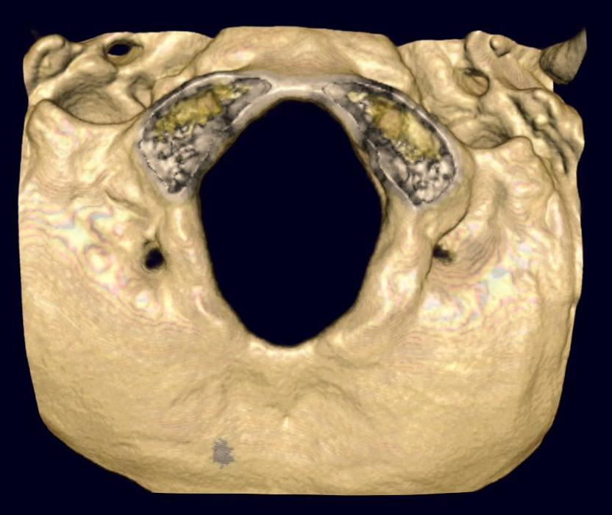

Slide 60
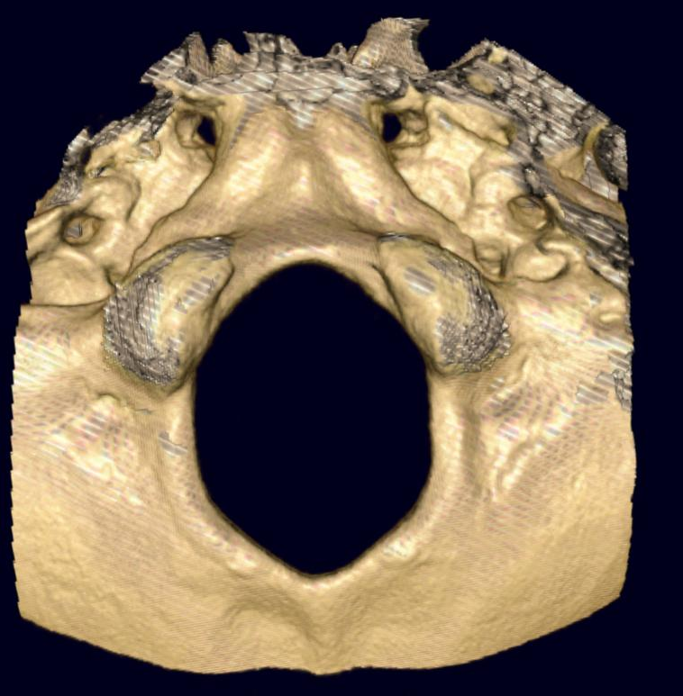
AS IS THIS ONE!

Slide 61
AS IS THIS ONE!

Slide 62
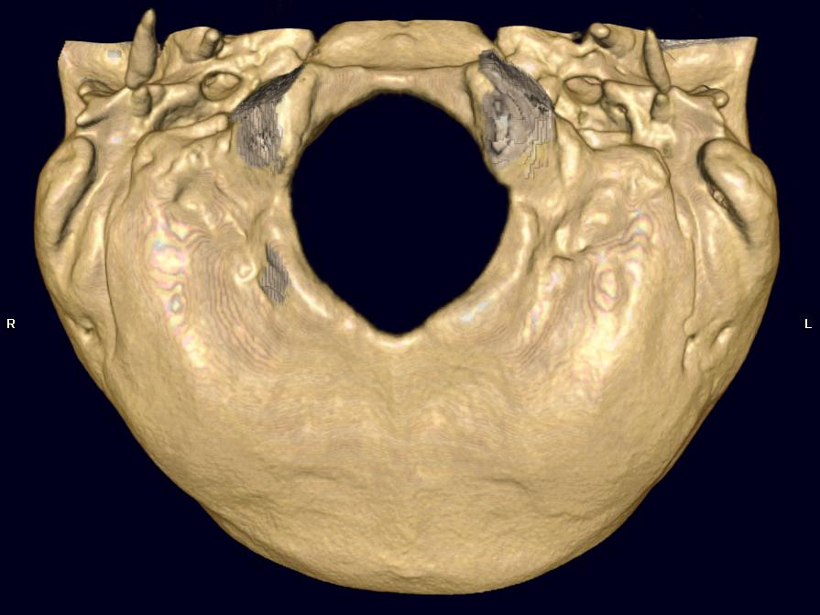
Which way will the atlas move, anterior or lateral?

Slide 63
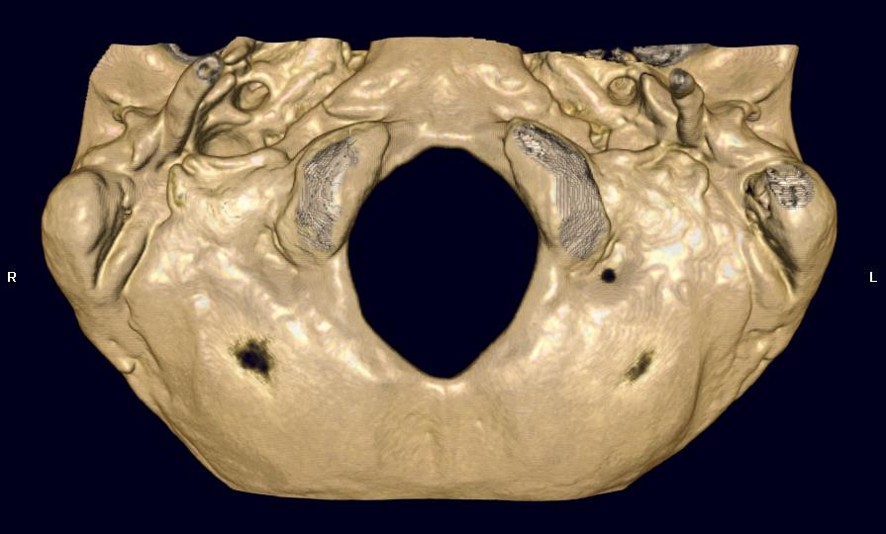

Slide 64
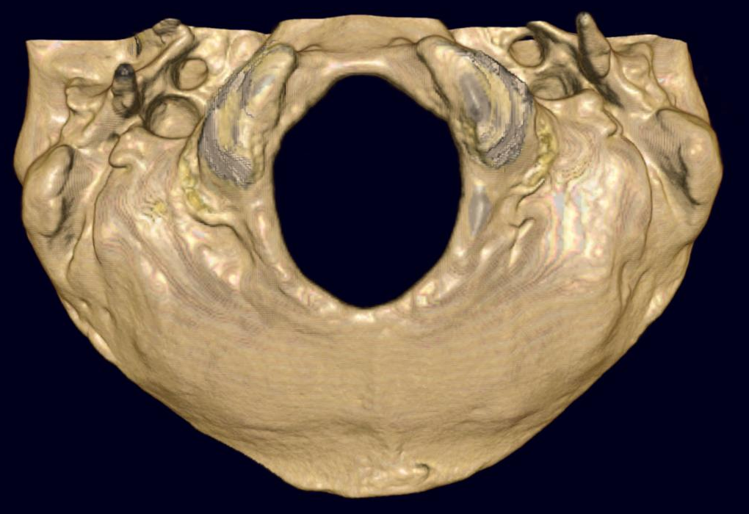

Slide 65
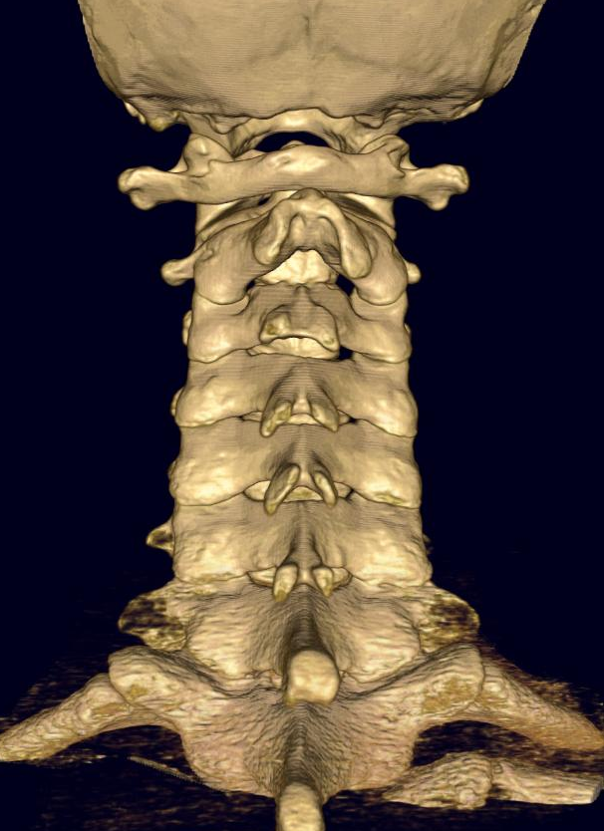
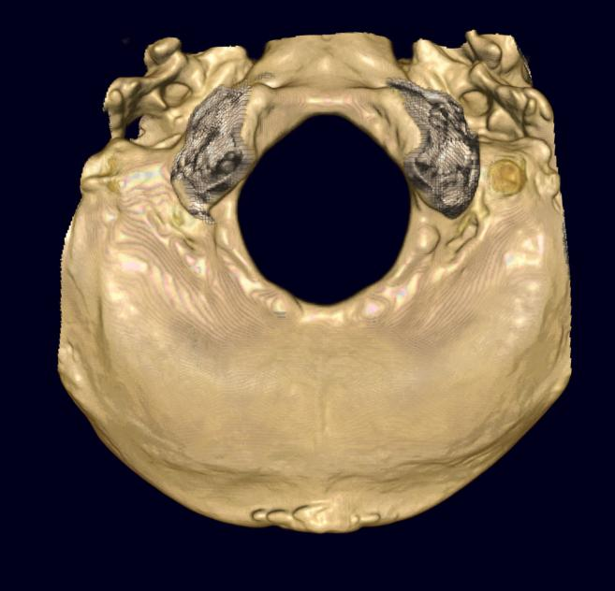
Occ/C2

Slide 66
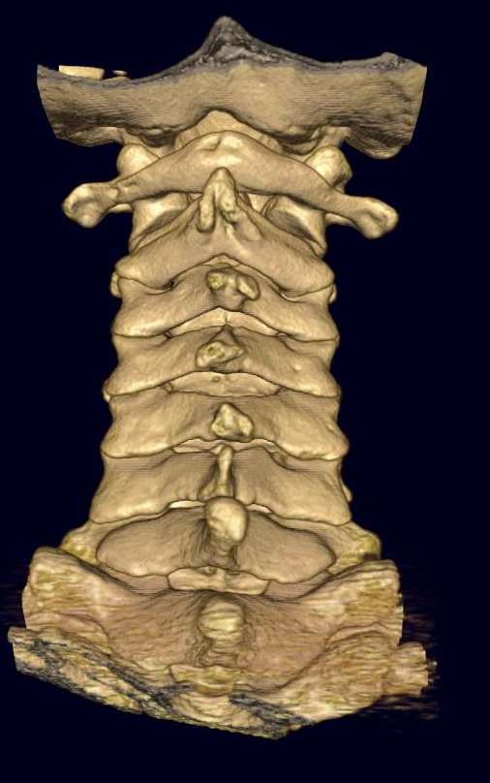
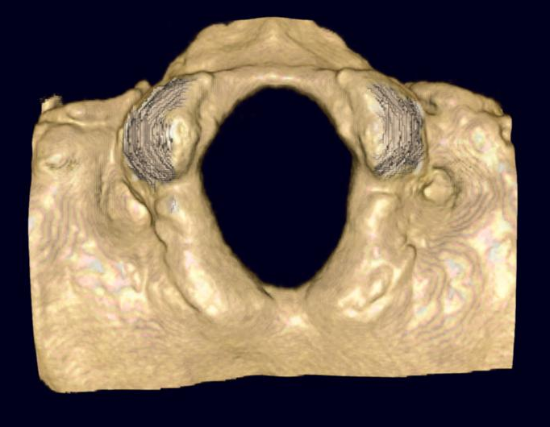
Centered foramen magnum

Slide 68
Centered axis spinous

Slide 69
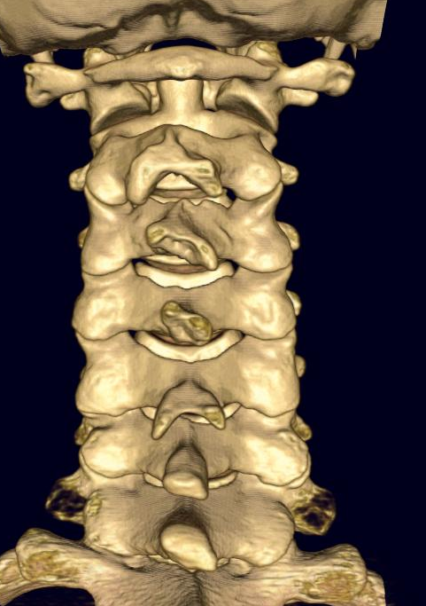
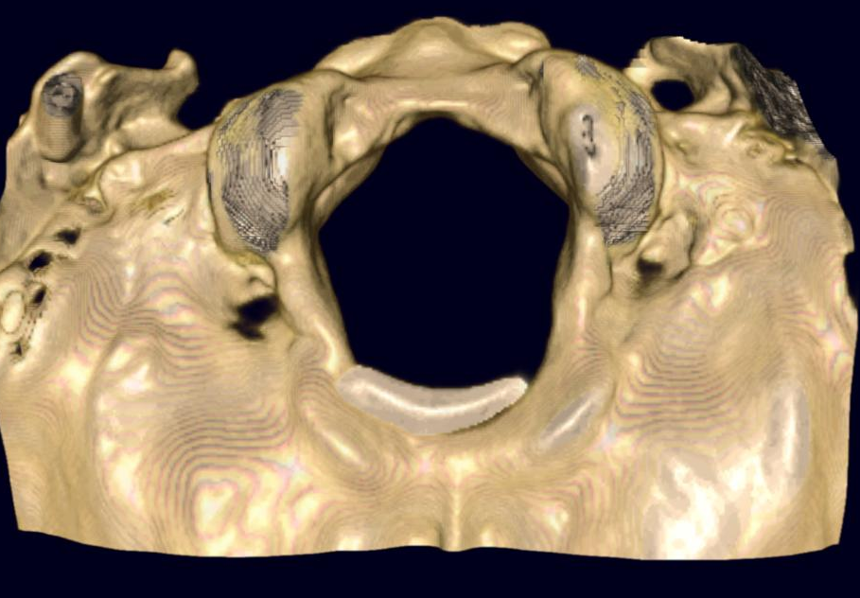
Note spinous of C-2 is left of center, which would coincide with left turned foramen magnum.

Slide 70
Note spinous of C-2 is left of center, which would coincide with left turned foramen magnum.

Slide 71
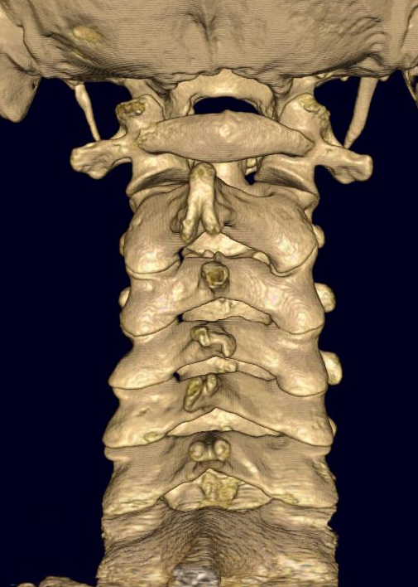
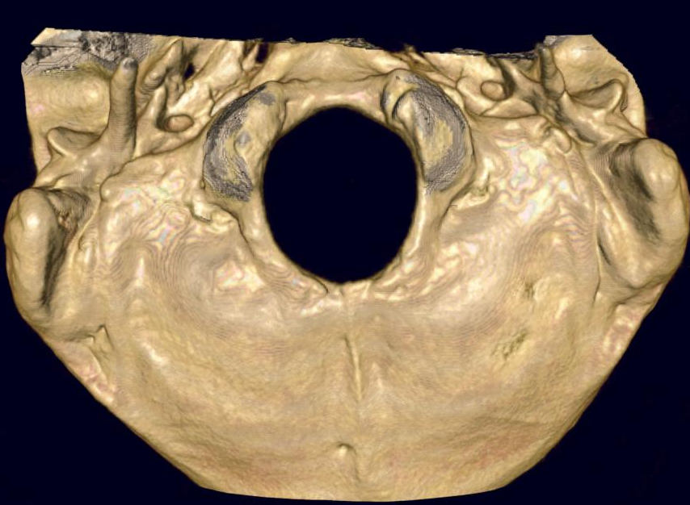
Note posterior tubercle is right- aligned with turned foramen magnum, but left C-2 spinous (look at left C-2 ALS) does not align with posterior tubercle.

Slide 72
Note posterior tubercle is right- aligned with turned foramen magnum, but left C-2 spinous (look at left C-2 ALS) does not align with posterior tubercle.

Slide 73
Note posterior tubercle is right- aligned with turned foramen magnum, but left C-2 spinous (look at left C-2 ALS) does not align with posterior tubercle.

Slide 74
Certain parts of the vertebral joint
margin can reveal much
about how the vertebra has
misaligned.
…the body is extremely capable of
precision design…

Slide 75
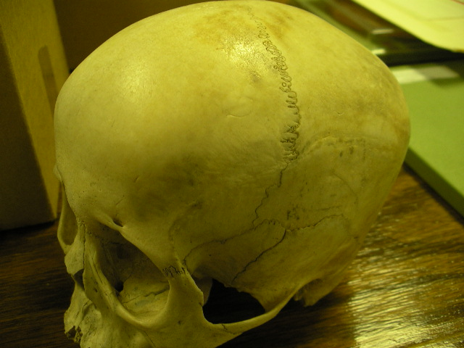
…when putting adjoining
structure together.

Slide 76
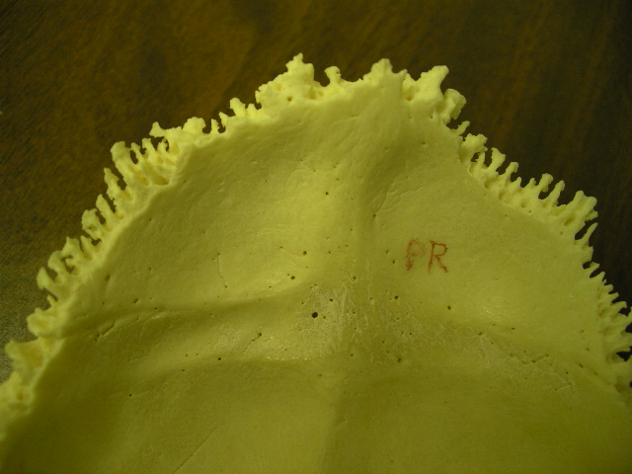
Of billions of skulls on the planet,
will any exactly match this one?

Slide 77
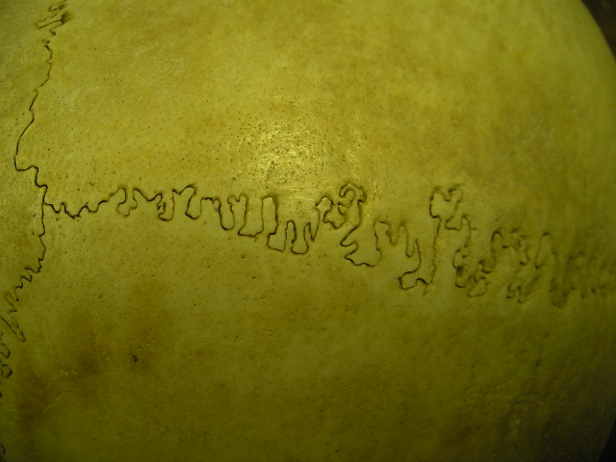
And yet, there are areas where
boney structure comes together
that will match precisely.
Certain areas of vertebral joints
also match precisely.

Slide 78
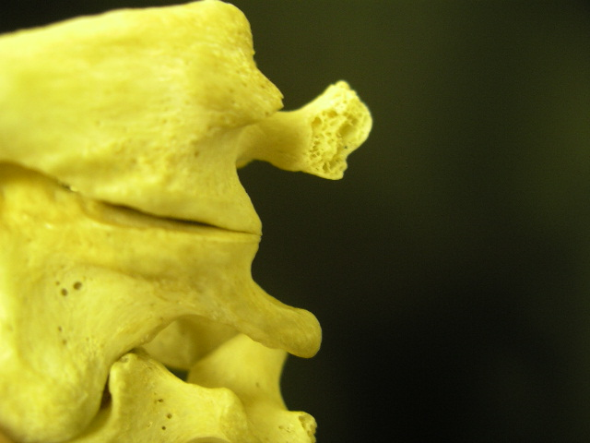
A study of vertebral articulations
reveals examples of matching exactness.

Slide 79


Slide 80


Slide 81


Slide 82
The antero-lateral margin
of occiput to atlas
frequently yields reliable
alignment information…
…and eliminates a myriad of
other malformation factors

Slide 83
But it takes custom x-rays
to see these margins.

Slide 84

This precise cadaver mold of the
antero lateral margin of atlas to
occiput shows the natural alignment
that occurs at this part of the
articulation.

Slide 85
It takes a custom made oblique view to see..
..the antero lateral margin
of atlas

Slide 86


Real bone atlas with matching cadaver mold of
same atlas and partner occiput shows how the
antero lateral margins fit precisely

Slide 87

Antero lateral margins

Slide 88


Slide 89



Anterior view Atlanto Occipital Joint
Right anterolateral margin
Left anterolateral margin
Rt. rotation
Lt. rotation

Slide 90




BJ diagonal cervical x-ray
BJ turned the patient a standard 45 degrees
and looked at the lateral aspect of the
atlas /condyle margin for
misalignment information

Slide 91
Since partner condyles usually converge unequally
Dr. Blair began customizing these views to look
specifically along the convergence of
each condyle.

Slide 92



By determining condyle
convergence from the base
posterior
a custom diagonal view
would reveal
misalignment usually
not visible on other views.
overlapped
lined up
25
28

Slide 93
By viewing the articulation
with “custom” made views,
and with the aid
of stereo x-rays,
the “malformation problem”
was significantly minimized.

Slide 94


It was discovered that viewing specifically
along each condyle convergence
revealed some very significant information

Slide 95
At first the information did not make sense
Atlas would show misalignment on one side..
..but in many cases
it would appear lined up on the other side
Was this just malformation?

Slide 96
We discovered the atlas moved in a different way
Atlas will track on one side, slip on the other
Because of this newly discovered atlas mechanical
movement, we now need to rethink our adjustments
Blair x-ray analysis will show you exactly
how atlas moves how it should be corrected

Slide 97

Solving problems with custom made views adds to the excellence we strive
strive
for in
subluxation
correction.

Slide 98
So what are these custom-made views and how do they give us more credible information?

Slide 99

It starts with the base posterior
to determine condyle convergence.
Why?
28 degrees
30 degrees

Slide 100
When a misalignment occurs it does
so at the articulation/joint.
Standard x-rays do not usually
view the joint in such a way
that true misalignment is
properly revealed.

Slide 101

(Blair diagonal)
The patient is turned to see the true lateral aspect of
the articulation by looking
along the condyle convergence.
This area frequently
provides more reliable
misalignment information
than parts of the
vertebra more subject
to malformation .

Slide 102
Here is a close up view

Slide 103

The patient is turned the
other way to see the
true lateral aspect
of the other articulation.

Slide 104
Here is a close up view
of the other side

Slide 105

When a custom diagonal
is taken to view the
antero lateral margin..
you will
also see:
Slope of
condyle
Anterior border
of
Foramen magnum
Convexity of
opposite
condyle

Slide 106

Mold of real occiput turned to
see antero lateral margin
(viewed from the anterior)
Slope of
rt. condyle
Anterior border
of foramen
magnum
Convexity of
left condyle

Slide 107
D.C’s who have studied Blair
Dr BJ Palmer-discoverer of the HIO system.
Dr. Don Kern-current President of Palmer College
Dr. Sid Williams-past President of Life College
Dr. Lyle Sherman-Past Director of the BJ Research Clinic
Dr. Elmer Crowder-B.J. Palmer’s personal chiropractor
Dr. Charlie Ward- Developer of Ward Management Services
Dr. Weldon Muncy-Dr. Blair’s right hand man in research
Dr Elmer Addington-current Director of the Blair Clinic
AND

Slide 108

Certified Blair instructor, Dr. Jon Schwarzbauer…
teaches the Blair adjusting course and assists students on the health center floor.

Slide 109

1980 – At Sherman Lyceum
ADIO president, Reggie Gold recruits
Perry Rush, D.C., to teach “Blair” at
ADIO

Slide 110


Then…
..and now.
Pres. of Life Chiropractic
College
“Easy” Riekman teaches
Blair course at Sherman
in the early years.

