Slide 1
Blair Upper Cervical seminar series
The Blair Society members are so enthused with your interest in the Blair technique. In our opinion, Dr. Blair was a genius discovering how spinal asymmetry played such a major role in locating and correcting upper cervical misalignments. We try to stay true to his teachings while adding advancements in technology which ideally with improver the efficacy of this natural, drugless form of care.

Slide 2
Blair Upper Cervical seminar series
Dr. B.J. Palmer developed the outstanding toggle recoil upper cervical method based upon his world famous clinic and radiology facilities. Obtaining the results of Dr. Palmer seemed almost impossible until Dr. Blair found a way that students and doctors could produce BJ type results. As we learn more and more about the craniocervical region neurologically, it is critical NOT to attempt Blair adjustments without x-rays nor proper repeated technique training from certified Blair Instructors.

Slide 3
Blair seminars hour 1
The slides are properties of
Dr. Thomas Forest & Dr Jeff Hannah
Certified Advanced Blair Instructor
They are not to be copied nor distributed

Slide 4
We would all like to see Upper Cervical Chiropractic changing the health of the entire world.

Slide 5
We would all like to see Upper Cervical Chiropractic changing the health of the entire world.
But what can I do, I’m only one person?

Slide 6
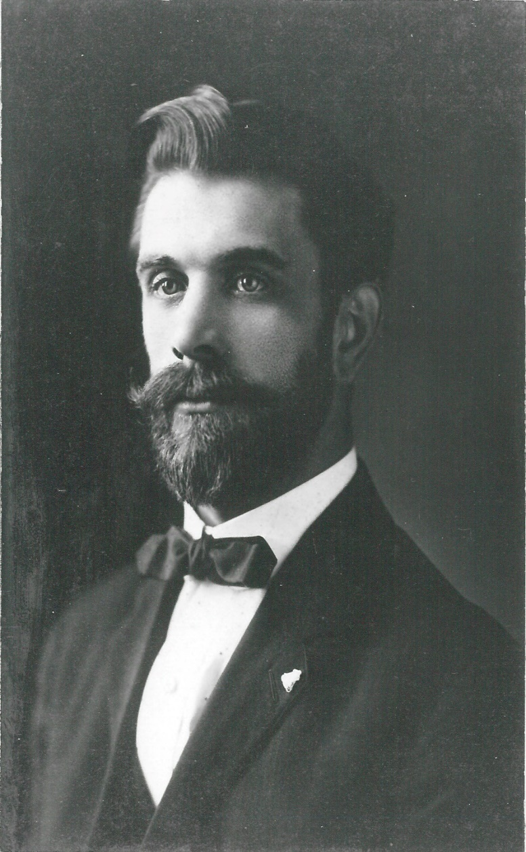
B.J. Palmer

Slide 7
The International Chiropractic Association was started in 1926 in Davenport, Iowa by Dr. B.J. Palmer. It is the oldest chiropractic association and is based on Dr. Palmer’s fundamental belief in the principle and philosophy of chiropractic as a unique, separate, distinct, and drugless health care profession.

Slide 8
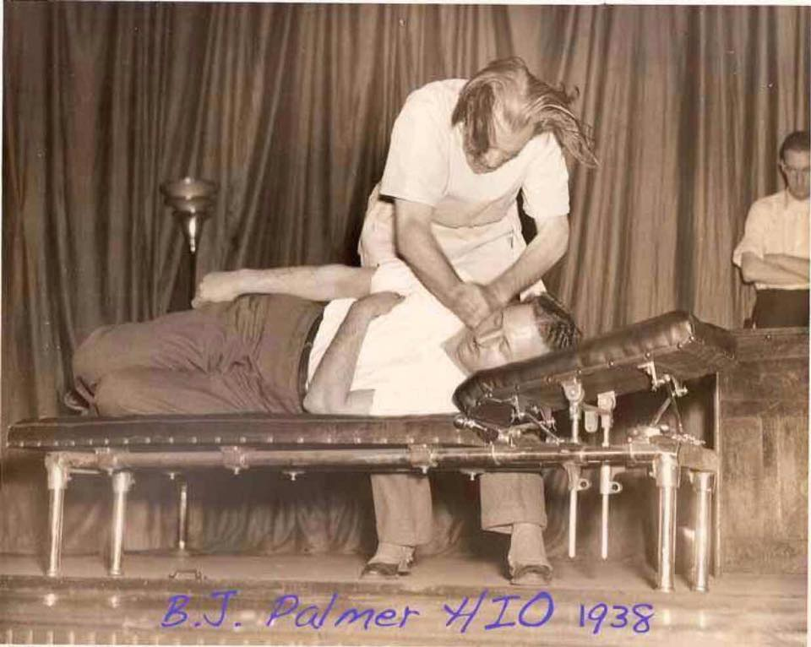
Most people assume that once B.J. Palmer discovered Upper
Cervical that he did so without any previous full spinal technique research.

Slide 9
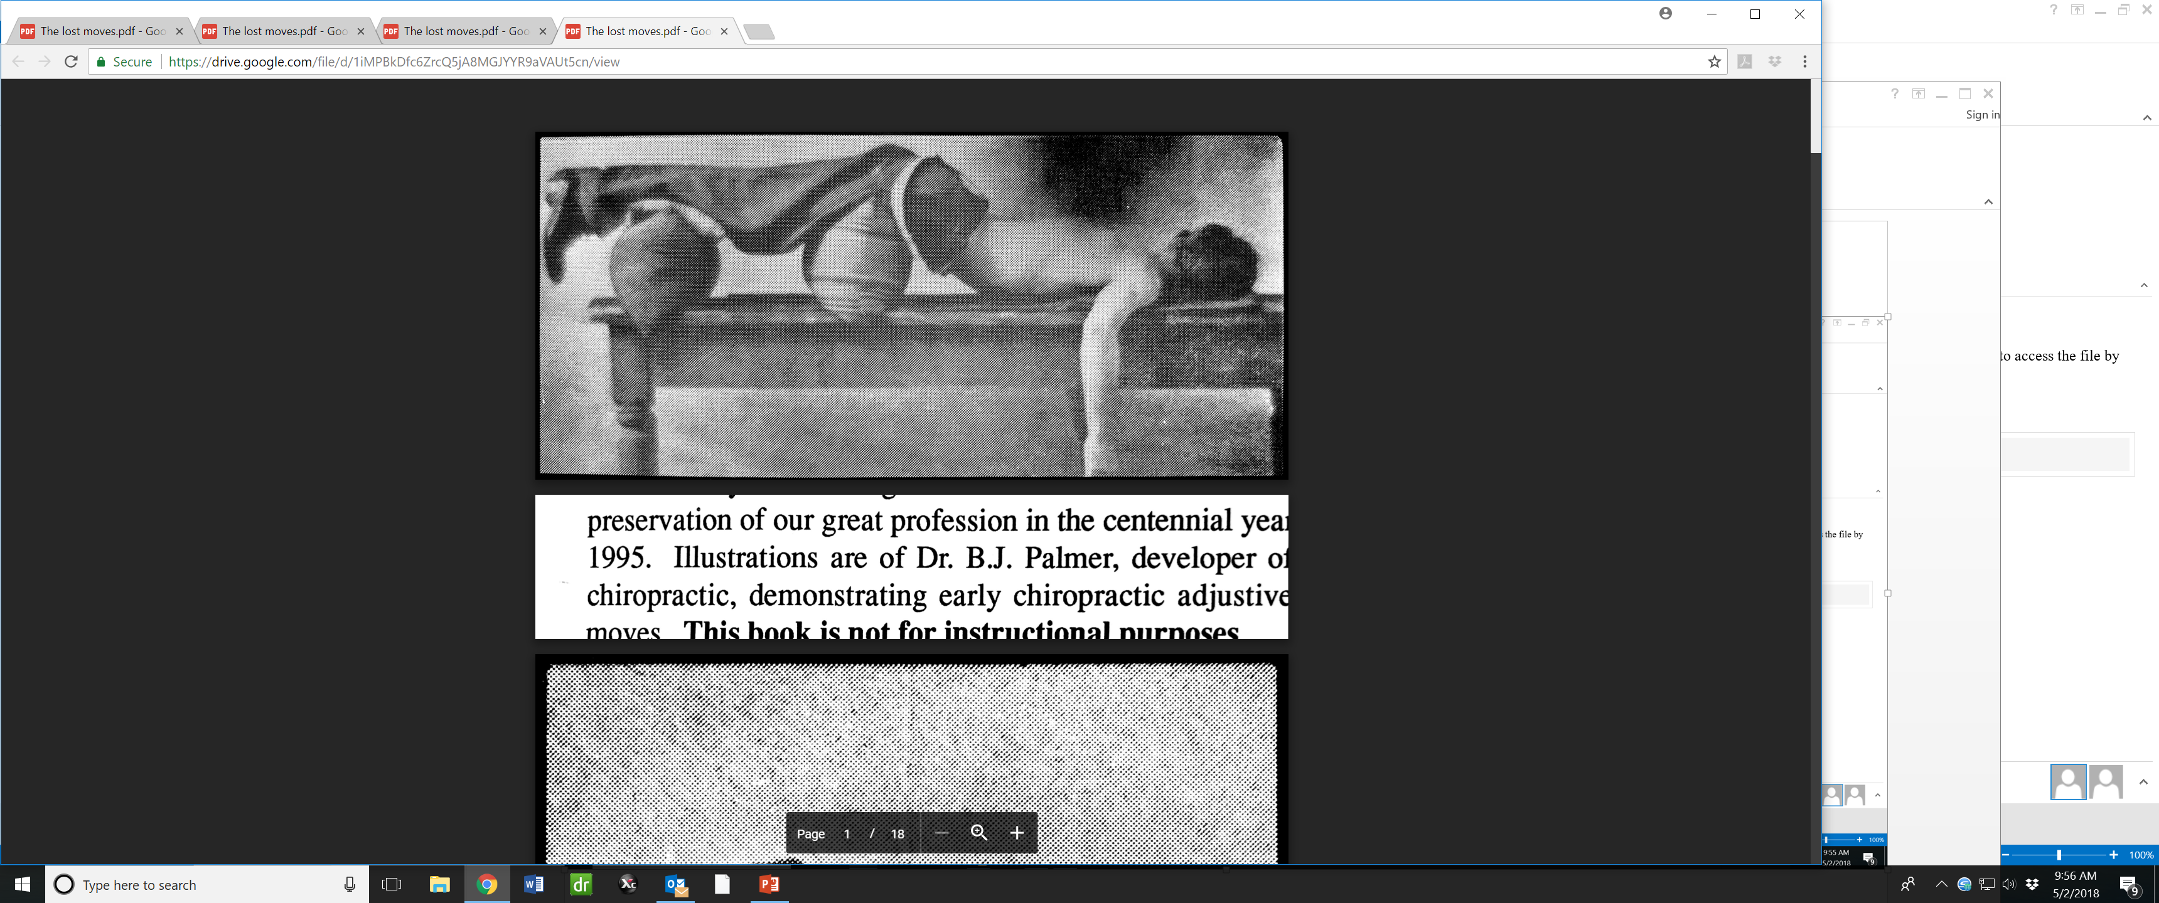
Illustrations are of Dr. B.J. Palmer, developer of chiropractic, demonstrating early chiropractic adjusting moves.

Slide 10
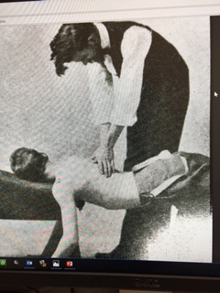

Slide 11
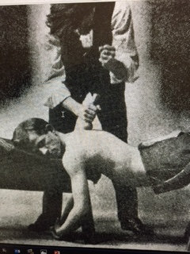

Slide 12
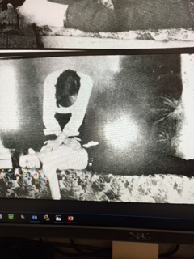
The toggle-recoil adjustive approach, was originally used in full-spine adjusting and adapted for atlas adjusting by B.J. Palmer himself.

Slide 13
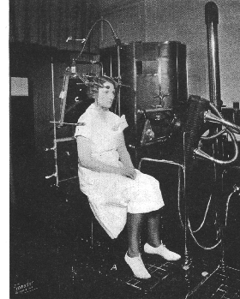
B.J. Palmer, D.C.
Brief synopsis of his life.
1910 introduced X-ray to the profession naming the images Spinographs.
BJ imported the 1st x-ray machine used in a chiropractic college. He developed the precision posture constant which would measure exact x-ray position so a patient could be filmed a year later in precisely the same position.
Patient postured in precise posture-constant position for “before and after”

Slide 14
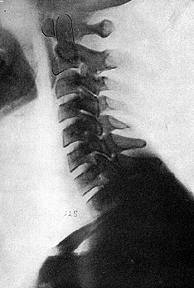
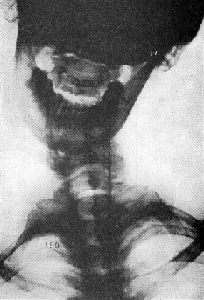
X-ray images from the 1934
The Subluxation Specific The Adjustment Specific

Slide 15
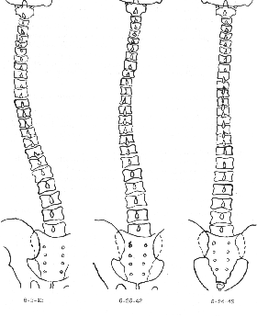
CHIROPRACTIC CLINICAL CONTROLLED RESEARCH 1951 BJP
Comparative full spinographs reveal correction of curvature.
Patient reports that he has had no adjustment since the atlas correction received which lasted eight years!

Slide 16
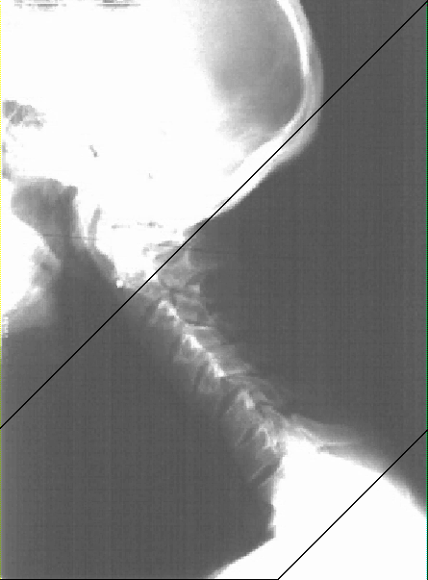
C-sp & L-sp changes with atlas adjustments

Slide 17
Precise, Posture-Constant, Spinograph, Comparative Graphs Vol 20
An Exposition of Innate Natural Adaptation
following HIO Adjustment
At this point in time they could not overlay x-rays to demonstrate before and after images. B.J. hired an artist to trace the x-ray images on special paper which would then allow the tracings of the x-rays to be reproduced.

Slide 18
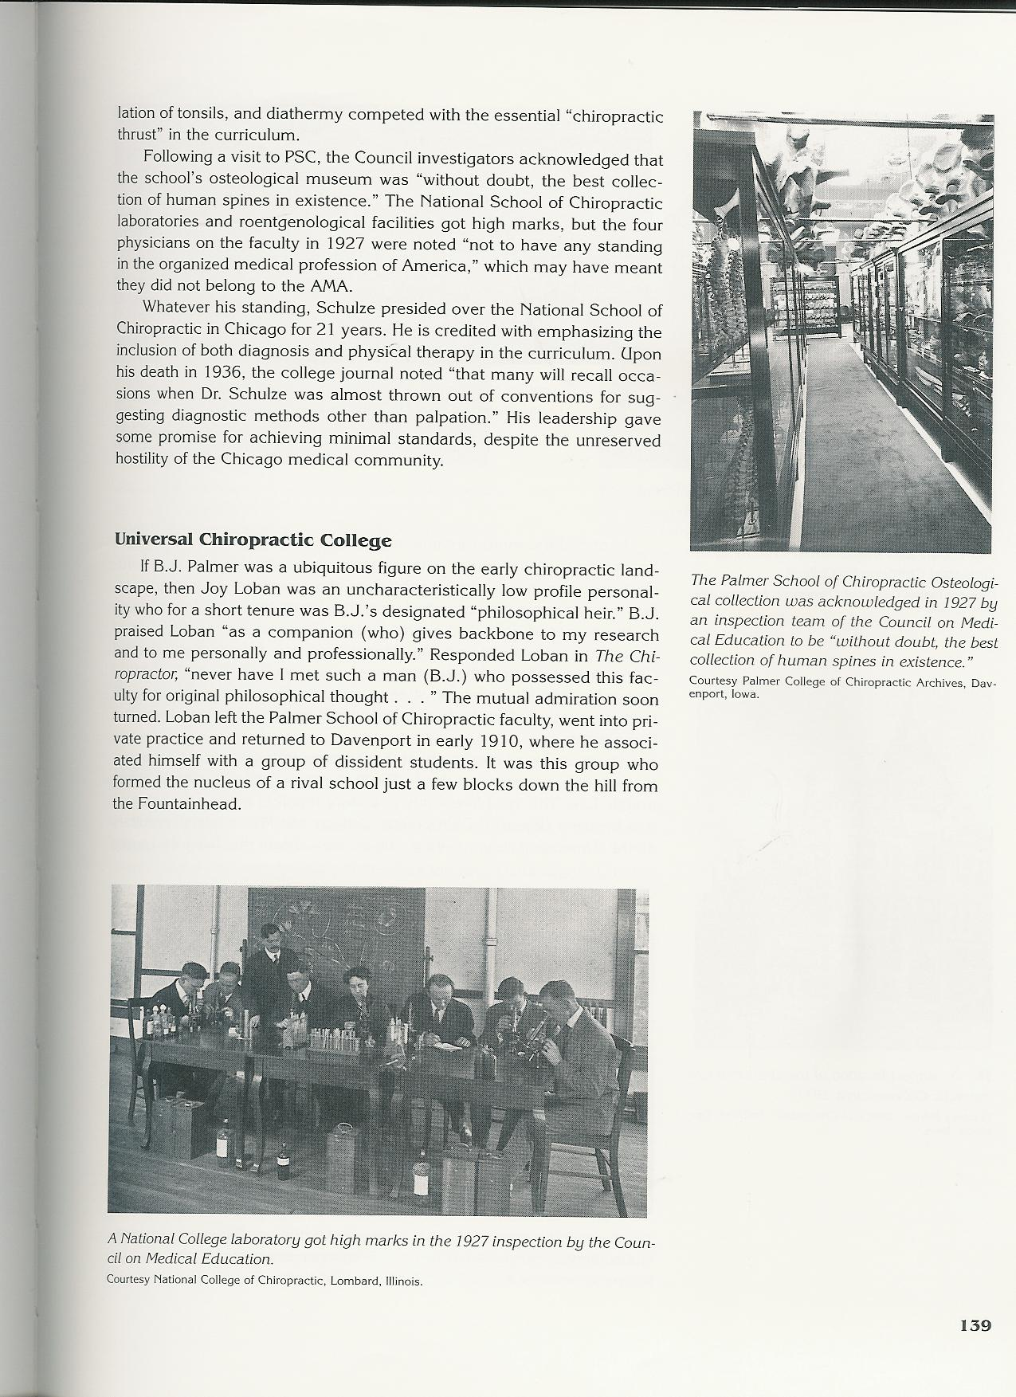
B.J.s Osteological collection was the largest in the world, Harvard University had the second largest! The Council on Medical Education stated “without doubt, the best collection of human spines in existence.”

Slide 19
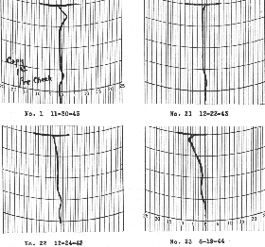
B.J. Palmer, D.C.
RESEARCHING THE UNKNOWN MAN vol. 25
Brief synopsis of his life.
1925 B.J. introduced the Neurocalometer
We demanded that Neurocalograph records be made to match, day by day, week by week, each with the other with PERFECT precision.
That pattern WILL NOT CHANGE until adjustment is given; after which, pattern will gradually begin building A NEW pattern—one towards the normal-constant with abnormal variables fading out and normal constant fading in.

Slide 20
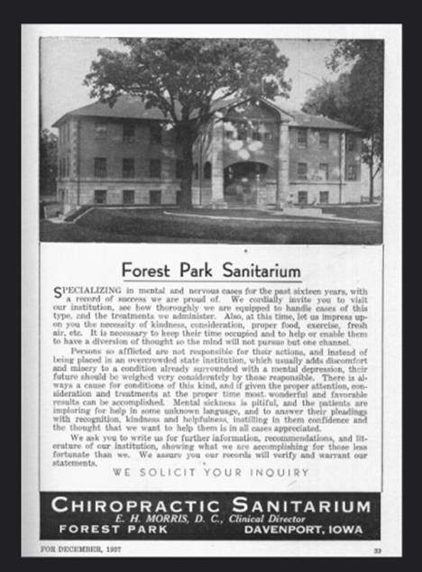
Clearview Sanitarium
In 1934, in North Dakota, a number of medically incurable patients were transferred to Forest Park Sanitarium and, within a year, a cure rate of more than 65 percent was reported. (vs medical cure rate of 18-27%)
Source:
Mental Health and Chiropractic, Christopher Kent, D.C.

Slide 21
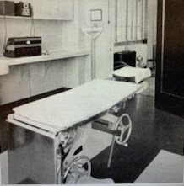
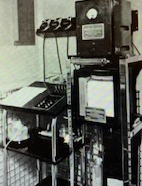
At the B.J. Palmer Chiropractic Research Clinic (BJPCRC)
M.D.’s would perform the intake exam, including pre and post adjustment EKG, blood and urine analysis and render a medical diagnosis. Then the patient was referred to the chiropractor for analysis and adjustment to upper cervical spine only.
Intake medical exam room
Neurocalometer & Neurocalograph room

Slide 22
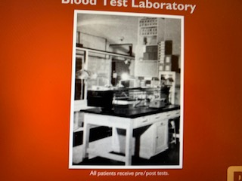
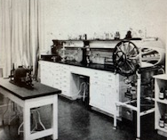
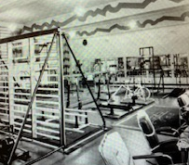
B.J. Palmer Chiropractic Research Clinic (BJPCRC)
Chemistry Research Lab
Blood Test Lab
Rehab Facility

Slide 23
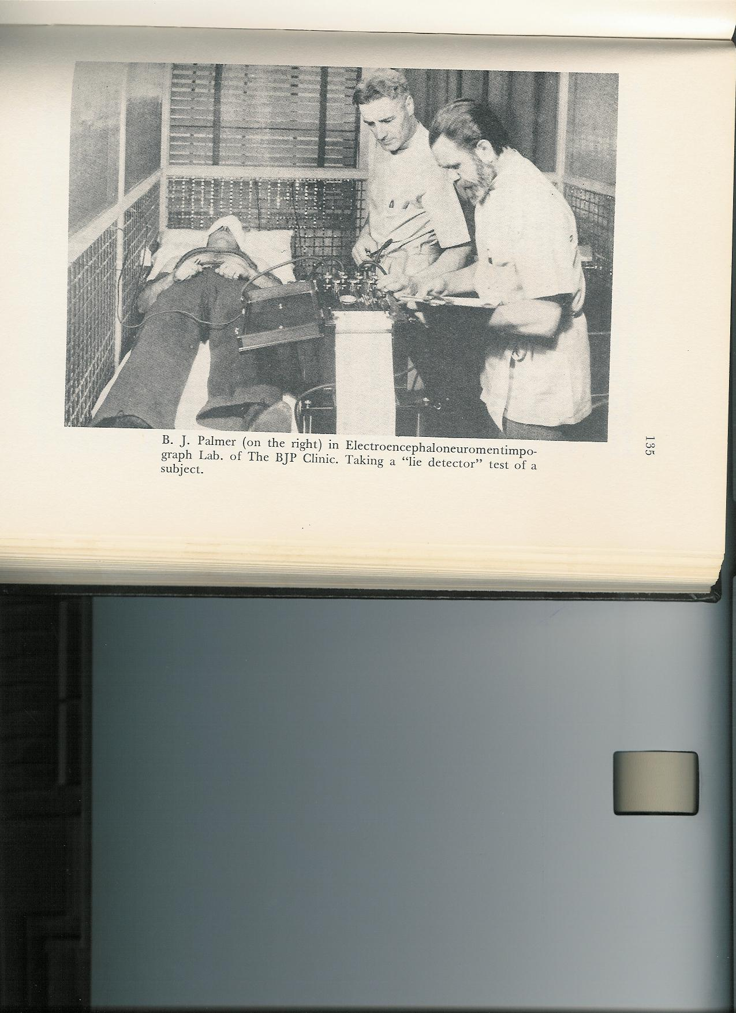
B.J. Palmer, D.C.
THE KNOWN MAN vol 19
Brief synopsis of his life.
B.J. had General Electric produce the Electroencephaloneuromentimpograph housed in a copper shielded and grounded booth along with the NCM and Keeler Polygraph used in criminal cases, as a “lie detector”. Electrodes were attached to skull, C-1,2 and afflicted organs looking for nerve blockage, which invariably emanated from the Upper Cervical region.

Slide 24
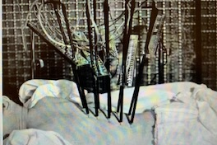
Close-up on fractured section of the spinal column giving a neurological comparison from both above & below
Note copper shielded and grounded wall in background

Slide 25
Epigrams were plastered on the walls by B.J. to inspire and make one think!
Kites fly against the wind, not with it.
Throw away your wishbone, straighten up your backbone, stick out your jawbone, and go to it!
Only mints can make money without advertizing!
Where there is no vision, the people perish.
Many a man has the eyesight of a hawk and the vision of a clam.
Some seek greatness, some acquire it, and some have greatness thrust upon them.
Following the paths of least resistance is what makes rivers and men crooked.
RULE # 9 Don’t take yourself too damn seriously!

Slide 26
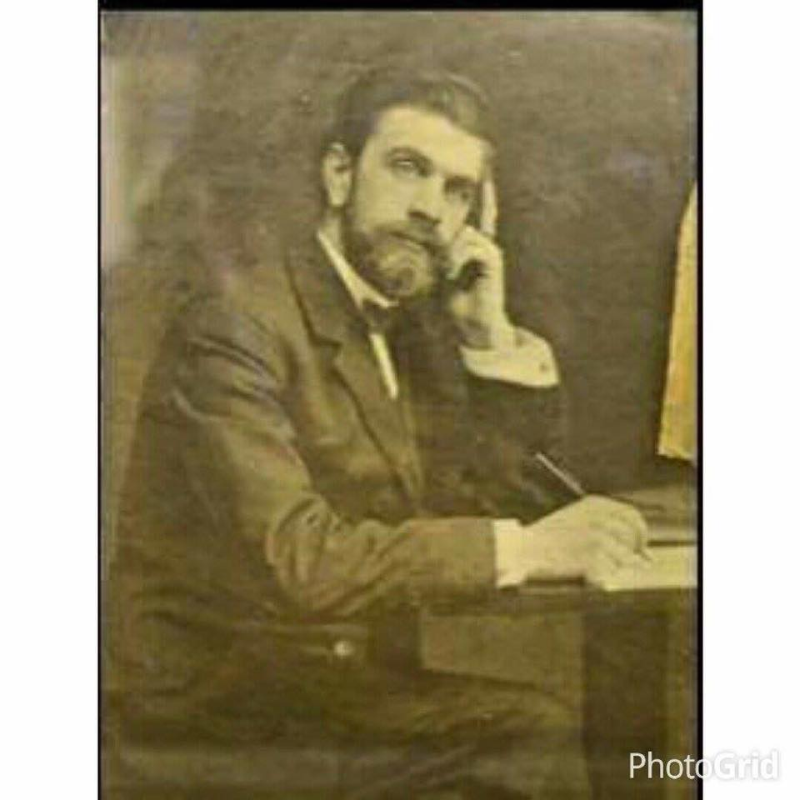
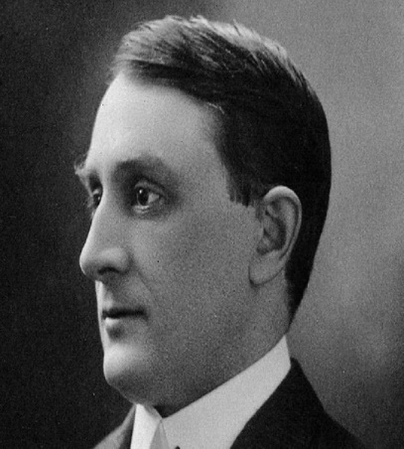
Conversation between B.J and Dr. Mayo
In the early 20th century, Dr. Charles Mayo, physician, surgeon, and co-founder of the famed Mayo Brothers Clinic in Rochester, Minnesota, brought his wife for treatment to the Dr. B.J. Palmer Chiropractic Research Clinic in Davenport, Iowa.
Dr. Mayo had taken his wife to other physicians, including doctors in Europe, all distinguished diagnosticians and specialists.
Mrs. Mayo received chiropractic care for several months and went home well. Dr. Mayo stated that it was impossible for her to get well with what Palmer did, yet he also admitted she was well.
Although Dr. “Charlie” Mayo passed on in 1939, 60-80% of the patients entering the B.J. Palmer Research Clinic were referred by “someone” on the staff of Mayo Clinic.
Source: L. Ted Frigard, D.C., Beverly Hills, CA
1) BJ Palmer, D.C., PhC Volume XXXII
2) PL Poulsen, D.C. Personal account

Slide 27
ALL SUBLUXATIONS ARE MISALIGNMENTS, BUT NOT
ALL MISALIGNMENTS ARE SUBLUXATIONS
THE SPECIFIC ADJUSTMENT - WHAT DO WE MEAN BY “HOLE IN ONE”?
1. One ADJUSTMENT, one place, having a staying-put value
(“the adjustment with that extra something”) covering
several days or weeks; rather than many “adjustments,”
many places, daily, few of which stay put 24 hours.
2. One continuous flow of mental impulses, covering a continuous flow for days or weeks.

Slide 28
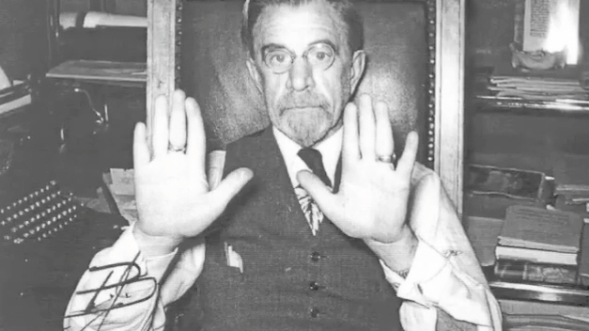
B.J. used the term ‘thot flashes’ regarding ideas which came to you when you were most at peace, but if not written down and acted upon, then ideas seem to stop coming, much like writer’s block.
B.J. discovered that when typing as he removed the paper from the typewriter, he’d lose his train of thought. So he had Remington Typewriter Company makes him a one of a kind model with a ream of paper attached so there would be no disruptions of the ‘thot flashes’. Here are the results of B.J.’s genius:

Slide 29
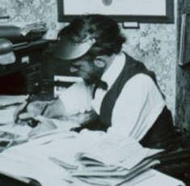
Authored 26 Green Books on the science, philosophy, and art of chiropractic:
Vol 1 -Science of Chiropractic Its Principles and Philosophies by B. J. PALMER, D. C.C. 1920
Vol 2 -The Science of Chiropractic 1920
Vol 3- The Philosophy and Principles of Chiropractic Adjustments 1911
Vol 4- The Philosophy of Chiropractic 1908
Vol 5 - The Philosophy of Chiropractic 1920
Vol 6 -The Philosophy, Science and Art of Chiropractic Nerve Tracing 1911
Vol 13 -THE PALMER TECHNIQUE OF CHIROPRACTIC 1920
Vol 18 -The Subluxation Specific—The Adjustment Specific 1934
Vol 19 THE KNOWN MAN 1936
Vol 20-Precise, Posture-Constant, Spinograph, Comparative Graphs 1938
Vol 22 -THE BIGNESS OF THE FELLOW WITHIN 1949
Vol 23-UP FROM BELOW THE BOTTOM 1950
Vol 24 -FIGHT TO CLIMB 1950
Vol 25-CHIROPRACTIC CLINICAL CONTROLLED RESEARCH 1951
Vol 26- CONFLICTS CLARIFY 1951
Vol 27- HISTORY REPEATS 1951
Vol 28- “ANSWERS” 1952
Vol 29-UPSIDE DOWN AND RIGHT SIDE UP with B.J. 1953 23. Vol 36 PALMER’S LAWS OF LIFE 1958
Vol 32-CHIROPRACTIC PHILOSOPHY, SCIENCE AND ART 1955 24. Vol 37- THE GLORY OF GOING ON 1961
Vol 33- FAME and FORTUNE and HOW TO ATTAIN IT 1955 25. Vol 38-THE GREAT DIVIDE 1961
Vol 34- EVOLUTION OR REVOLUTION 1957 26. Vol 39- OUR MASTERPIECE 1961
Vol 35- HISTORY IN THE MAKING 1957 (Bold print are must reads)
B.J. Palmer, the Author

Slide 30
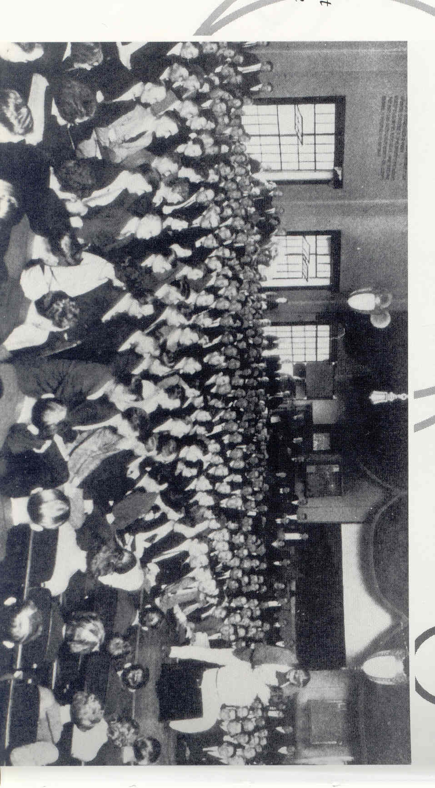

Slide 31
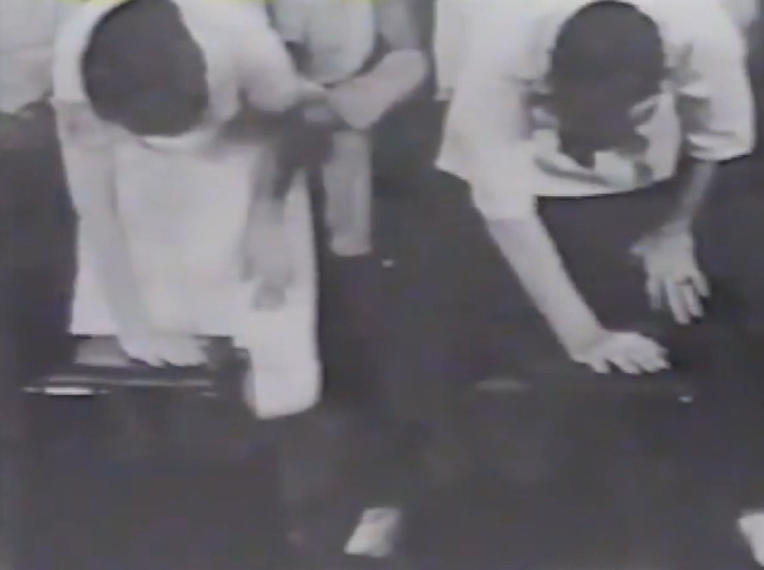
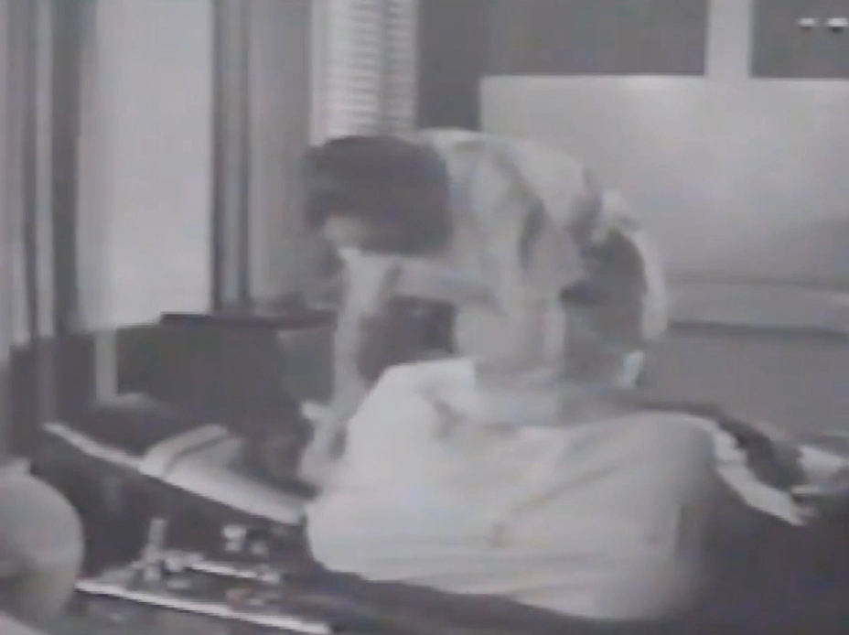
PSC Toggle Recoil Class
B.J. Palmer adjusting in his clinic
No Torque
Torque

Slide 32
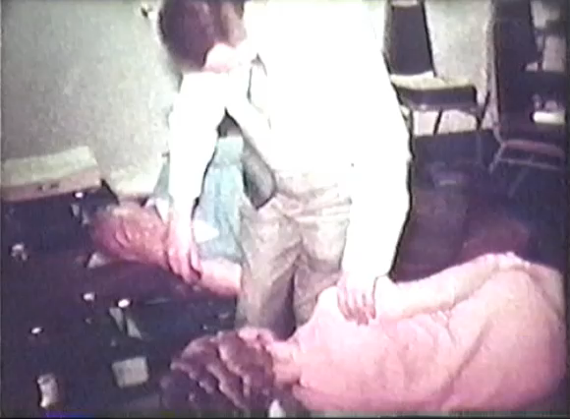
Note the similarity
‘The adjustment with something extra.’

Slide 33
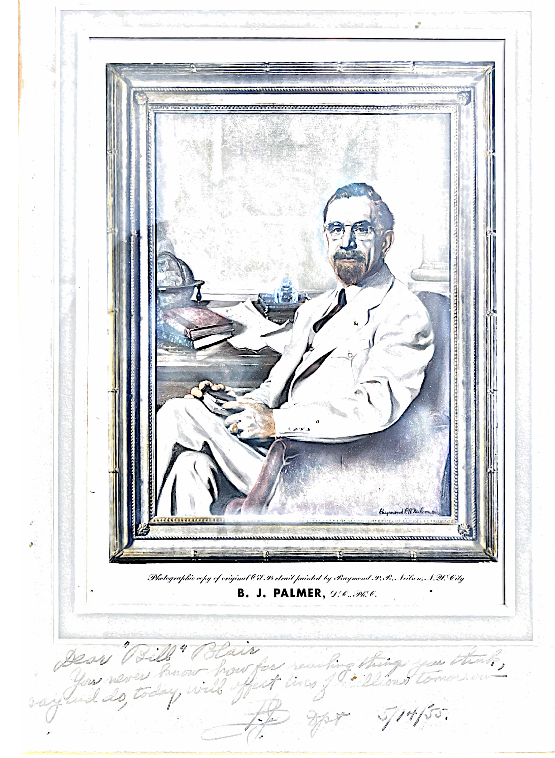
Dear ‘Bill’ Blair,
You never know how far reaching things you think, say and do, today, will affect lives of millions tomorrow.
BJP 5-14-55

Slide 34
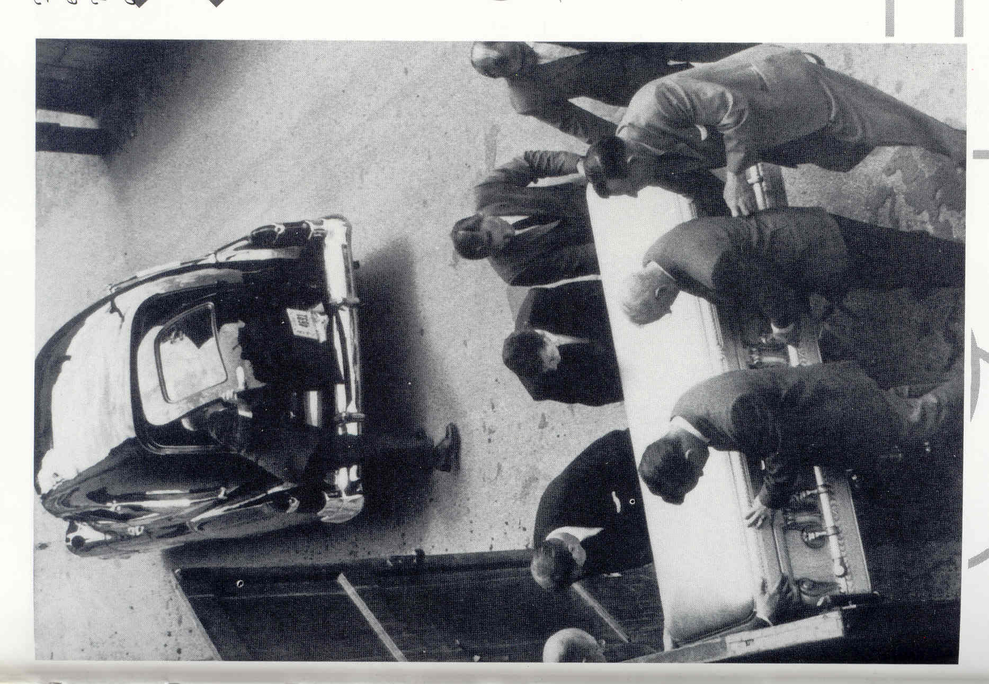
One word describes B.J. – CONVICTION – conviction that he was called for a specific purpose, that he was equipped to achieve that purpose, and that every obstacle and opposition were merely tests for the strengthening of that purpose. This is what made him great and this is the heritage of greatness he passes on to you and me.
Dr. Marcus Bach

Slide 35
End of hour one
B.J.’s close friend Marcus Bach, PhD, authored an excellent book The Chiropractic Story. Upon hearing of B.J.’s death the words of Marcus Aurelius in reference to the death of Hippocrates came to mind:
Incredible that he who saved so many from death should himself have to die.

