Slide 1
Blair seminars hour 2
The slides are property of
Dr. Todd Hubbard.
Certified Advanced Blair Instructor
They are not to be copied nor distributed

Slide 2
William Blair DC

Slide 3
Dr. William G. Blair, D.C., Ph.C.
“I first came in contact with the work of Dr. William G. Blair in 1958 during my internship at Palmer School of Chiropractic. Because I had made the honor roll, I was permitted to do my internship in the Research Clinic under Dr. B.J. Palmer. At that time, Research Clinic faculty were evaluating the work of a doctor in Texas who had invented a new way of taking x-rays. They predicted that it would be the way of the future of chiropractic x-rays.”
Dr. Weldon Muncy, Progress in Chiropractic by Steven J. Boyle

Slide 4
Dr. William G. Blair, D.C., Ph.C.
“After graduating and moving to Southern California to start my practice, I attended the first Blair class given on the west coast in Oakland, California. After that, wherever Dr. Blair taught his classes, I was in attendance. There was always something more to learn. It’s been a thrill to learn Dr. Blair’s work because he was so precise and so scientific in everything he did. He was a genius, who worked out a way for the rest of us to make a precision, scientific, accurate adjustment. ”
Dr. Weldon Muncy, Progress in Chiropractic by Steven J. Boyle

Slide 5
Notes:
Dr. Muncy attended every seminar Dr. Blair ever gave and took meticulous notes during these seminars. Dr. Blair passed the distinguished honor of continuing the Blair technique to Dr. Muncy

Slide 6
William G. Blair, DC, PhC
1922 Born in Oklahoma
Married Beatrice "Dotty" Kobold on July 20, 1946
Asthma sufferer (Called himself a “semi-invalid” Chiropractic Economics February 1971 )
2 weeks after receiving his first Chiropractic adjustment he moved to Davenport, IA.
William and Dotty Blair

Slide 7
Dr. William G. Blair, D.C., Ph.C.
“He was first diagnosed with asthma at the age of nine months. The humidity of his native Oklahoma intensified the asthma, prompting him to move to El Paso, Texas, a non humid city.”
Despite the dryer climate, the respiratory illness intensified. His medical doctors felt the prognosis was very poor and the chances of recovery quite dismal.
Dottie Blair, Progress in Chiropractic by Steven J. Boyle

Slide 8
Dr. William G. Blair, D.C., Ph.C.
“I saw how much he suffered when he did have an asthma attack in spite of the dry climate, so I was attempting to find anything, anywhere that might help. A dear friend met my husband, recognized his condition, and recommended an Upper Cervical Chiropractor, Dr. Leon Halstead…He was x-rayed, adjusted, rested for an hour and went home feeling like a new man.”
Dottie Blair, Progress in Chiropractic by Steven J. Boyle

Slide 9
Dr. William G. Blair, D.C., Ph.C.
“Bill decided to study chiropractic and Dr. Halstead recommended Palmer College. Somewhere in Kansas we noticed a chiropractic clinic and decided to talk with the doctor. He convinced us to go to a local college. We even rented an apartment there. Bill had an asthma attack, the chiropractor from the college performed many full spine chiropractic adjustments which provided no relief.”
Dottie Blair, Progress in Chiropractic by Steven J. Boyle

Slide 10
Dr. William G. Blair, D.C., Ph.C.
“The doctor said he’d done all he could and we’d better continue on to Palmer. Dr. Halstead happened to be on campus (at Lyceum). He met us with a portable adjusting table and gave Bill an upper cervical atlas adjustment. The response was positive and the relief was significant. Bill enrolled in Palmer but the humidity was miserable and he suffered terribly. With determination, he survived. He attended every seminar and graduated with straight A’s.”
Dottie Blair, Progress in Chiropractic by Steven J. Boyle

Slide 11
William G. Blair, DC, PhC
1922-1985
Founder of the Blair chiropractic Technique
Palmer Graduate, Member of Delta Sigma Chi
Awarded Daniel David Palmer Scientific Award in 1966

Slide 12
Dr. William G. Blair, D.C., Ph.C.
After opening a small office In Lubbock, Texas, Bill and Dottie went to work building their practice.
“It was during this time he began researching why some patients got wonderful results and others did not. Every evening he studied x-rays, graphs, and anything he thought might give him the reason that some did much better than others.”
Dottie Blair, Progress in Chiropractic by Steven J. Boyle

Slide 13
Notes:
It was during his years at his first clinic location (in may of 1951) that he began the research that eventually led to the Blair Principal of Occipito-Atlanto Misalignment.

Slide 14
Dr. William G. Blair, D.C., Ph.C.
“He labored to get the best x-rays…he was very conscientious and tried, to the best of his ability, to make the spinograph x-rays as near perfect as possible.”
“He sometimes worked until midnight, sometimes all night. He always felt that genuine skill comes from practice. He had an unrelenting desire to get perfect x-rays.”
Dottie Blair, Progress in Chiropractic by Steven J. Boyle

Slide 15
Dr. William G. Blair, D.C., Ph.C.
Based on his meticulous x-ray studies, Dr. Blair came to certain conclusions:
The right and left side are not symmetrical.
Opposing surfaces of the joints do match.
Therefore Dr. Blair surmised:
“We are not looking for the perfectly straight spine, we are looking for the perfectly articulated spine.”
Dottie Blair, Progress in Chiropractic by Steven J. Boyle

Slide 16
Dr. Blair at the Armed Forces Institute of Pathology Washington DC

Slide 17
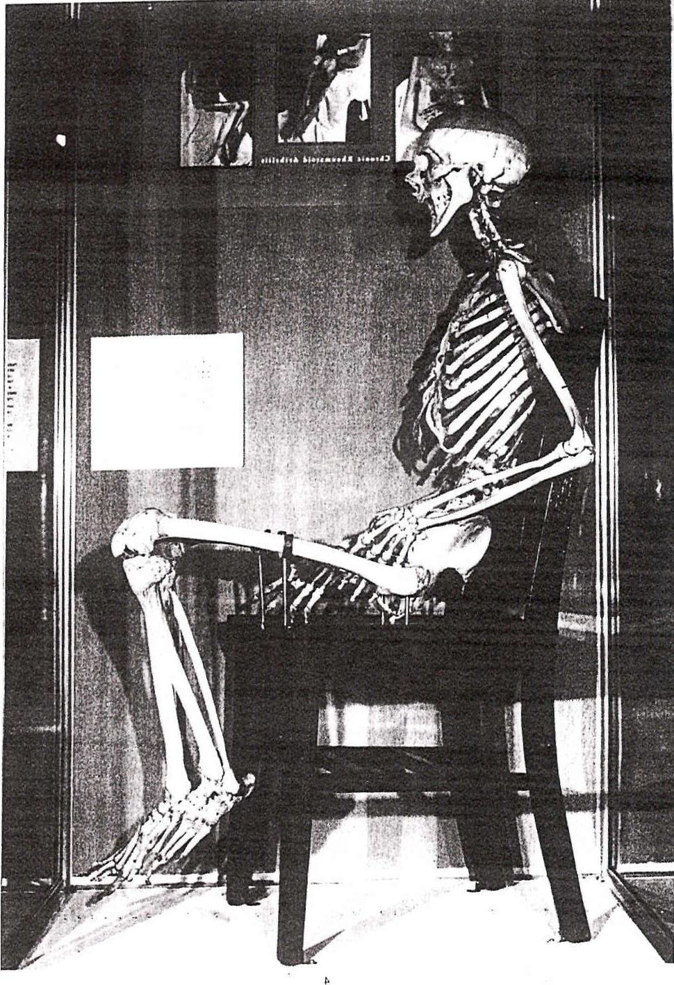

Slide 18
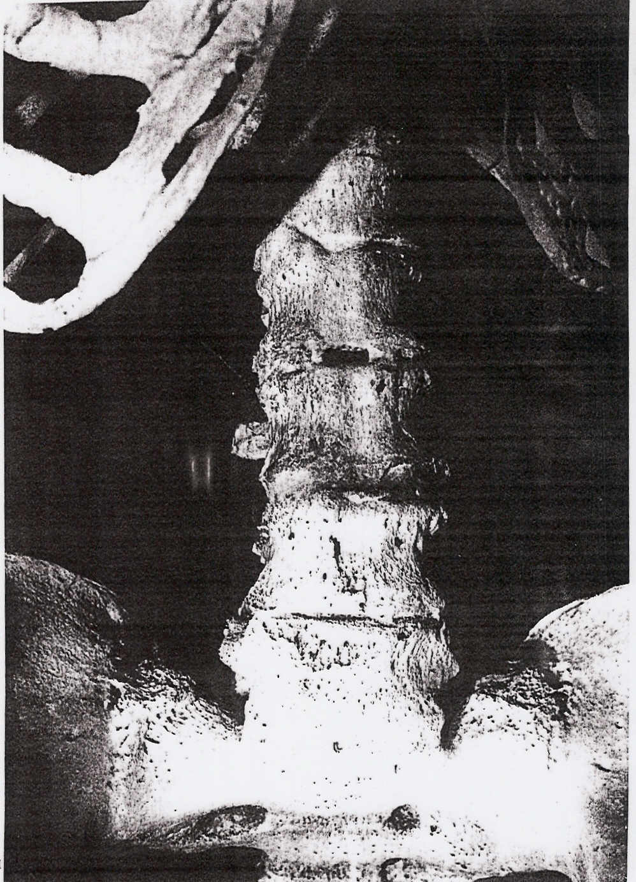

Slide 19
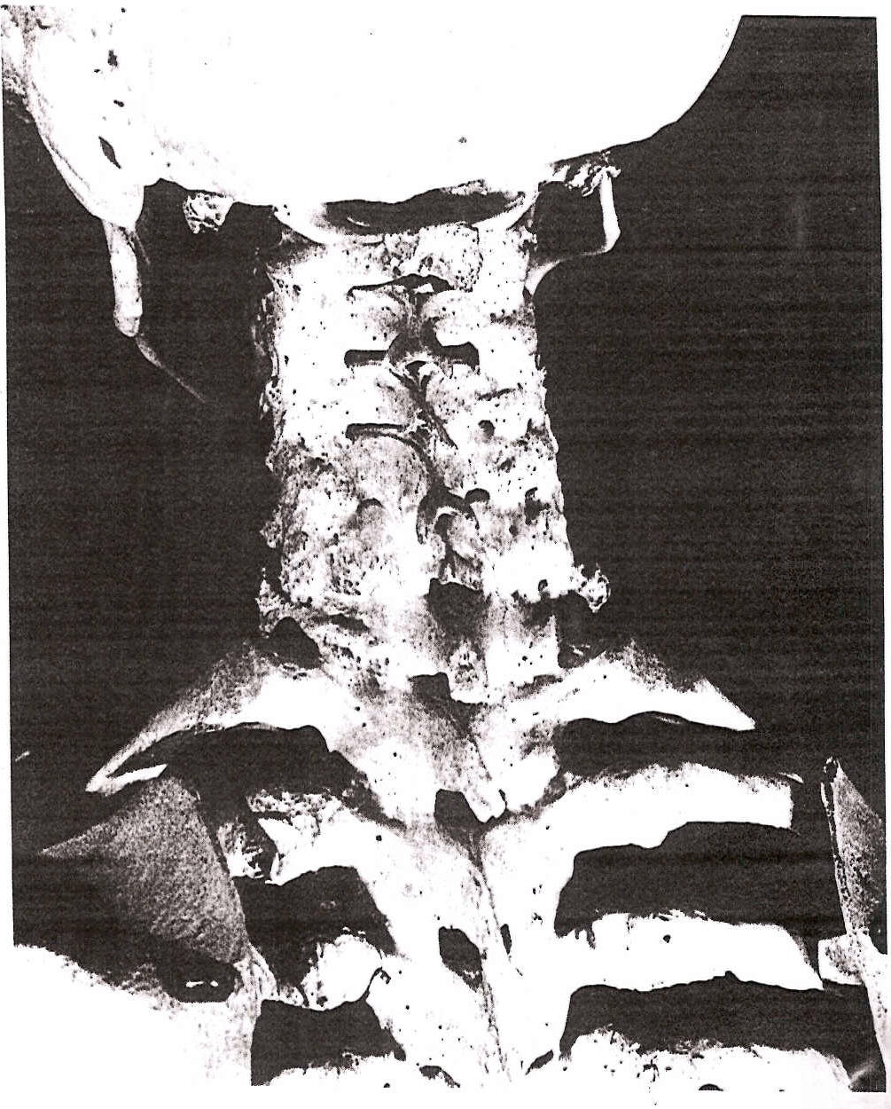

Slide 20
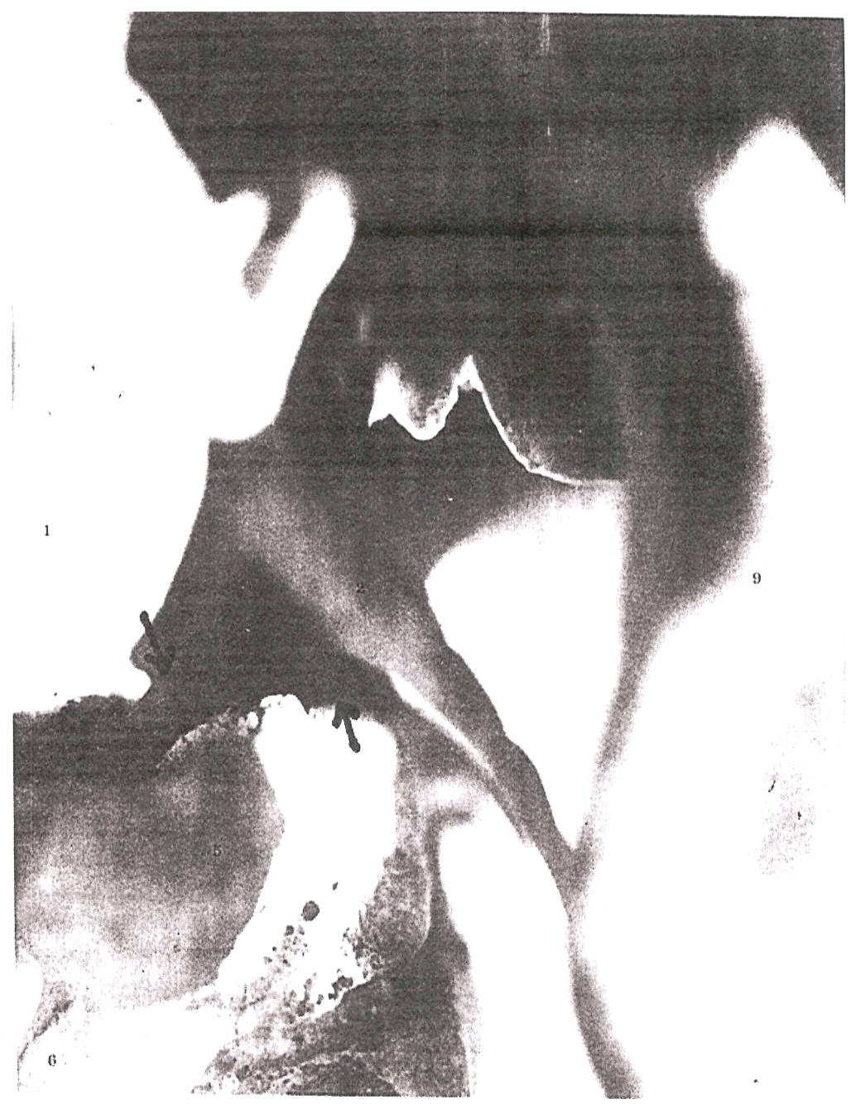
Lateral Margin of Condyle
Lateral Margin of Lateral Mass

Slide 21
Dr, Blair standing between Dr. Carl Cleveland and the Emperor of Etheopia.
Notes:
Dr. Blair standing between Dr. Carl Cleveland and the emperor of Ethiopia.

Slide 22
Dr. Blair spoke on a distinguished panel with Drs. DeJarnette, Gonstead, & Gregory.
Notes:
In 1969 Dr. Blair spoke on a distinguished chiropractic panel with Drs. DeJarnette, Gonstead and Gregory. Here he spoke of his research and what he had discovered about what he felt was the true motion of the occipito-atlantal articulation.

Slide 23
William G. Blair, DC, PhC
Dr. Blair felt Chiropractors should
put service to his patient first.
render the best scientific, specific Chiropractic care they can.
“In a world where we get less and less for our money, we, as a profession, should try to give better and better service to our patient”
“We must not sacrifice quality of our service for quantity of patients”

Slide 24
William G. Blair, DC, PhC
People refer people when they are happy with the results they receive from their doctor.
Be specific, Be Scientific, Be Precise, and give only quality care to your patient. You will be rewarded bountifully.

Slide 25
Notes:
At this panel discussion He also that all chiropractic techniques needed to give their information to the research community and let it be tested. His research was focused on the upper cervical spine because he felt that if this area was interfered with, the rest of the body wouldn’t be able to function properly. However, he did acknowledge that other areas of the spine and body are also important and that others have done much research and taken great strides in these areas to forward chiropractic. It was at this panel discussion in 1969, where Dr. Blair stated it was time for the true research be done by those who know how. So that the doctor of chiropractic could be given the knowledge of the true efficacious chiropractic procedures and the chiropractic community would have the backing of the strongest research available. Showing that even 37 years ago, the top scientific chiropractors where calling for evidence based chiropractic.

Slide 26
Dr. Blair’s advice to students and doctors.
In skills it is the small details that count.
It is putting that something extra in all you do that’s separates the mediocre from the professional.
Visualizing your objective will cause you to do the things necessary for your success.

Slide 27
Why Upper Cervical
Best Case Scenario: to adjust a spine as few times as possible while keeping that spine free of neurological interference with optimum function for as long as possible.
Specific Upper Cervical Chiropractic care incorporates the tools needed to know when, where and how to adjust. But more importantly, when NOT to adjust.
“The Right Place at the Right Time” BJ Palmer

Slide 28
Thoughts for Seminars Dr. William G. Blair
“Innate can do all things for which Reg Gold and Sid Williams give it credit, but only in the person free of nerve interference. So even if you have the BIG IDEA you are worthless to that patient if you cannot correct nerve interference and keep it corrected.”

Slide 29
Thoughts for Seminars Dr. William G. Blair
“Correcting nerve interference is not easy. Partial and/or temporary correction can sometimes be had by pernicious introduction of forces with partial and/or temporary results. To do the right job takes some analytical effort.”

Slide 30
Thoughts for Seminars Dr. William G. Blair
“Adjustments must hold. If interference is returning enough that an adjustment is required several times daily or even several times weekly then there in not enough accumulative hours of interference clearance to do the patient much good.”

Slide 31
Thoughts for Seminars Dr. William G. Blair
Remember it is only during the time that an adjustment is holding that the patient is receiving any benefit from the doctor’s efforts.”

